Slide 1
CPHCE Annual Forum 2021
Centre for Primary Health Care and Equity
Learning from a codesign exercise aimed at developing a navigation intervention in general practice setting
Sabuj Kanti Mistry
A/prof Elizabeth Harris
Scientia Professor Mark Harris

Slide 2
Is there difficulty in healthcare navigation?
People from culturally and linguistically diverse background face difficulties accessing health and social care services
Involving community navigators is a potential way of addressing it (Mistry et al. 2021)
Mistry, S.K., Harris, E. and Harris, M., 2021. Community Health Workers as Healthcare Navigators in Primary Care Chronic Disease Management: a Systematic Review. Journal of General Internal Medicine, pp.1-17.

Slide 3
Co-designing an intervention
Patients are traditionally considered passive recipients of health interventions
In the co-design approach, both health service providers and consumer experiences are considered in the design process
This research aimed at co-designing a navigation intervention in general practice setting

Slide 4
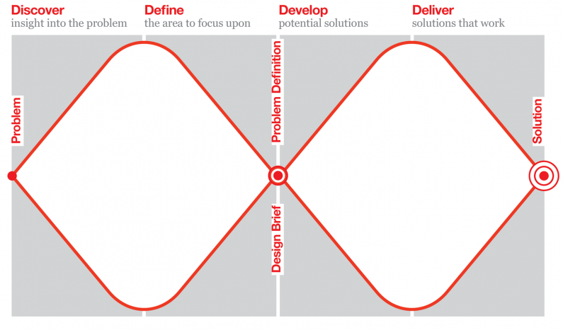
Methods
The double diamond method of design process
(Design Council, 2015)
Design Council. Design methods for developing services 2015 [05/03/2021]. Available from: https://www.designcouncil.org.uk/resources/guide/design-methods-developing-services.
Notes:
Method

Slide 5
Methods
Preparation: Pre-workshop consultations with patients
Codesign workshop: Two online workshops using zoom platform
Codesign partners: patients, their caregivers, general practice staff, researchers, CHWs and other stakeholders
Process: Brainstorm improvement ideas and ways to implement them in clinical practice
Techniques: Breakout rooms, Zoom whiteboard, case discussion and visual presentation of ideas
Data: Audio recorded, transcribed, thematic analysis

Slide 6
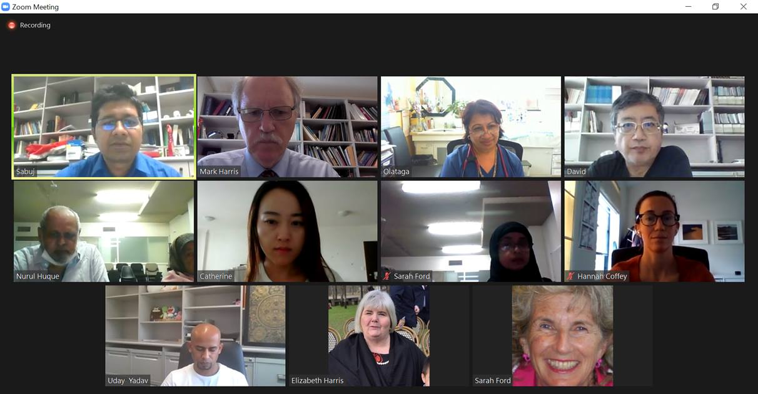
Methods

Slide 7
Outputs
Priority navigation problems identified: Inadequate health literacy, cultural and language barriers, problems navigating specialist services and local resources, lack of trust and comfort with health services
Potential roles of navigators:
Health education
Help making appointments
Help navigating health services
Inform patients about the local resources and education groups
Considerations for navigator roles:
Recruitment from the same community
Proper training and supervision
Clear role definition
Privacy, confidentiality, professionalism

Slide 8
Lessons learned
Different perspectives of partners complemented each other
Difference in thought process among codesign partners
It was difficult to move the discussion from problem to solution
Two workshops were just enough
Communication skills of the patients are important
Pre-workshop consultation was useful to ensure patient engagement
Zoom went reasonably well, easier for the provider but difficult for the patients
Having live supervision was crucial for patients, invited in the centre
Non-mixed group small group discussion was effective for power balance

Slide 9
What next?
More discussion with practice
Preparation for the intervention
Feasibility and acceptability of the intervention

Slide 10
Acknowledgements

Slide 11
Contact Details:
Sabuj Kanti Mistry
sabujkanti.mistry@unsw.edu.au

