Slide 1
Rainbow Model of Integrated Care (RMIC)
Experiences & lessons learned
Dr. Pim P. Valentijn, PhD, MSc
Maastricht University Medical Centre, Maastricht University & Department Integrated Care University, Essenburgh
December 2016
Notes:
First of all I want to thank the UNSW for their invitation to speak at this wonderful seminar.
Last year I finished my PhD thesis ‘Raindbow of Chaos: a study into the theory and practice of integrated primary care’
And today I want to share with you some theoretical as well as practical insights based on my thesis
And I will will focus on the the concept of integrated (primary) care.

Slide 2
Agenda
Why integrated care?
What is integrated care?
Lessons learned
Implications
Notes:
Within the next 40 minutes I want to discuss with you the following topics.

Slide 3
1. Why integrated care?

Slide 4
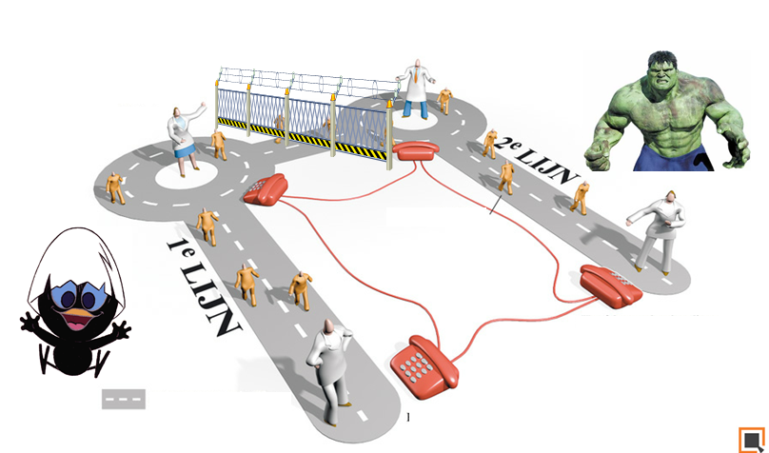
The problem
Secondary care
Primary care
Valentijn (2016), Gröne (2001), WHO (2008)
Notes:
Well, I think most of you here recognise the problem of fragmented service provision. And the imbalance between primary care and secondary hospital based care
Several authors have argued that western health systems are dominated by a disease-focused view which is considered one of the drivers of fragmentation,, In addition it is caused by a siloed and specialised orientation deeply embedded within many western healthcare systems.

Slide 5
Fragmented delivery system
Poor coordination of care
Lack of accountability across providers
Misalignment of payment incentives
Little transparency in cost and medical outcomes
App. 25% of all patients' are harmed by medical mistakes
30% of all funds expended to healthcare are wasted
Ageing
62 %
Multimorbidity
50 %
Costs
$6.5 trillion
Global trends
Kodner (2009), Anderson (2011), Barnett (2012 ), WHO (2001, 2012)
Notes:
Cost
Cost for health and social care programs world wide
Multimorbidity
Represents already 50% of the disease burden of OECD countries
Ageing
People aged over 75 y, >60 has one or more chronic diseases

Slide 6
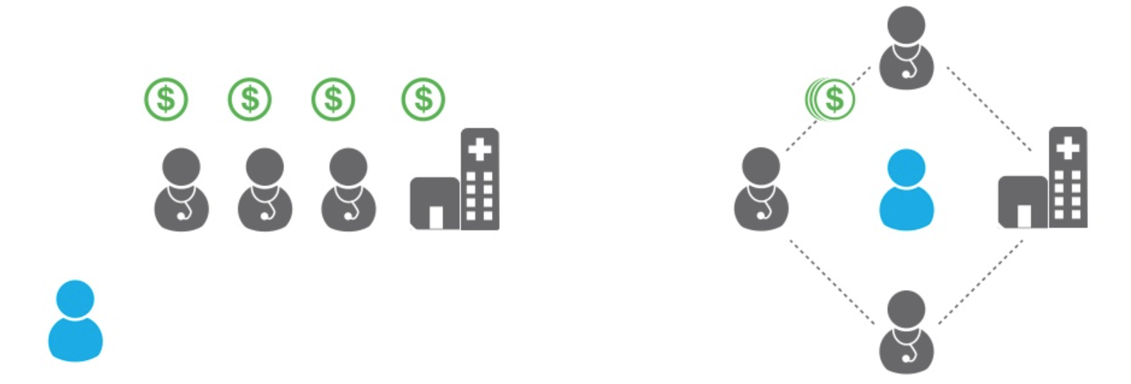
Shift from volume to value
Fee for service | Payment | Shared Risk/Reward
Treat | Incentive | Prevent
Patient | Focus | Population
“Everyone For Themselves” | Provider | Joint Contracting
Retrospective | Information | Predictive
Porter (2006), Valentijn (2015 & 2016)
Notes:
The current challenges of western healthcare systems are forcing them to shift from a volume towards a value based system
Which is expressed in several policy reforms. Which can be summarised using the following topics.

Slide 7
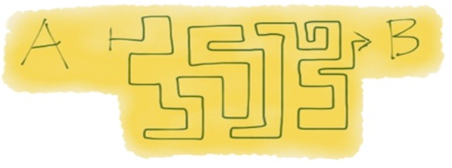
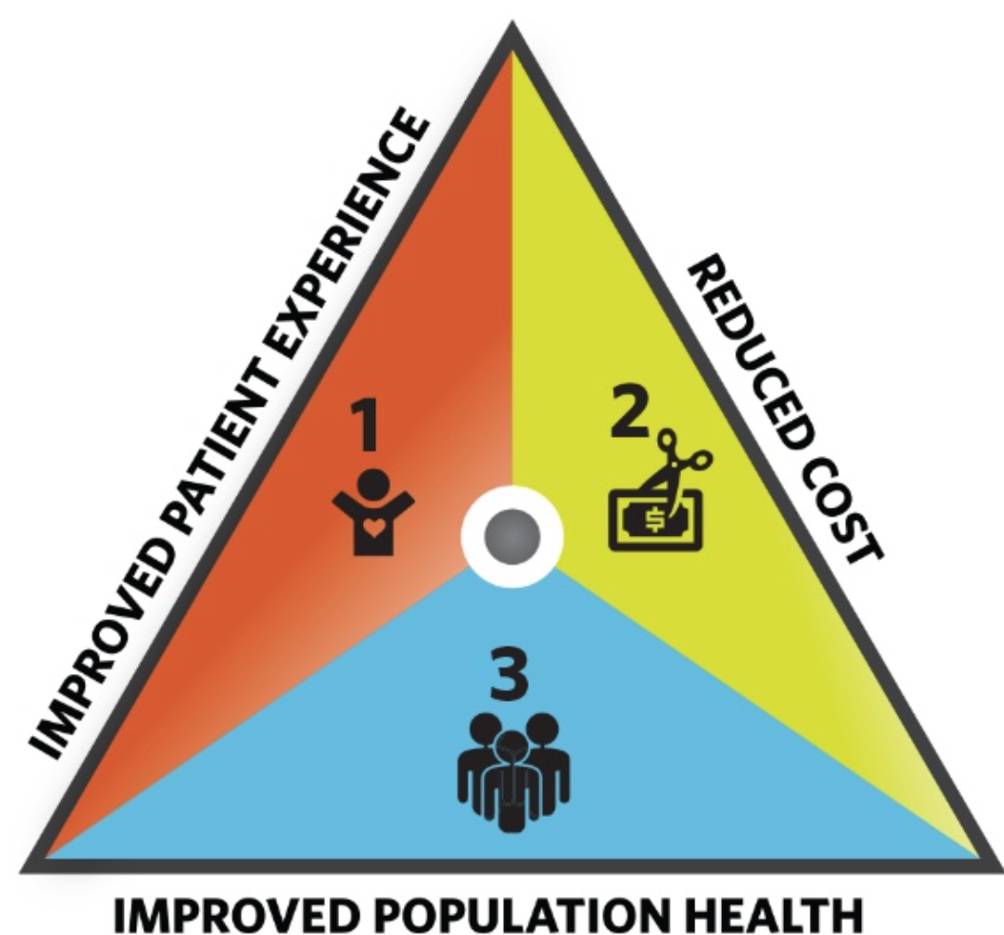
Views on value
Reductionism
(Disease specific)
Inter-determinism
(Person-focused)
Porter (2006), Berwick (2008), Begun (2003), Valentijn (2015 & 2016)
Notes:
Within the literature we can distinguish two approached how to create value for a population:
First approach is called VBHC and based on the work of Michel Porter.
It is based on a disease specific approach. It assumes that value (defined as quality defined by cost) is created by means of a linear quality/ industrial approach
The second approach is called Triple Aim and is based on the work of Donald Bewrick
It explicitly include a population health management approach. And, it assumes that cause and effect relationships are based on organic, nonlinear patterns that are non-predictable but potentially understandable through (retrospective) pattern observation [16, 17].
Especially from a primary care perspective and population health perspective the latter holds more true, because:
A community needs to as well as a primary care systems needs considered as a complex adaptive systems. A CAS has a strong tendency to learn, adapt and self-organise in response to continuous feedback from changing patterns of relationships and interactions among stakeholders and their environment.
Which is particular the case for a community with a complex needs.

Slide 8
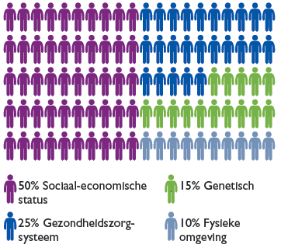
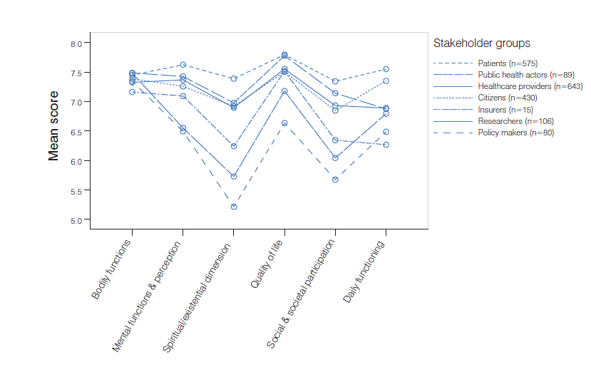
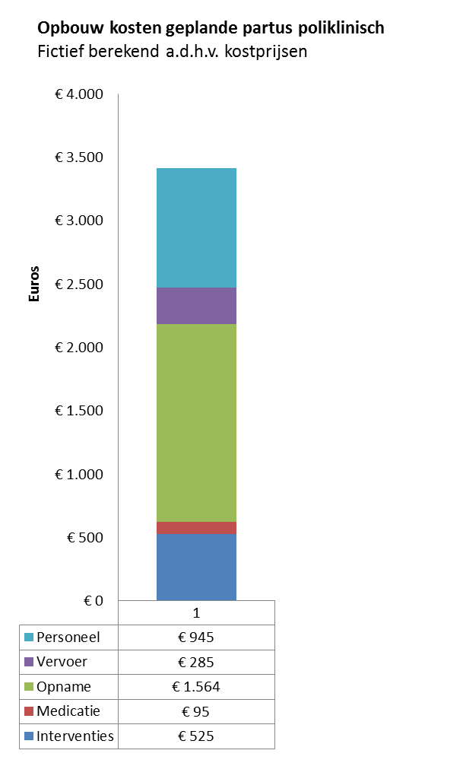
Value
50% Socio-economic
15% Genetic
25% Healthcare
10% Environmental
(Population health + Experience of care)
Value =
Cost
Berwick (2008), and Huber (2011 and 2015)
Notes:
Following the definition of the Triple Aim we can define value by:
1) Population health: Several studies have indicated that healthcare services have a modest impact on the overall health of a population
2) Experiences of care: Health can be defined using six definitions. Interestingly, there is no consensus regarding how to define health between the different stakeholders.
3) Costs: Calculating the total healthcare cost per capita. This is, at least in the Netherlands, extremely complicated because databases are not connected
To conclude, in order to determine the success/ or the value, these variables need to be very clearly set at the beginning of a initiative. It also indicates that there is a broad range of stakeholders needed in order to create value

Slide 9
2. What is integrated care?

Slide 10
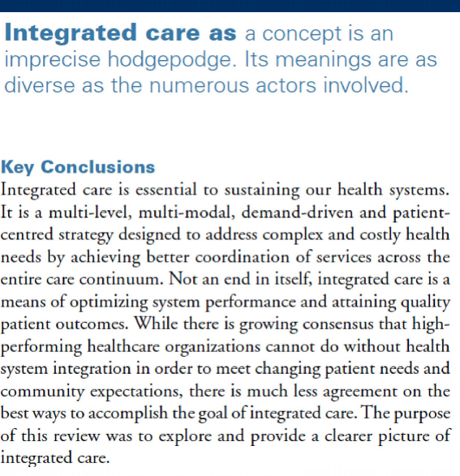
Integrated care
Kodner (2009)

Slide 11
Current challenges
Integrated care is considered an essential strategy to improve patient experience of care, health of the population and reduce the cost per capita (Triple Aim) (Berwick 2009; Alderwick 2015)
However, there is a lack of published data to back up this assertion (Valentijn 2015; Nolte; 2014).
Information on outcomes and performance shaping factors are needed to determine the added value of an integrated care strategy for different stakeholders (Porter 2006; Evans 2012 & 2014; Valentijn 2015)
There is a lack of comprehensive performance frameworks that specify the outcomes and performance shaping factors needed to evaluate and develop value based integrated care* initiatives.
* Defined as patient outcomes achieved relative to the amount of money spent by providing accessible, comprehensive and coordinated services to a targeted population. (Valentijn 2014)

Slide 12
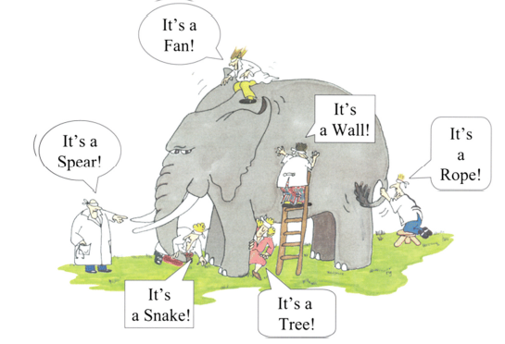
Studying integrated care
Notes:
Studying IC = Like a blind men and the proverbial elephant, each aware only of the part of the animal touched and with no experience of the whole; the reality of integrated care still depends in part on one's own perspective.

Slide 13
Different perspectives
Improve access, quality and continuity of services
Policymakers
Improve quality, market share and efficiency
Managers
Coordination of tasks, services and care across professional and institutional boundaries
Easy access and navigation; seamless care
Professionals
Patients

Slide 14
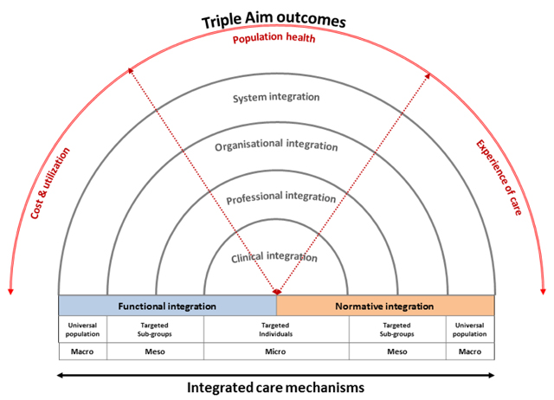
RMIC
System integration
Coherent set of (informal and formal) political arrangements to facilitate professionals and organisations to deliver a comprehensive continuum of care .
Organisational integration
Inter-organisational partnerships based on collaborative accountability and shared governance mechanisms, to deliver care to a defined population.
Professional integration
Inter-professional partnerships based on a shared accountability to deliver care to a defined population.
Clinical integration
Coordination of care for a complex need at stake in a single process across time, place and discipline.
Valentijn (2013, 2015 and 2016)
Notes:
Horizontal integration: alignment within a single-care sector. For instance: Collaboration between primary care professionals…
Vertical integration: alignment between different care sectors. For instance: primary care and hospital services…
Incorporating vertical- and horizontal integration through partnerships → address/ tackling complex needs of individuals and populations!
Based on the Rainbow Model of Integrated Care (RMIC) the main perspectives can be divided in four key dimensions:
clinical or service integration (patient or client perspective at the micro level),
professional integration (professional perspective at the meso level),
organisational integration (managerial perspective at the meso level), and
system integration (policy-maker perspective at the macro level).
Until now, most of the studies on integrated care have focused on the clinical and professional integration processes, and less is known about the organisational and system integration processes

Slide 15
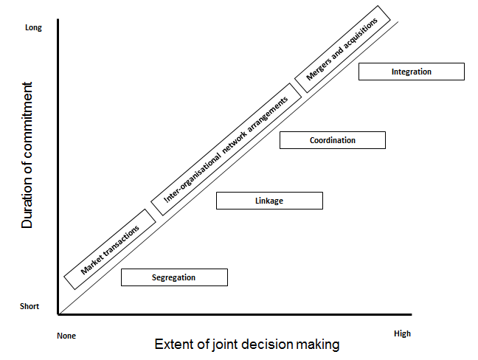
The continuum
Valentijn (2013)
Notes:
The degree of integration can be expressed as continuum.
Market environment
Networkmechanisms
Hierarchical mechanisms
Typology of 'loose' to 'tight' governance agreements is widespread in alliance and network literature… as preseted by Gomess-Caseres
PC: is a favorable environment for network-like partnerships because of its relative stability and shared social norms

Slide 16
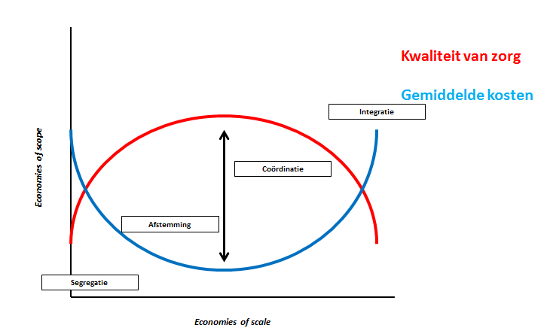
The hypotheses
Quality of care
Average costs
Integration
Coordination
Linkage
Segregation
Valentijn (2014)

Slide 17
Opening the black box
 | Segregation | Linkage | Coordination | Integration
Service
Professional
Organizational
Functional
Normative
System
?
Valentijn (2014)

Slide 18
3. Lessons learned

Slide 19
International best practices
Best practice | Country | Population (insured) | Integration | Functional enablers | Outcomes
Blue Cross Blue Shield Alternative Quality Contract |  | 1,35 million | Primary + Secondary care | 5 year contract (Shared savings +FFS) | ↓ (ca. 10%) | ↑ (12 points above average) | ↑ (ca 25%)
Torbay/Devon Community Care Group |  | 281.900 | Social + Primary + Secondary care | Multi-annual total budgets (Health & Social Act 2012) | ↓ ( 33% emergency admissions) | ↑ (improved quality outcomes compared to benchmark) | ?
Gesundes Kinzigtal Disease management |  | 32.000 | Primary + Secondary care | 10 year contract (Shared savings) | ↓ (ca. 10%) | ↑ (35% decrease CVM) | ?
Ketenzorg DM & CRM Disease management |  | 308.591 | Primary care | Bundled payments | ↑ (DM +€142) | +/- (modest improvement in outcome measures) | ?
Song (2012), Hilderbrandt (2010), Struijs (2011 &2016)
Notes:
BCBS:
25% increase in quality score (based on 34 quality indicators)
Improved health outcomes (12 points above national average)
5.8%-9.1% saving on medical spending relative to trend
T/D:
33% decrease use of hospital beds
24% decrease in emergency admissions (>65)
No delayed transfers of care
Sign. Decrease in av. Length of stay (days hospital) compared to national average)
GK:
53% decrease in cardiovascular mortality
Av. life expectancy increased with 1.5 year
23% reduction hospital admissions.
‘Shared saving’ per AOK insured: €150 per insured pro year (-10%)
DM:
Coordination improved
Slight to modest improvement in process and outcome measures
No evidence cost effectiveness
BP increased curative health care cost (due to increase in hopsital cost + initial investment in BP)
Total specialist cost increased for PB DM patients (€142 compared usual care)

Slide 20
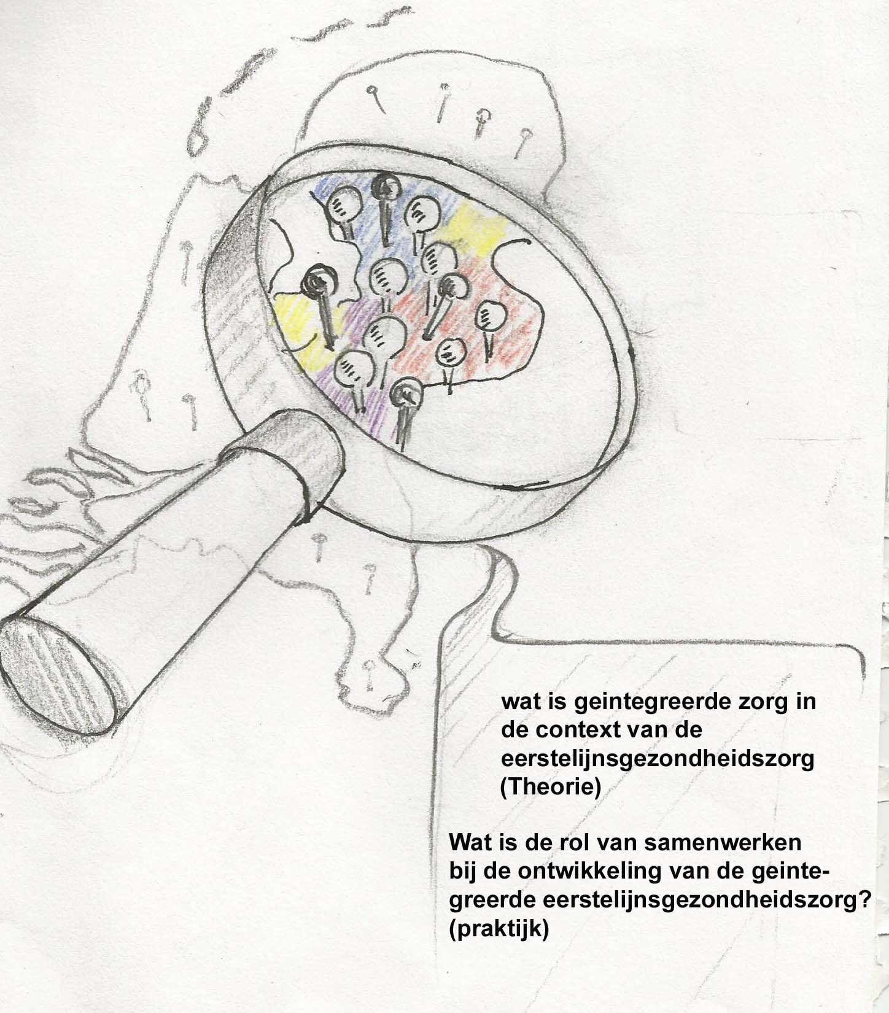
Experiences from the Netherlands
Ministry of Health aimed to stimulate the integrated care in primary care setting
Funded 69 integrated care projects (ICP)
What hampers or facilitates the development of integrated care in a primary care setting?
Valentijn (2013) & Valentijn (2015a)
Notes:
Within the Netherlands: Primary care services have traditionally been delivered in disjointed mono-disciplinary small-scale practices.
This hampers the integration with other services which is particularly needed for complex patients.
In response, the national integrated primary care programme Op één lijn in The Netherlands (translated as “Primary Focus”) was initiated
The programme aimed to stimulate integration through partnerships among local health and social services.
In total, 69 integrated care projects were selected and evaluated for three years.
Longitusinal study > multi-method approach using surveys and interviews were conducted to gain an understanding how integrated service models were being developed across the ICP.

Slide 21
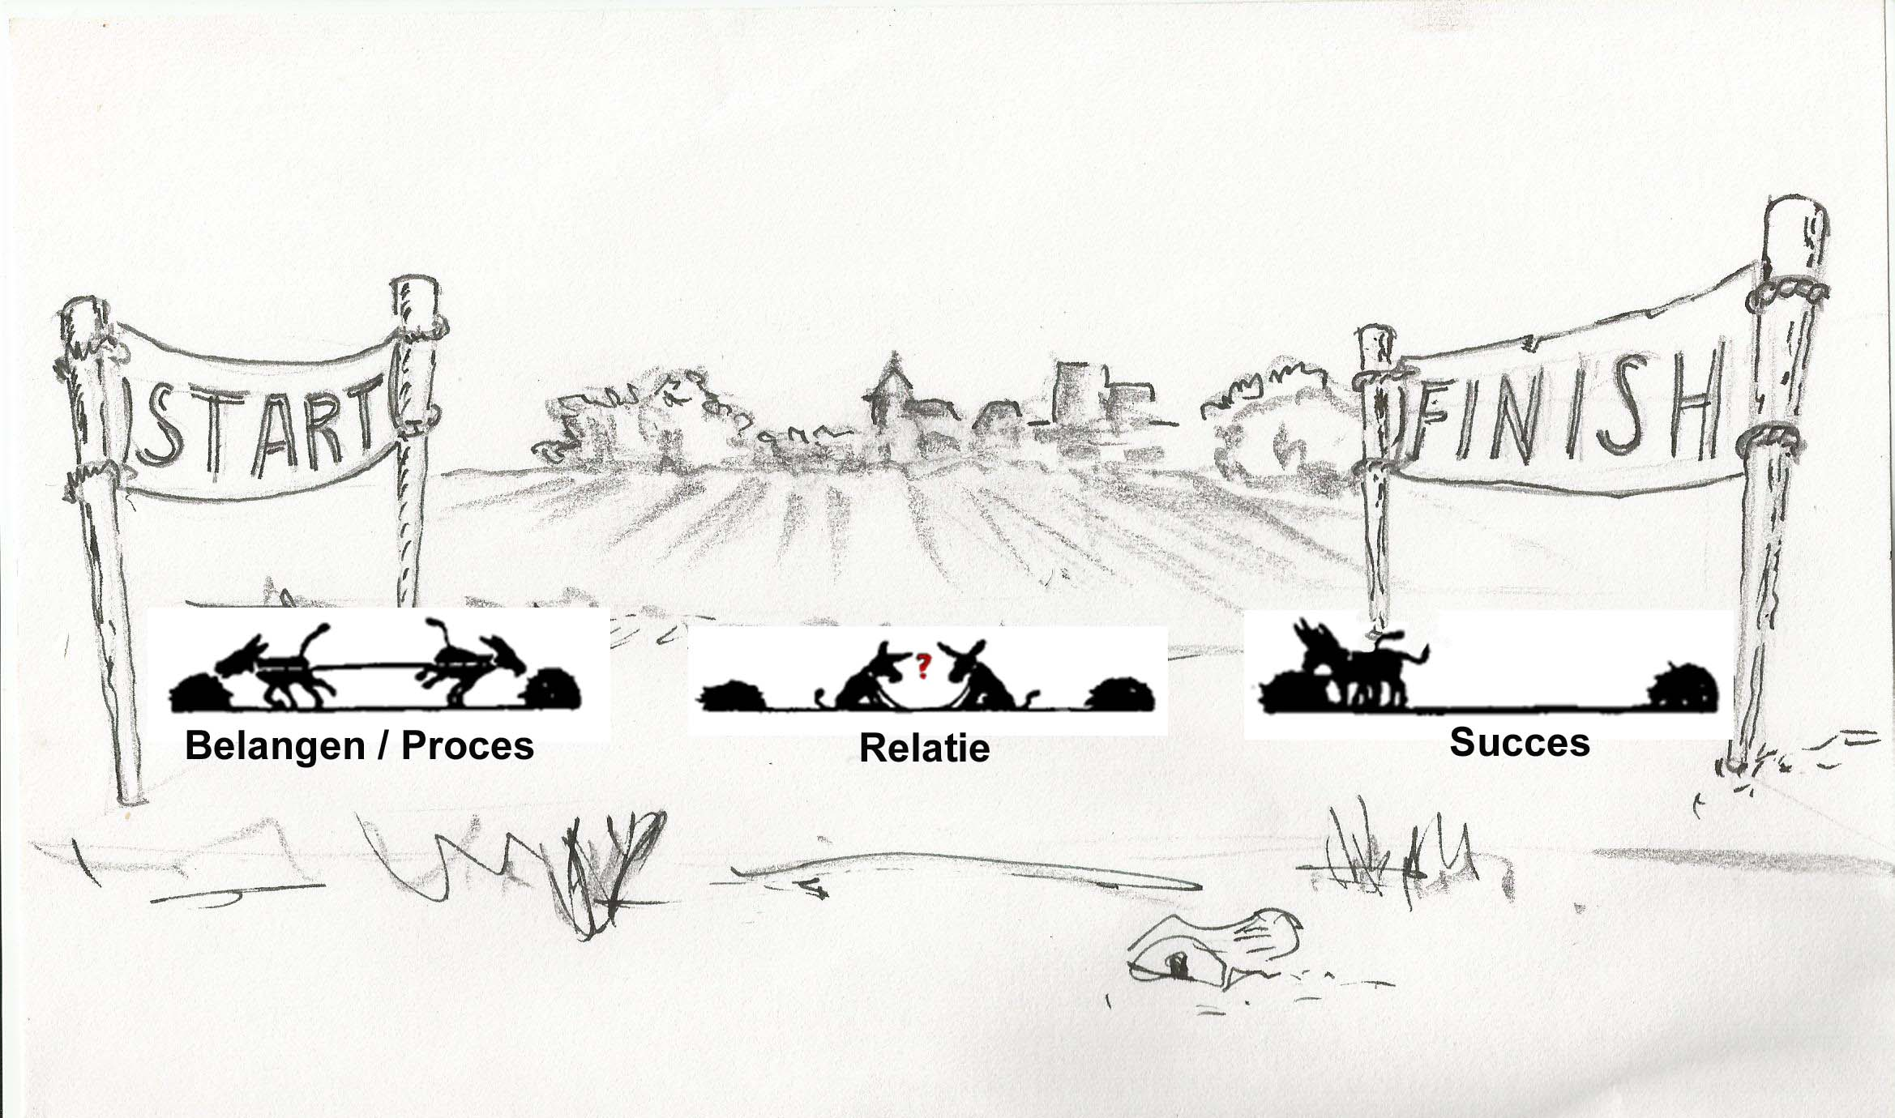
Normative enablers
Mutual gains;
Process management
Relationship dynamics
Succes
Valentijn (2013) & Valentijn (2015a)
Notes:
As part of my thesis we studied the development of the ICP by focusing on the underlying collaboration processes.
Conceptual framework of Bell et al. that consists of five different themes in order to evaluate the collaboration processes of a partnership
The framework is grounded on a solid base of literature in which the individual themes have been described by various authors
Mutual gains = the dialogue about the underlying interests of the partners to provide an ideal win-win solution
Relationship dynamics = relational capital e.g. close interpersonal ties between the partners
Process management = facilitate the complex and delicate nature of forging a partnership.
Managing a successful partnership requires transparency of partners’ interests and process management at the start, and building relational capital throughout the collaboration process.

Slide 22
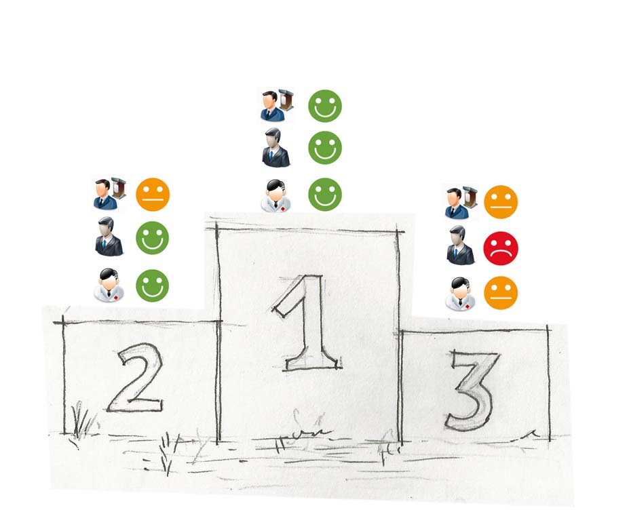
(Dis)united stakeholders’ perspectives
Valentijn (2013) & Valentijn (2015a)
Notes:
Third group (21%):
No integrated care arrangements were made
All stakeholder considered their project ineffective
Negative decrease collaboration mechanisms
Second group (41%):
Mainly professional oriented integrated care arrangements were achieved
Healthcare professionals considered these projects effective
First group (38%):
Professional, organisational and policy oriented integrated care arrangements were achieved
All stakeholders considered these projects effective
A positive increase overtime in collaboration mechanisms

Slide 23
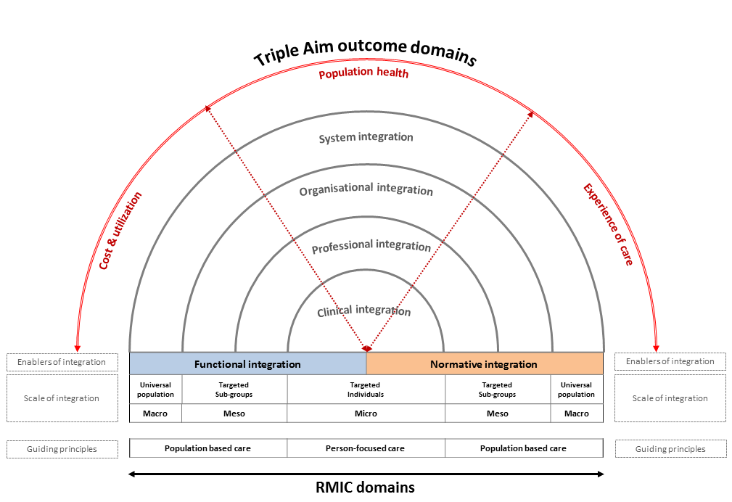
Gaps identified
Valentijn (2016)

Slide 24
4. Implications

Slide 25
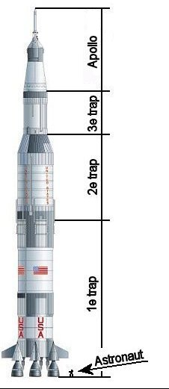
Make it happen
Legislation
Value-based payment models
Regional ‘integrator’
Triple Aim intervention and prevention programs
BIG Data (Population: Quality and Cost)
Start-up financing

Slide 26
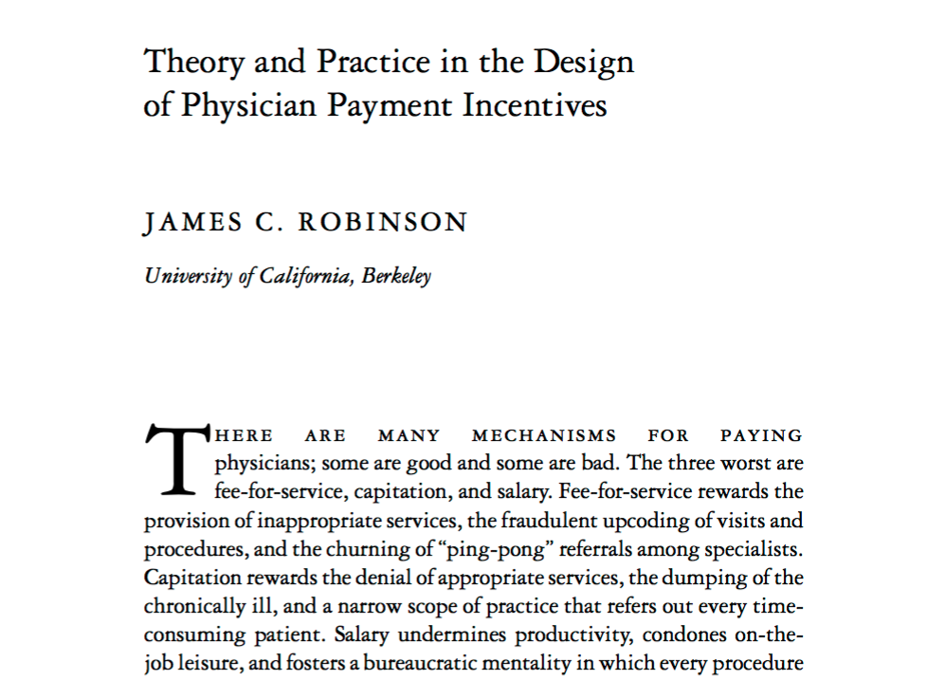
Robinson, James C. "Theory and practice in the design of physician payment incentives." Milbank Quarterly 79.2 (2001): 149-177.

Slide 27
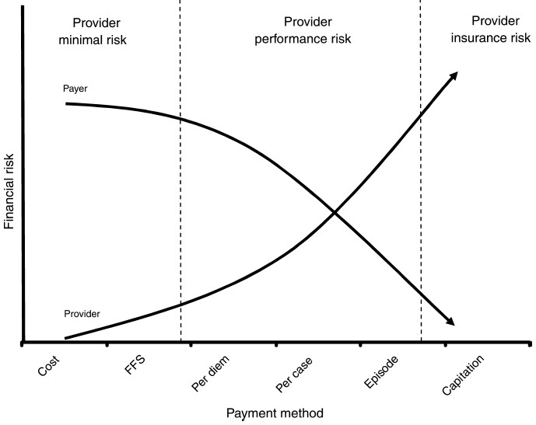
New payment methods
FFS
Bundled payments
Shared savings/ risk
Capitation (full risk)

Slide 28
Make it happen
Legislation
Value-based payment models
Regional ‘integrator’
Triple Aim intervention and prevention programs
BIG Data (Population: Quality and Cost)
Start-up financing

Slide 29
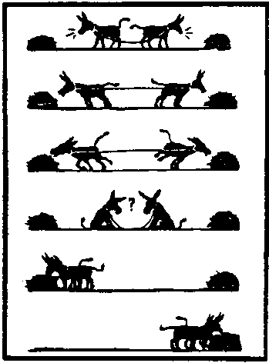
Integrator skills: mutual gains
Give?
Party A
Party B
SSocietal interest
SSocietal interest
Organisational interest
Organisational interest
Personal interest
Personal interest
Take?

Slide 30
Questions
My organization has identified the high risk / high-cost patients in the community
My organization is willing to become accountable for the financial and quality outcomes achieved at a community level
My organization has power and influence in the community
My organization has access to all quality & cost data of each member of the community

Slide 31
Questions?

Slide 32
Will you join us?
Optimizing healthcare for patients around the world
Initiating high-level research and supporting evidence-based decision-making
Bring parties together in the discussion on the evaluation of integrated care, and to facilitate them with our RMIC evaluation tool and our Evaluation Lab
We look forward to working with you!
www.integratedcareevaluation.org

Slide 33
Contact
Dr. Pim Valentijn, PhD. MSc
Senior Research Consultant
Maastricht University Medical Centre, Maastricht University & Department Integrated Care University, Essenburgh
valentijn@essenburgh.nl
@pimvalentijn
https://nl.linkedin.com/in/pimvalentijn
https://www.researchgate.net/profile/Pim_Valentijn/publications
www.interatedcareevaluation.org

Slide 34
References
Berwick DM, Nolan TW, Whittington J. The triple aim: care, health, and cost. Health Aff. 2008;27(3):759–769. doi: 10.1377/hlthaff.27.3.759.
Alderwick H, Ham C, Buck D. Population health systems: Going beyond integrated care. 2015.
Valentijn P.P. Rainbow of chaos: A study into the theory and practice of integrated primary care. Tilburg: University Press; 2015. Doctoral thesis Tilburg University. ISBN: 978-94-91602-40-5
Valentijn P.P. Rainbow of Chaos: A study into the Theory and Practice of Integrated Primary Care: Pim P. Valentijn, [S.l.: s.n.], 2015 (Print Service Ede), pp. 195, Doctoral Thesis Tilburg University, The Netherlands, ISBN: 978-94-91602-40-5. International Journal Integrated Care. 2016;16(2):3.
Nolte E, McKee M. Integration and chronic care: a review. In: Nolte E, McKee M, editors. Caring for people with chronic conditions: A health system perspective. Maidenhead: Open University Press; 2008. p. 64–91
Porter ME, Teisberg EO. Rede ning health care: creating value-based competition on results. Boston: Harvard Business Press; 2006
Evans JM, Baker GR, Berta W, Barnsley J. The evolution of integrated healthcare strategies. Adv Health Care Manag. 2013;15:125–61.
Evans J, Baker G, Berta W, Barnsley J. A cognitive perspective on health systems integration: results of a Canadian Delphi study. BMC Health Serv Res. 2014;14(1):222.
Valentijn P.P., Biermann C., Bruijnzeels M.A. Value-based integrated (renal) care: setting a development agenda for research and implementation strategies. BMC Health Serv Res. 2016;16:330- 016-1586-0.
Valentijn P.P., Schepman S.M., Opheij W., Bruijnzeels M.A. Understanding integrated care: A comprehensive conceptual framework based on the integrative functions of primary care. International Journal of Integrated Care. 2013;13:e010.
Valentijn P.P., Boesveld I.C., van der Klauw, D.M., Ruwaard D., Struijs J.N., Molema J.J., Bruijnzeels M.A., Vrijhoef H.J. Towards a taxonomy for integrated care: A mixed-methods study. International Journal of Integrated Care. 2015;15:e003.
Valentijn P.P., Vrijhoef H.J., Ruwaard D., Boesveld I., Arends R.Y., Bruijnzeels M.A. Towards an international taxonomy of integrated primary care: A Delphi consensus approach. BMC Family Practice. 2015;16(1):64-015-0278-x
World Health Organization. The world health report 2008: Primary health care - now more than ever. Geneva: World Health Organization; 2008
Gröne O, Garcia-Barbero M. Integrated care: a position paper of the WHO European of ce for integrated health care services. Int J Integr Care 2001, 1:e21.
Kodner DL. All together now: a conceptual exploration of integrated care. Healthc Q 2009, 13 (Special Issue):6-15.
World Health Organization. Scaling up action against noncommunicable diseases: How much will it cost? Geneva: World Health Organization; 2011.
Anderson G, Hopkins J. The latest disease burden challenge. In Health reform: Meeting the challange of ageing and multiple morbidities. Edited by OECD. Paris: OECD Publishing; 2011:15-35.
Barnett K, Mercer SW, Norbury M, Watt G, Wyke S, Guthrie B. Epidemiology of multimorbidity and implications for health care, research, and medical education: a cross-sectional study. The Lancet 2012, 380(9836):37-43.
Begun JW, Zimmerman B, Dooley K. Health care organizations as complex adaptive systems. In Advances in health care organization theory. Edited by Mick SS, Wyttenback ME. San Francisco: Jossey-Bass; 2003:253-288.
Huber M, Knottnerus JA, Green L, van der Horst H, Jadad AR, Kromhout D, Leonard B, Lorig K, Loureiro MI, van der Meer JW, Schnabel P, Smith R, van Weel C, Smid H. How should we de ne health? BMJ 2011, 343:d4163.
Alderwick H, Ham C, Buck D. Population health systems: Going beyond integrated care. London: Kings Fund; 2015.
Song Z, Safran DG, Landon BE, Landrum MB, He Y, Mechanic RE, Day MP, Chernew ME. The ‘Alternative Quality Contract,’ based on a global budget, lowered medical spending and improved quality. Health Aff (Millwood) 2012, 31(8):1885-1894.
Hildebrandt H, Herman C, Knittel R, Richter-Reichhelm M, Siegel A, Witzenrath W. Gesundes Kinzigtal Integrated Care: improving population health by a shared health gain approach and a shared savings contract. Int J Integr Care 2010, 10:e046.
Struijs JN, Baan CA. Integrating care through bundled payments—lessons from the Netherlands. N Engl J Med 2011, 364(11):990-991.

