Slide 1
First session
9:00am –10:20am
Opening addressing by Prof Mark Harris
Presentation by Prof Victoria Palmer
CPHCE Annual Forum 2021
#cphceannualforum2021

Slide 2
Opening address
Image goes here
#cphceannualforum2021
By Prof Mark Harris, Director, CPHCE

Slide 3
CPHCE began operating as a UNSW Research Centre within the Faculty of Medicine & Health since 2005.
Our mission, shared by UNSW, is to create “better, fairer health and health care in the community” by conducting research, evaluation and development that strengthens primary health care and by designing local, place-based interventions to prevent and reduce harm rising from inequities in health.
Mission

Slide 4
To Improve the capacity of consumers, communities, local governments and health services and primary health providers to identify needs and challenges in access, equity, integration, and prevention.
Support the health system and its partners to improve and adapt to meet current and future challenges.
Identify and influence the determinants of health and inequitable distribution of health.
Promote partnerships within the health system and across sectors as an effective way of addressing issues and ensuring relevance of research.
Aims

Slide 5
CPHCE is part of the Faculty of Medicine and affiliated with the UNSW School of Population Health and provides teaching and supervision in its undergraduate and postgraduate programs.
Steering Committee chaired by Professor Rebecca Ivers
Advisory Committee chaired by Dr Greg Stewart.
Structure
Notes:
CPHCE is part of the Faculty of Medicine and affiliated with the UNSW School of Population Health and provides teaching and supervision in its undergraduate and postgraduate programs.
Steering Committee chaired by Professor Rebecca Ivers, Professor Ilan Katz SPRC, Professor , Dr Teresa Anderson, Sydney Local Health District, Sue Colley, South Western Sydney Local Health District Dr Marianne Gale, South Eastern District Local Health District
Advisory Committee chaired by Dr Greg Stewart. Dr Brett Biles, UNSW Sydney, Tish Bruce, NSW Ministry of Health, Dr Ben Harris-Roxas, UNSW Sydney, Tony Jackson, South Eastern Sydney Local Health District, Miranda Shaw, Sydney Local Health District, Dr Stephen Conaty, South Western Sydney Local Health District, Professor Bill Bellew, University of Sydney Dr Christine Walker, Chronic Illness Alliance, Louise Riley, Department of Health and Ageing,Regina Osten, NSW Agency for Clinical Innovation, Dr Michael Moore, Central and Eastern Sydney Primary Health Network.

Slide 6
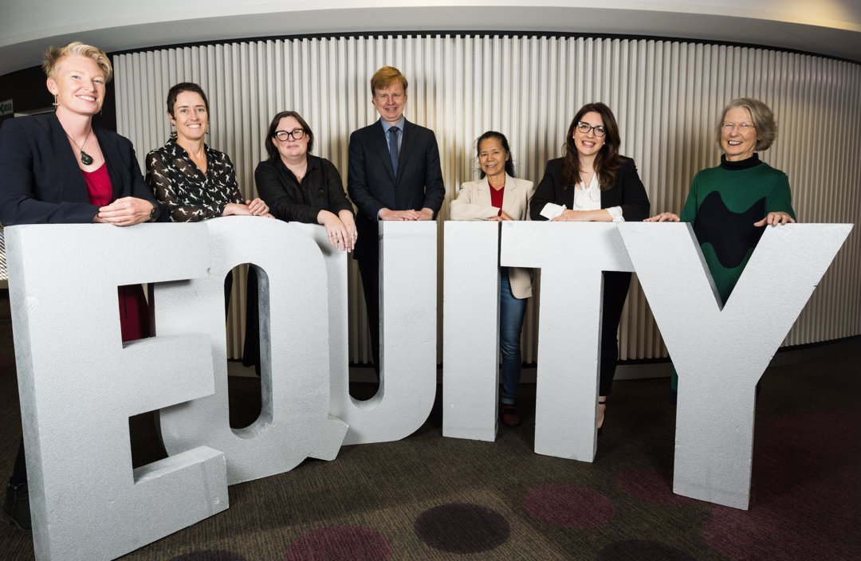
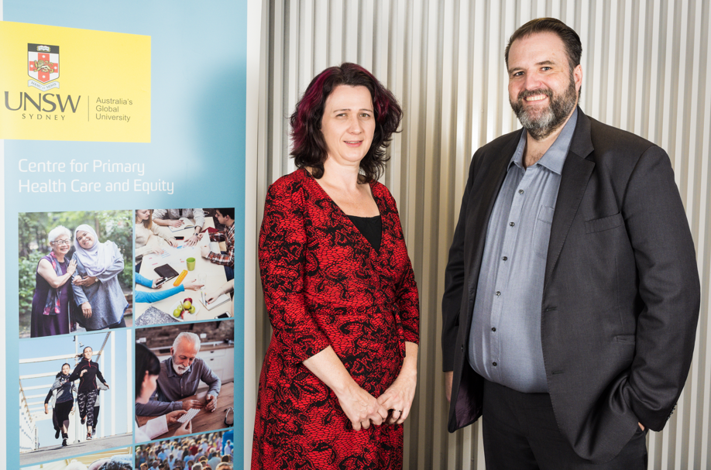
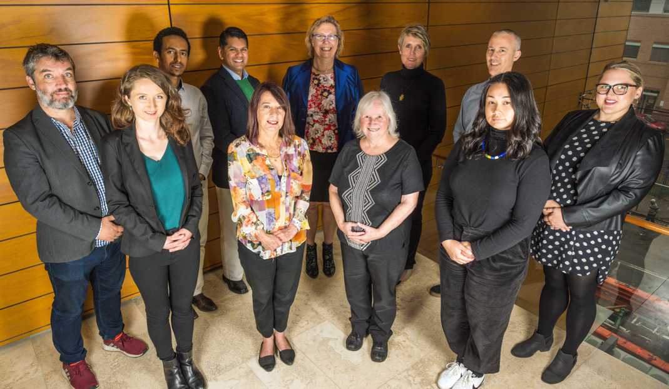
HERDU Team
SEaRCH Team
CHETRE Team
Notes:
We have collaborative research Hubs in Local Health Districts (HERDU in Sydney, SEARCH in South East Sydney and CHETRE in South Western Sydney)

Slide 7
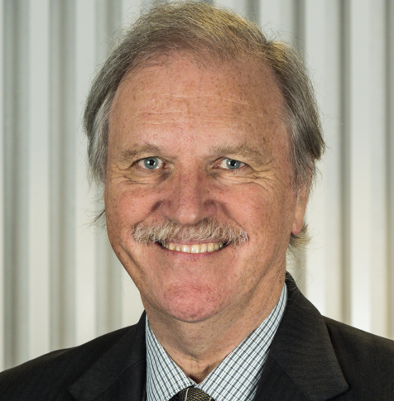
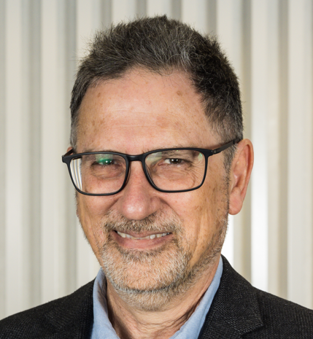
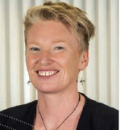
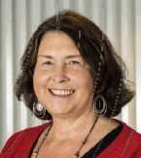
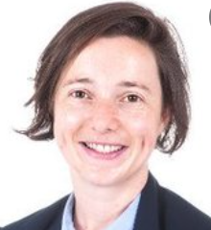
CPHCE Executive
Prof Mark Harris
Executive Director
Prof Evelyne de Leeuw
Director of CHETRE
A/Prof Freddy Sitas
Director
A/Prof Fiona Haigh
Director of HERDU
A/Prof Margo Barr
Director, CES-P&CH
A/Prof Éidín Ní Shé
Director, School of Population Health
Notes:
Ben Harris-Roxas was a member of our advisory group in 2020 before he moved to take up a position the School.

Slide 8
Activity
4 Streams of research
34 research projects
Teaching: masters courses and research students
Notes:
4 Streams of research – prevention and management of chronic disease, primary health and integrated care, health equity, health environments and primary care informatics
34 research projects – 10 new in 2020, 12 collaborative with NSW Health staff
Teaching: 5 masters courses and 19 research students

Slide 9
Highlights
Community Health Navigators program
“Shisha no thanks” project.
Health and housing partnership between FACS and NSW Health
NSW Active Transport Health Model
Severe mental illness and health equity
OPTIMISE study of refugee health improvement in general practice
Notes:
Developed a stream of work on Community Health Navigators including two systematic reviews a large partnership project with SLHD and a project in general practice with the Central and Eastern Sydney Primary Health Network.
Cancer Institute NSW funded “Shisha no thanks” project won the Business Campaign of the Year award at the NSW Premier's Multicultural Communications Awards and the Keeping People Healthy category of in the SESLHD Health Awards.
Through our health and housing partnership between FACS and NSW Health we used an equity focused perspective to make an impact in changes in procedures for social housing bedsit environments to improve conditions of vulnerable residents. HERDU is part of a research team commissioned by NSW Health to develop the NSW Active Transport Health Model best practice method of valuing the health benefits of active transport in NSW. When implemented, the model will change the way health is considered in major infrastructure projects across NSW.
People with severe mental illness and health equity: we have four research projects from competitive funding (Mindgardens, Translational Research Grants Scheme, Mental Health Commission of NSW and UNSW). Our projects are building stronger partnerships with LHDs and PHNs and meeting their needs
We completed the OPTIMISE study - a trial of refugee health improvement in general practices in collaboration with NSW Refugee Health Services, SWSPHN, SWSLHD and Settlement Services International.

Slide 10
COVID-19 response
Support for response to COVID-19 and vaccine roll
Contribution to various State and professional advisory groups
Notes:
CPHCE staff provided ongoing support to NSW Health and LHDs response to the COVID-19 pandemic. This included contact tracing, plans, rapid reviews, activities, equity-checks, spatial mapping, and guided the consideration of equity-related impacts in relation to vulnerable population groups, including the implementation of the Covid-19 Vaccine roll out.

Slide 11
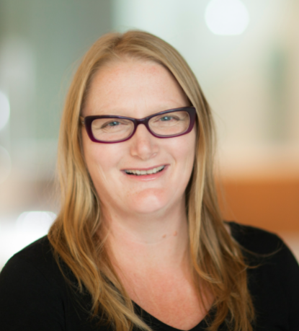
2021 Ian Webster Oration: Prof Victoria Palmer
Notes:
I would now like to introduce the Ian Webster oration.
Our speaker is Victoria Palmer is Professor in the Department of General Practice at the Melbourne Medical School, University of Melbourne. She is the Inaugural Director of the ALIVE national research translation centre to implement mental health care at scale in the primary care and community settings. The national centre is funded by the NHMRC Special Initiative in Mental Health (2021-2026). Victoria first trained in applied ethics and the humanities graduating from her PhD in 2007 using narrative theory to examine cooperative practices. She worked in the community, domestic violence and disabilities sectors before this. Victoria has expertise in qualitative methods including creative arts, mixed-method design and analysis, participatory design and experience-based co-design for health systems improvement. She led the first trial of an adapted mental health experience co-design intervention in community mental health services (The CORE Study 2012-2017). She is CIA of a primary care focused trial to improve heart health with people who live with severe mental illnesses and leads a clinical trial validation of a software as medical device self-monitoring app CovidCareTM. In 2017 Victoria established the Co-Design Living Lab program, a model to embed the perspectives of people with lived experiences of mental illnesses in research design to translation.

Slide 12
Summary

Slide 13
SHORT Break
10 min only

Slide 14
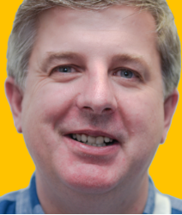
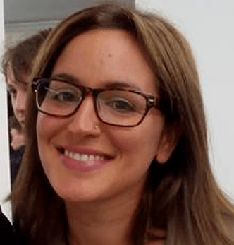
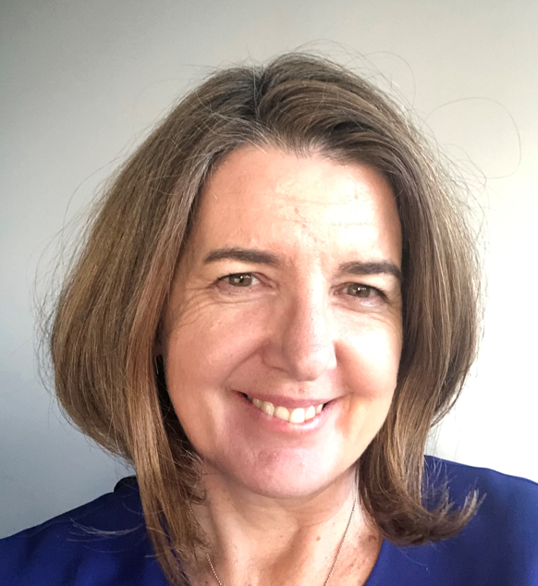
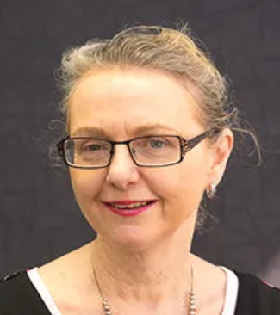
Panel member discussion
Dr Anthony Brown, Executive Director, Health Consumers NSW
Shifra Waks, Casual Researcher, CPHCE, UNSW
Prof Rebecca Ivers, Head, School of Population Health, UNSW
Dr Peri O’Shea, Lived Experience Researcher, Experienhance and UNSW

Slide 15
Final remarks
Prof Mark Harris

Slide 16
CPHCE Awards

Slide 17
Organisational
Partnership Award 2021
Image goes here
Multicultural Health Communication Service,
NSW Health
The NSW Multicultural Health Communication Service was established in 1997 and is hosted by South Eastern Sydney Local Health District (SESLHD). The Service aims to strengthen the capacity of health services and programs to effectively and appropriately communicate with people from culturally and linguistically diverse backgrounds and coordinate the provision of multilingual health information. The Service is led by Ms Lisa Woodland.

Slide 18
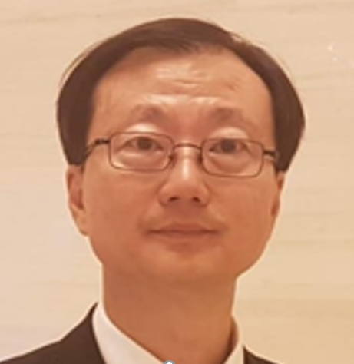
Primary Care Award 2021
Dr George Tang,
Healthpac Medical Centre Hurstville
Dr George Wen-Gin Tang graduated from National Taiwan University in 1987 with a Bachelor of Medicine. He went on to complete a Graduate Diploma of Health Professional Education and Master of Health Administration from UNSW and is now a fellow of RACGP. George is a specialist in family medicine in Taiwan. He is a Senior Examiner in the Australian Medical Council and the RACGP and is a Conjoint Senior Lecturer in the school of Public Health & Community Medicine at UNSW. George has a special interest in teaching medical students and junior doctors. He particularly enjoys writing medical case journals for educational purposes.

Slide 19
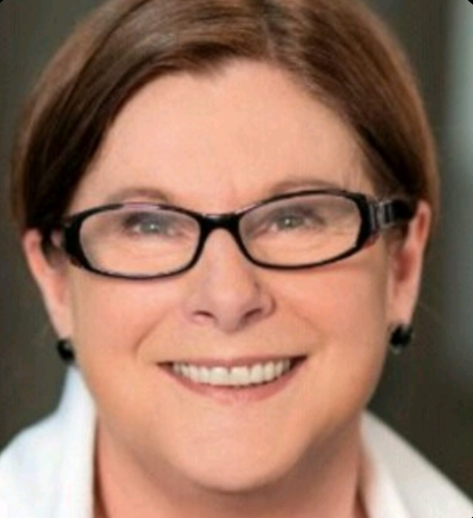
Consumer Award 2021
Catherine O’Donnell
Despite having a long history of living with mental illness Catherine decided some 7 years ago to use her experience to raise awareness and support others who identified with mental illness. Catherine started her journey as a Peer Support Worker and Peer Health Coach. Catherine currently is the Lived Experience Project Manager at Mindgardens Neuroscience Network. Her role in pivotal in ensure that the voice of lived experience is at the centre of the transactional research projects conducted by Mindgardens and its partners. Catherine also holds a degree in Adult Education.

Slide 20
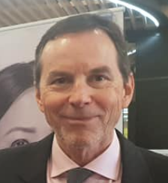
Individual Partnership Award 2021
Dr Mitchell Smith
Dr Mitchell Smith, a public health physician, has been involved in the health care of refugees for over 30 years. Since 1999 he has been the Director of the NSW Refugee Health Service. The Service undertakes health assessments, health education, teaching, research and advocacy for refugees and asylum seekers living in the community. He is currently working on the COVID-19 response in south western Sydney, including its impact on those of refugee background.

