Slide 1
Annual Forum 2022
Centre for Primary Health Care & Equity, UNSW
Tuesday 30th August 2022@9am – 11:30am via Teams

Slide 2
First session
9:00am –10:20am
Opening addressing by Prof Mark Harris
Presentation by Dr Mitchell Smith & Ms Sundus Yousif on ‘Refugee and Immigrant Health’
CPHCE Annual Forum 2022
#cphceannualforum2022

Slide 3
CPHCE
16 years in Review
Image goes here
Mark Harris, Exec Director, CPHCE
Notes:
I would like to acknowledge the traditional owners of the land I am on – the Bidjigal people of the Aora nation and pay my respects to elders past, present and emerging.
2021 was a successful year for CPHCE and we were successful again in our application for the 6th round of funding from the NSW Health Prevention Research Support.
However today I would like to make a few reflections on our work over the past 16 years since the establishment of CPHCE.

Slide 4
Our mission, shared by UNSW, is to create “better, fairer health and health care in the community” by conducting research, evaluation and development that strengthens primary health care and by designing local, place-based interventions to prevent and reduce harm rising from inequities in health.
Mission
Notes:
Our mission has remained to create “better, fairer health and health care in the community”

Slide 5
1995 CGPIS
1998 CHETRE
2006 CPHCE
2012/3
COMPARE-PHC CRE
Informatics Stream
2015 HERDU & SEARCH
2016/7 CESPaCH
Health Environment
1995
2000
2005
2010
2015
2020
Divisions of GP
PHC strategy
Medicare Locals
Primary Health Networks
Preventive health strategy
Primary Health Care 10 year plan
Enhanced Primary Care 1
Enhanced Primary Care 2
General practice evaluation Program
Primary Health Care Evaluation Strategy
APHCRI
CRE
Notes:
CPHCE formed from two existing research units within the School of Population Health in 2006 – Centre for Integration Studies and CHETRE. Over the past 16 years it has developed other collaborations with local health districts, primary health networks and other researchers. It has developed in response to changes in policy and services some of which are shown in the diagram below.

Slide 6
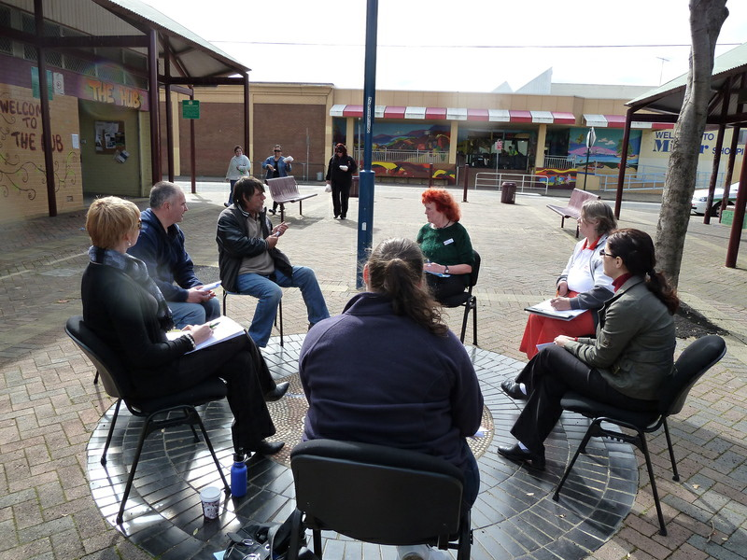
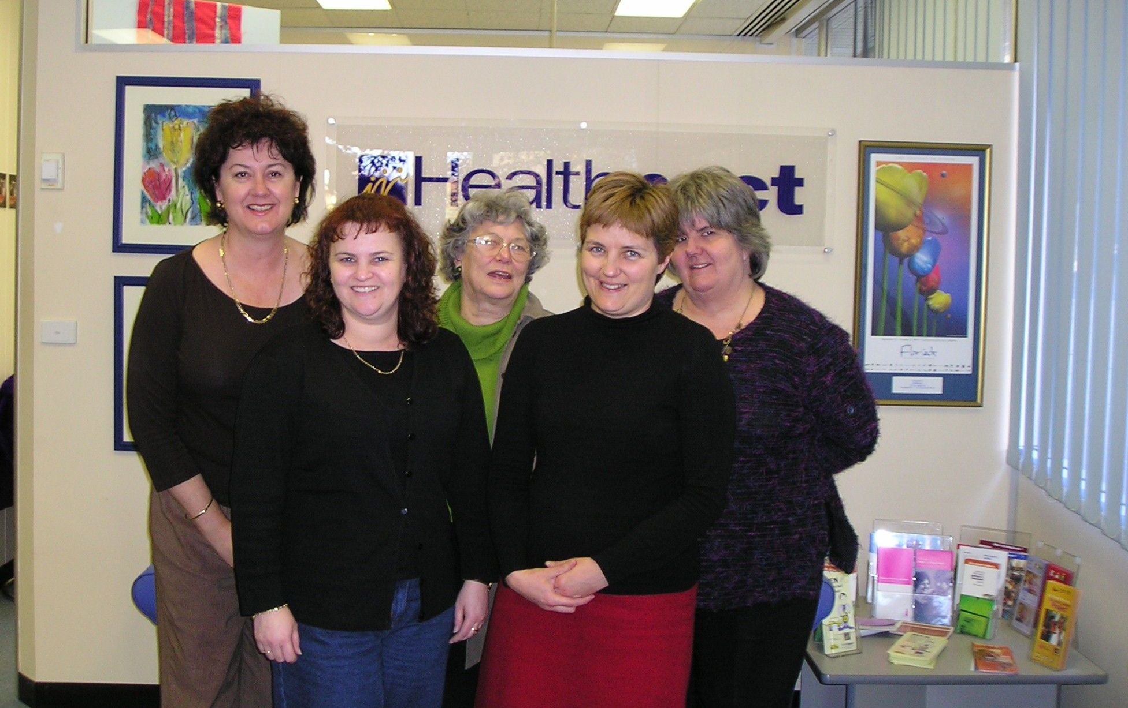
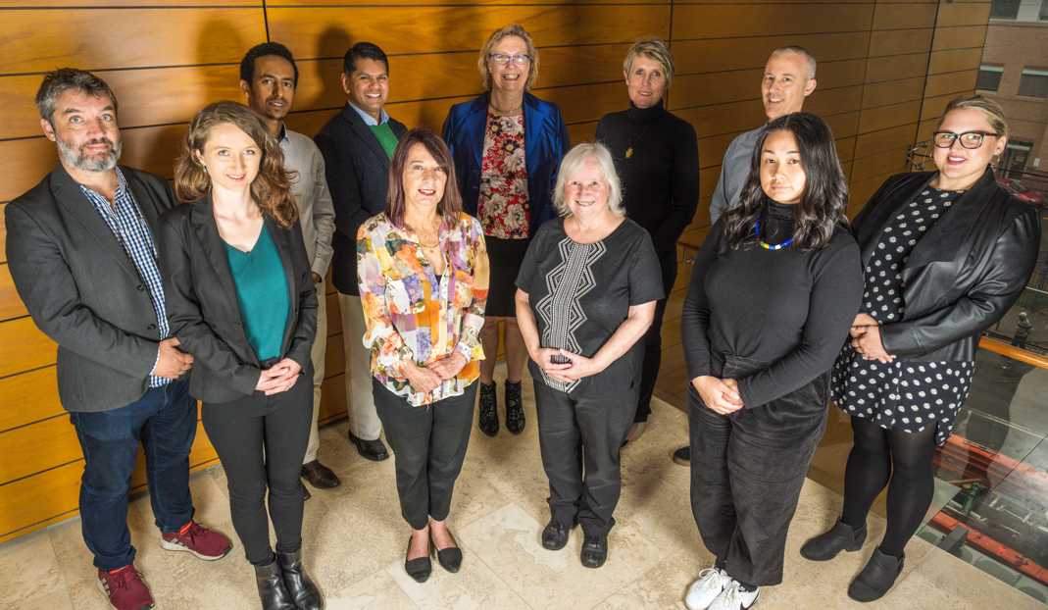
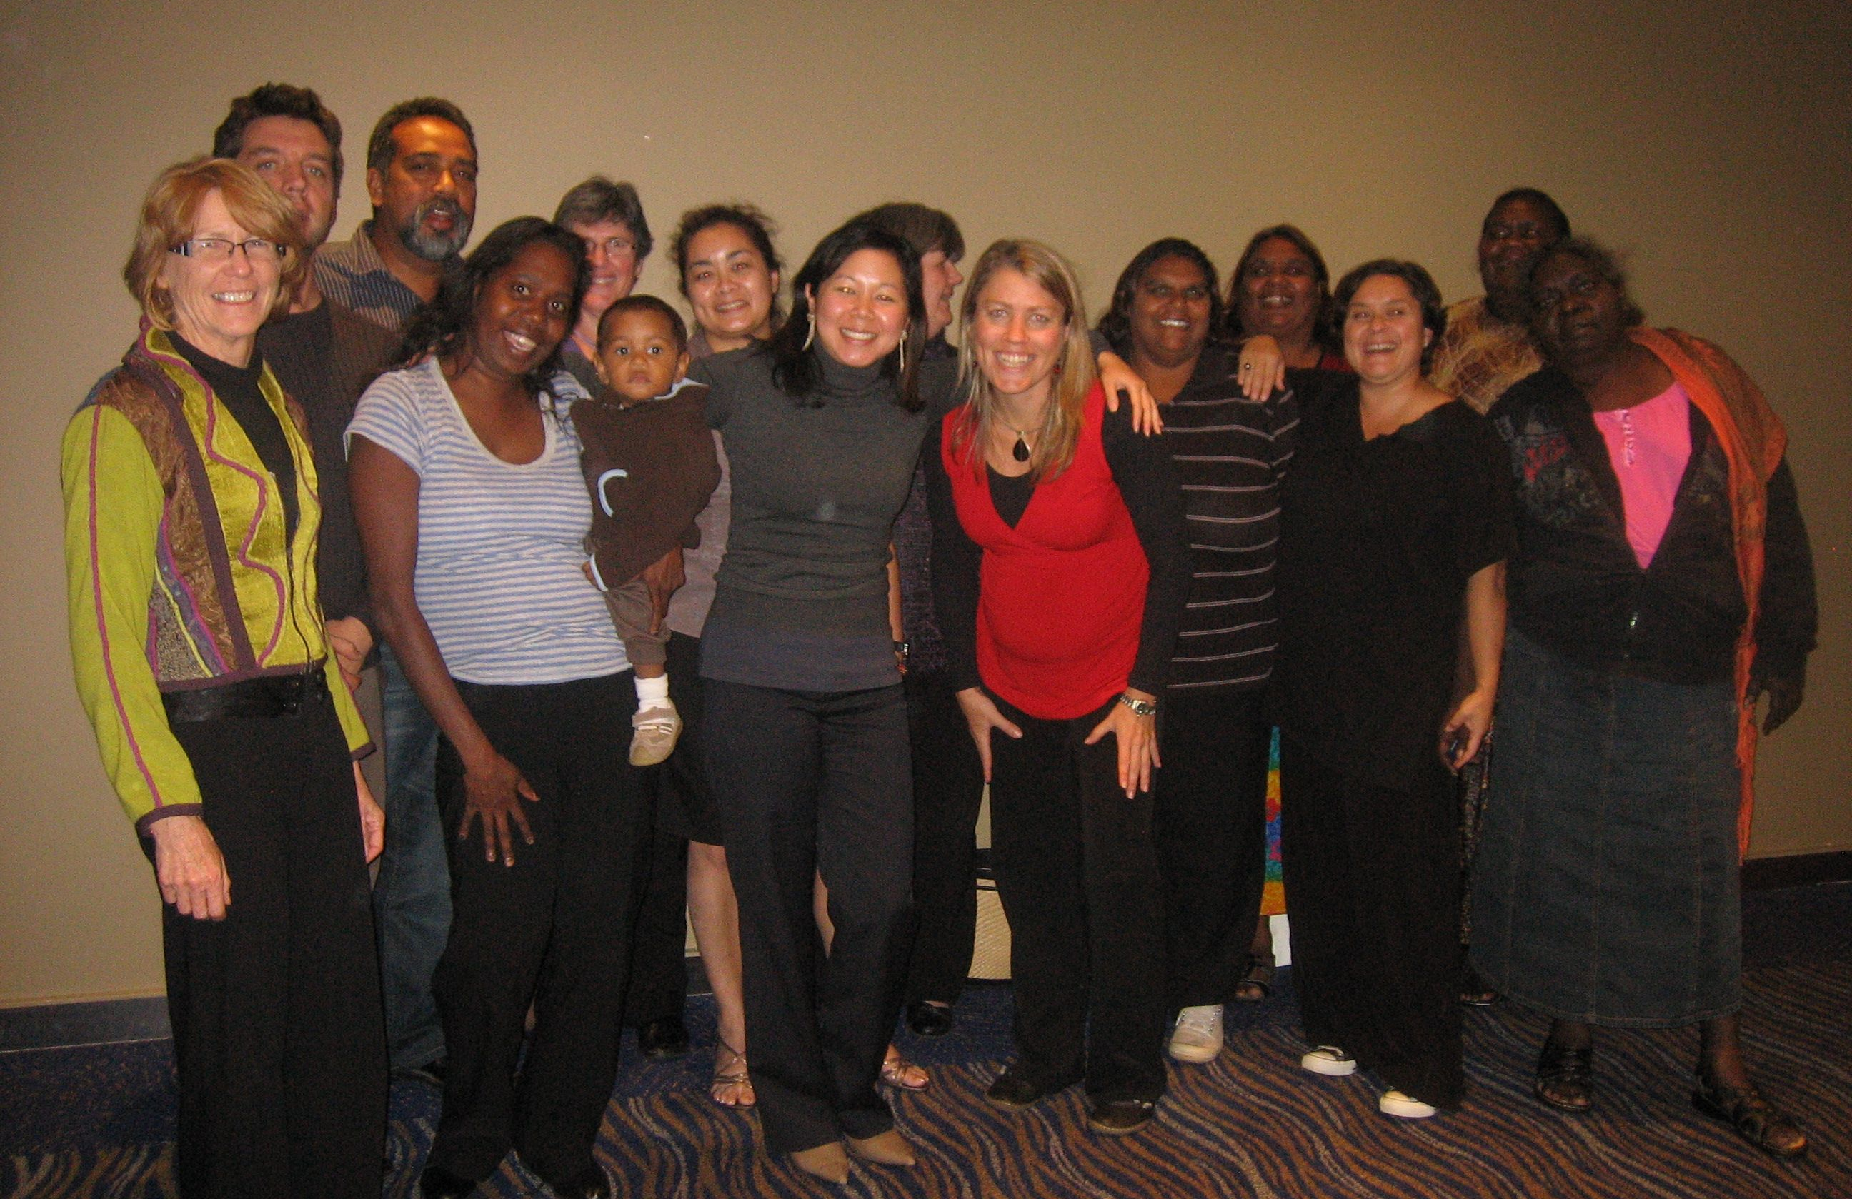
Notes:
The next two slides illustrate some of the diverse range of great people that have been involved in the centre over the past 16 years and perhaps prompt some memories of what we have been involved in over the period.

Slide 7
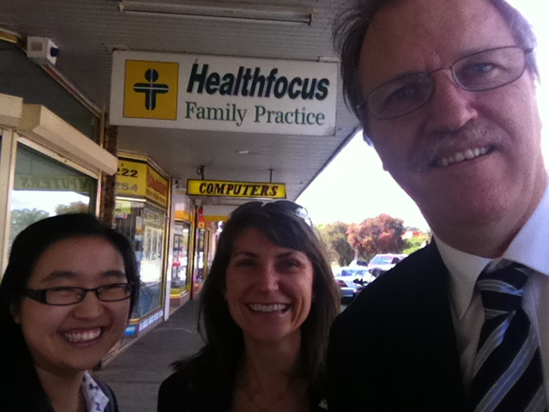
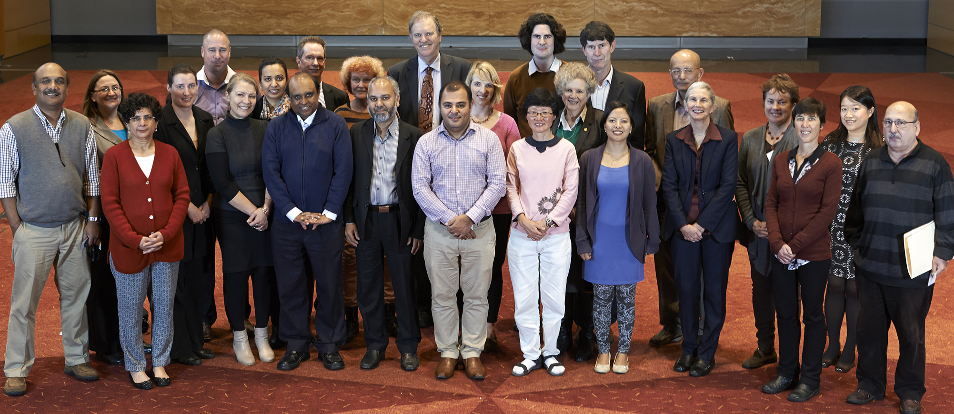

Slide 8
System – Urban planning, Policy, Guidelines, Integrated care, HIA, EFHIA, Climate change, Use of routine data
Setting –facilitation, QI, MD team – PNs, allied health, CHW, disadvantaged communities, unemployment
Individual – 5As/SNAP, CV risk, self-management, health literacy, home visiting share care plans, m-health
Health environments
Health equity
Health Informatics
Primary & Integrated care
Prevention and management of chronic conditions
Notes:
We have developed 5 programs: Health environments, health equity, health informatics, prevention and management of chronic conditions and primary and integrated care.
The diagram illustrates some the larger projects implemented through these program streams. There are too many to list all of them. I’ve grouped them according to their focus using a version of socioecological model:
At the individual level our research has implemented new models of behavioural and risk assessment and management, self management, home-visiting, planned care. At the setting level these include practice facilitation, quality improvement, new models of MD teams including PNs, allied health and community workers, unemployment and health and outreach into disadvantaged communities. At the system level it includes HIA, EFHIA, urban planning and policy, climate change, guideline implementation, use of routinely collected health data.

Slide 9
Some of the things we have learnt
Engaging communities, consumers and health providers in codesign and co-production can be difficult but is possible with perseverance
Change is incremental, takes time and is strongly influenced by context
Where you are in the system affects your motivation and capacity to act.
In complex systems, the impacts are often surprising and difficult to predict.
A crisis like COVID-19 exposes the disparities in health but may create new opportunities for change.
Notes:
We have learnt many things in addition to some of the direct outcomes of our research. They include these:
Engaging communities, consumers and health provider in codesign and co-production can be difficult but is possible with perseverance
Change is incremental, takes time and is strongly influenced by context
Where you are in the system affects your motivation and capacity to act.
In complex systems, the impacts are often surprising and difficult to predict.
A crisis like COVID-19 exposes the disparities in health but may create new opportunities for change.

Slide 10
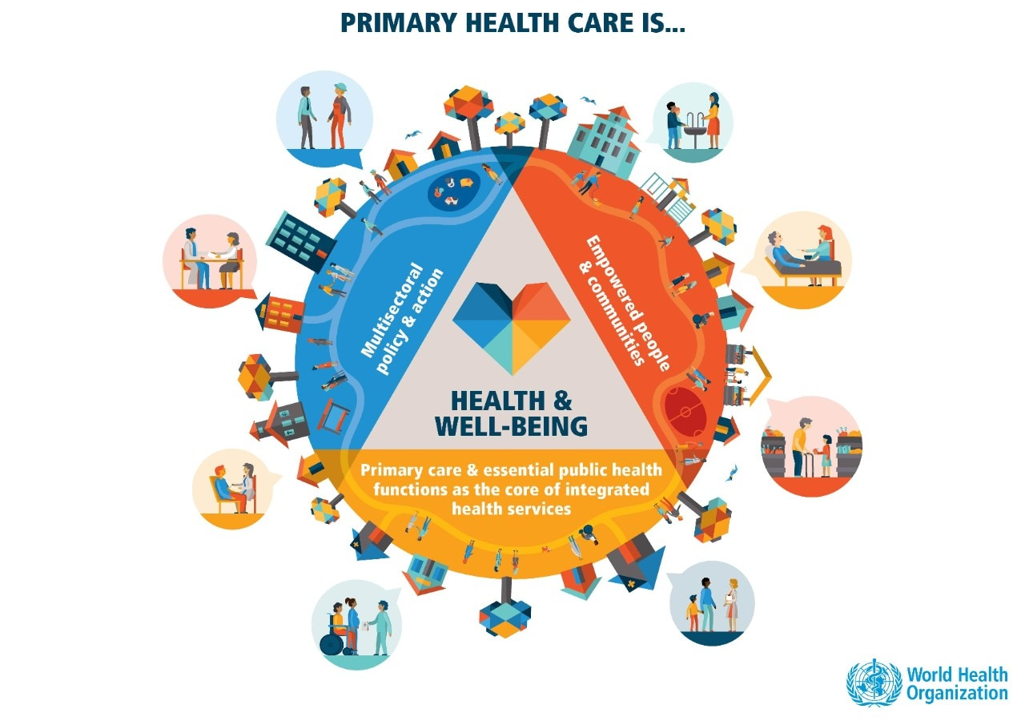
There is no shortage of unresolved issues and questions
Individual: How can we better engage vulnerable and disadvantaged consumers in planned care? Is codesign enough?
Setting: How can we increase health system capacity to address the needs of vulnerable consumers and respond to the current workforce crisis?
System: How do we move upstream to address causal structural problems creating inequity and underinvestment in primary health care and prevention.
Notes:
There are many unresolved issues and no shortage of research quetions to address. We are still involved with our partners in many of the programs outlined in the previous slide. Moving forward these are three issues on our current agenda.
Individual: How can we better engage vulnerable and disadvantaged consumers in planned care? Is codesign enough?
Setting: How can we increase health system capacity to address the needs of vulnerable consumers and respond to the current workforce crisis?
System: How do we move upstream to address causal structural problems creating inequity and underinvestment in primary health care and prevention.

Slide 11
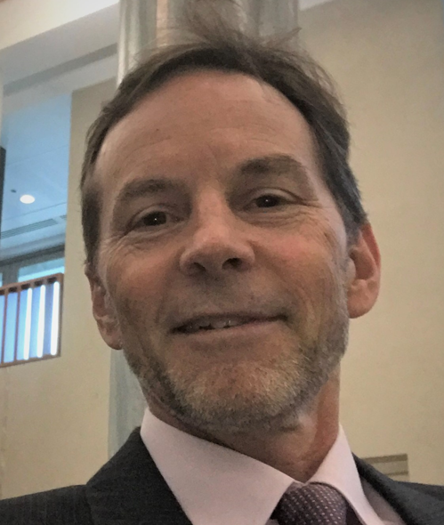
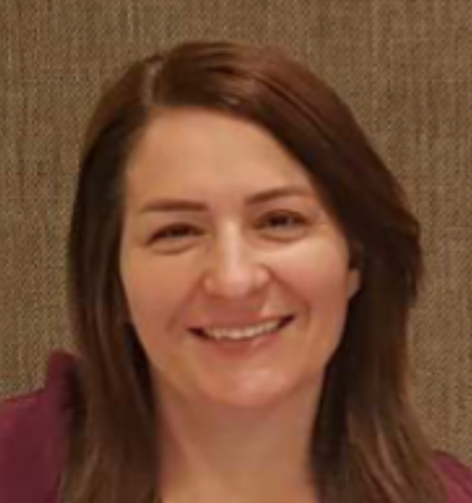
2022 Ian Webster Health For All Oration:
Dr Mitchell Smith & Ms Sundus Yousif
Notes:
Now I would now like to introduce the Ian Webster oration. Ian is still actively engaged with the Centre and a mentor to many of us.
This year we have two speakers
Dr Mitchell Smith is a public health physician involved in the health care of refugees for over 30 years, both overseas and in Australia. Since 1999 he has been Director of the NSW Refugee Health Service, where he oversees clinical programs, health education, teaching. Dr Smith provides advice on refugee health policy at state and national levels.
Ms Sundus Yousif was born in Baghdad, Iraq. Chaldean by background and speaks Arabic and Chaldean. Has Bachelor’s Degree in Medicine and General surgery from Al - Mustansiriya University in Baghdad. She worked as a doctor in Iraq until she was forced by the ISIS threat to move the Kurdistan area of Northern Iraq and later to Jordan and arrived in Australia in 2016. In 2019, she trained as a Bilingual Community Educator (BCE) with the NSW Refugee Health Service (RHS). She currently works delivering health information in language to the Arabic and Chaldean speaking community. During the COVID-19 pandemic she worked at testing and vaccination clinics as a language support officer.

