Slide 1
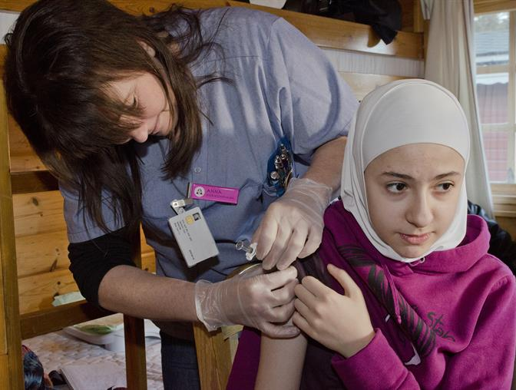
Health Navigation by Refugees from General Practice
Some qualitative findings from OPTIMISE study
Mark Harris and Sabuj Kanti Mistry

Slide 2
Australian Humanitarian Entrants 2004/5 to 2020/1 (ABS Dec 2021)
Notes:
In recent years 15,000 to 20,000 refugees resettled annually in Australia. Refugees arrive with complex physical and mental health issues as result of traumatic experiences such as civil war. They face many challenges to access health care. The quality of health care they receive may not be optimal due to language and cultural barriers among other reasons. The health care providers on the other hand may not have adequate knowledge to provide care to meet the refugee patients’ needs.

Slide 3
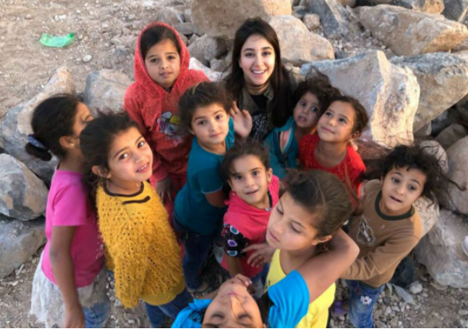
The OPTIMISE study and its background
Aim: to improve the quality of refugee health care at the general practice setting.
3 sites of high refugee settlement areas in 2 states in Australia
3 universities(UNSW, Monash U. & La Trobe U.) and regional partners
Conducted from 2016 to 2020
Funded by NHMRC
Notes:
The OPTIMISE study aimed to improve the quality of refugee health care at the general practice setting in 3 regions of high refugee settlement across 2 states in Australia. It was carried out by 3 universities in partnership with primary health network, refuge focused health services, settlement services or Community Health program in each study region. Funded by National Health and Medical Research Council of Australia.

Slide 4
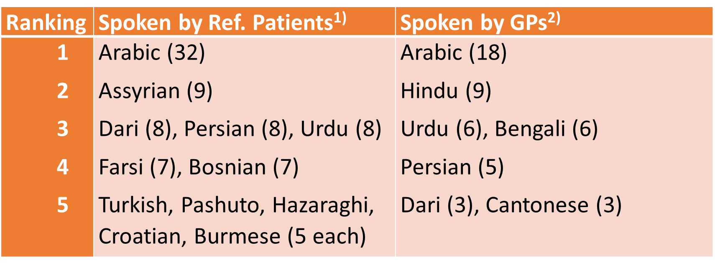
Characteristics of Practice staff and GPs
 |  | Speak LOTE¹⁾ |  | Speak Refugee language²⁾
Practice staff | n | Yes (n) | % | Yes (n) | %
GPs | 134 | 115 | 86 | 58 | 43
Nurses | 61 | 33 | 54 | 8 | 13
Reception | 117 | 75 | 64 | 36 | 31
Many speak languages other than English (LOTE). Fewer speak one of languages spoken by recent refugees.
GPs born in 19 different countries (including Australia)
Practice staff
GPs
Nurses
Reception
Data source for LOTE: Practice description survey. 1) Chi-square test of 3 x 2 table for "Speak LOTE" p=0.000. 2) Chi-square test of 3 x 2 table for "Speaks Refugee language" p=0.000. Refugee languages refers to languages spoken by recently arrived refugees and are based on patients’ country of origin or ethnicity of the source countries of recent humanitarian entrants to Australia (Department of Immigration and Border Protection, 2013 to 2017). Date Source for the Ranking of languages: Baseline Practitioner survey.
Notes:
Many GPs spoke languages other than English and consulted in them (compares with only 3% of Australian GPs who conducted more than half of their consultations in a language other than English). GPs were significantly more bilingual, as they were born in 19 different countries. 43% of them spoke at least one language spoken by recently arrived refugees. Conversely nurses were least bilingual and spoke languages spoken by refugees. A closer look at GPs’ and their patients’ languages (as reported by the GPs) indicated a moderate degree of language concordance.

Slide 5
Findings of Optimise study
Health assessments
Language
The proportion of patients with an RHA in the previous 6 months increased from 19.1% to 27.3% (OR 1.9 (95%CI 1.4 to 2.5).
Outreach practice facilitation in collaboration with local refugee health services helped improve the quality of assessment provided to refugees
Russell, G.M., et al. (2021), OPTIMISE: a pragmatic stepped wedge cluster randomised trial of an intervention to improve primary care for refugees in Australia. Med J Aust. 215: 420-426
The use of credentialed interpreters was sub-optimal but did improve
The use of bilingual staff and family members as alternatives remained frequent.
Time and cost were main barriers as well as availability of interpreters.
Saito S et al.(2021) Response to language barriers with patients from refugee background in general practice in Australia: Findings from the OPTIMISE study BMC Health Services Research 21, 921.
Notes:
In conclusion, general practice responds to language disconcordance by having bilingual GPs, using interpreters, relaying on bilingual staff or family members. The use of interpreters by general practice was sub-optimal. The availability of bilingual GPs is a possible confounding factor for this trend. The use of bilingual staff and family members as alternative remained frequent. Time and cost are barriers as well as availability of interpreters reported by GPs. To improve the use of interpreter, a practice-wide approach is required with the involvement of reception staff, who have a key role in identifying such a need.
Implications may include enhancing awareness among all the practice staff of the benefits of using interpreters, so that they can inform patients and their family why and when it is necessary to use interpreters. The Primary Health Network agencies could facilitate this kind of training based on the needs of the general practice. A practice-wide interpreter friendly system could be built-up by linking it with the accreditation process of general practice. Finally, an interaction of patient with a GP or a nurse using an interpreter takes extra time. This could be subsidised by, such as Medicare rebate, to promote the use of interpreters in general practice.

Slide 6
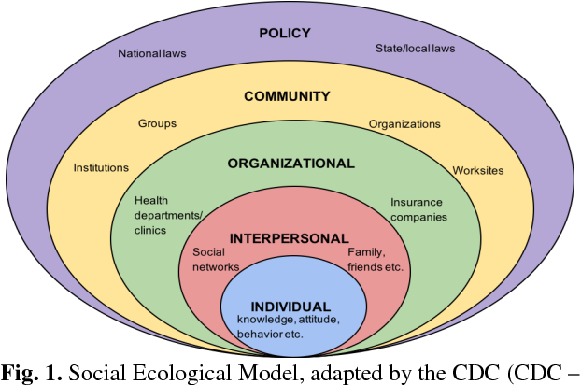
Study Objectives and Methods
Research Question: What navigation problems were identified in the general practice staff in OPTIMISE study in South-West Sydney
Secondary Analysis of Qualitative interviews and notes collected from staff of 12 practices and 3 practice facilitators
Analysis: Descriptive thematic analysis using socioecological model as a framework
Notes:
This study sits within the overall OPTIMISE study, using the subsets of data collected through implementing the OPTIMISE study.
The OPTIMISE study was a stepped-wedge cluster randomised control trial in 3 regions with general practices randomised to early or late intervention groups, meaning the late group receiving the same intervention after 6 months when the early group completed its intervention.
Mixed method was employed for this evaluation using both quantitative and qualitative data collected at baseline and after 6 months from 55 general practitioners and 31 practices. In other words, only the early group was subjected to the intervention between these time points. We assessed changes in procedures for assessing and recording language and interpreter needs, perceived barriers of providers in using interpreters and the level of interpreter use. Data was analysed descriptively as well as comparing early and late intervention groups adjusting for clustering by practice.

Slide 7
Factors influencing navigation by refugees
Individual level
Interpersonal
Health system literacy: Refugees may lack understanding of and information on the Australian health system including the availability of services and technology to deal with health problems that may be different from their country of origin.
“that they don’t have sufficient information on how to access health care, because the health care system in Australia might be entirely different to their parent country from where they are coming from”
Health literacy: Understanding of certain tests (eg breast or bowel cancer screening)
English language literacy: This is a problem for some recently arrived refugees especially for parents brought out to Australia by more established younger refugees as they find it difficult to learn English.
“language barrier is the main issue in finding appropriate services to refer patients to. Mental health referrals are particularly challenging”
Distance to language and cultural appropriate services services and the availability of transport to take them was an issue for some services
“transport and um access to you know in terms of location to the health services, um, some of them they don’t have any family to drive them”
Tailored: Health care providers need to sensitive to the different needs of refugee groups
“and how to treat these people differently, and I don’t know, just depends on what they come from they’ve got all different expectations, you can’t really compare the refugee.”
Linkage: If they arrive via the sponsorship pathway, refugees that they may not be connected with the services they need.
“their families are sponsoring them, and they arrive in Australia without much support and most of their families are also, they’re not aware of what much they can do for them”GP
Notes:
At the individual level the navigation was influenced by the health literacy, English language proficiency and health system literacy of refugees.
In accessing services, distance was a barrier. Services that were more sensitive to the needs of refugees were sought after. While sponsors were important in facilitating access to services such as GPs these often neglected other health services.

Slide 8
Navigation issues faced by refugees in SWS:
Organisational level
Policy
Lack of time in consultations was a barrier to effective navigation related to the limitations on funding from Medicare.
“Unfortunately, you can’t just um, um, even the time that you spend with them, claim in terms of Medicare billings..”
Information on the referral processes needs to be provided in multiple languages or through the use of health navigators
“Providing referral navigation information in multiple languages (eg; how to book and get to referral service etc.) either in writing or using a health navigator”
Cost is a major constraint. The availability of low cost or bulk billing medical specialists especially in the surgical specialties such as ENT and orthopaedics, mental health and dentists.
“It becomes very frustrating when trying to impart info to our refugees not just for us but for them also, difficult for us when trying to make appts. ie specialists as there is always a cost involved & they have no funds. We do not have access to their case managers to find out if funding is available.” (GP)
In the public sector wait times are a significant barrier
“Dental is the main issue, not for children but the adults, even when we state their refugee status there is a long waiting period.”
Notes:
Within practices lack of time and information in multiple languages was a barrier
Cost and wait times were very important constraints on refugees access and navigation to preventive services.

Slide 9
Other Issues identified in other research
Taylor J and Haintz GL Aust J Prim Health 2018
Au M et al. BMC Int Health and Human Rights 2019
Language and culture
Access to/uptake of interpreter service
Health literacy
Health seeking behaviour
Trust in health care providers
Resettlement issues
Cost of health care
Wait times
Language
Access to interpreters
Expectations of the health care system
Cultural differences
Provider knowledge of refugee health
Health information translated and/or culturally appropriate
Empowerment
Affordability, accessibility, accommodation, and availability
Notes:
Our findings broadly concur with those of other researchers. Other issues that have been identified are highlighted in red in this slide.

Slide 10
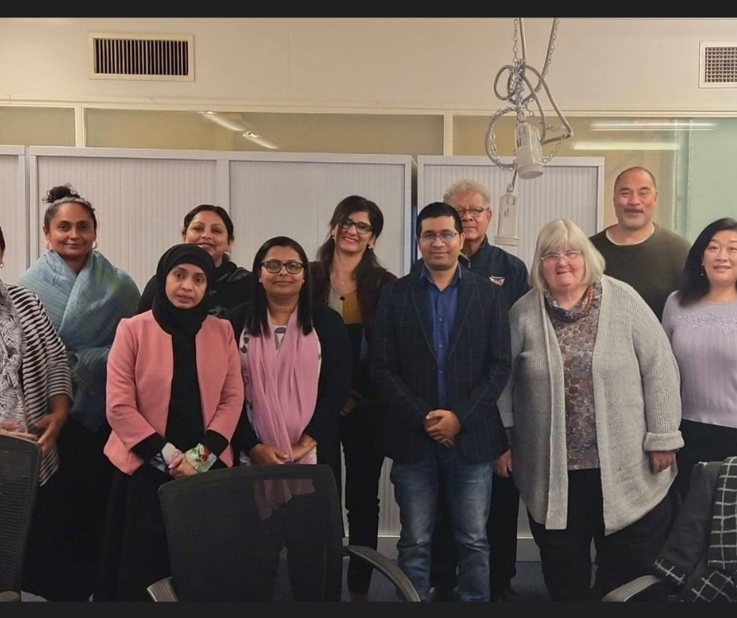
Bilingual community health navigators
Lay health workers from the same language and cultural background
Bridge between community and health services
Improve access to culturally appropriate health services
Notes:
This also has implications for our work with community health workers as navigators in general practice
Hand to Sabuj:

Slide 11
Which refugee issues might BCNs address
Overcome cultural and language barriers
Help navigate health and social care services
Improve health literacy
Build trust within the health system

Slide 12
Opportunities for research and development
Training LHWs as BCNs
To develop a model of care for BCNs working in refugee setting
Explore the impact of involving BCNs for refugees
Explore the cost-effectiveness of the intervention

Slide 13
Partners of the OPTIMISE study
Notes:
We would like to acknowledge all the partners involved in the OPTIMISE study and the CHW involved in our research projects.

Slide 14
Thank you!
Questions or comments?
m.f.harris@unsw.edu.au
Notes:
Thank you.
This is the end of the presentation.
Please email us any questions or comments

Slide 15
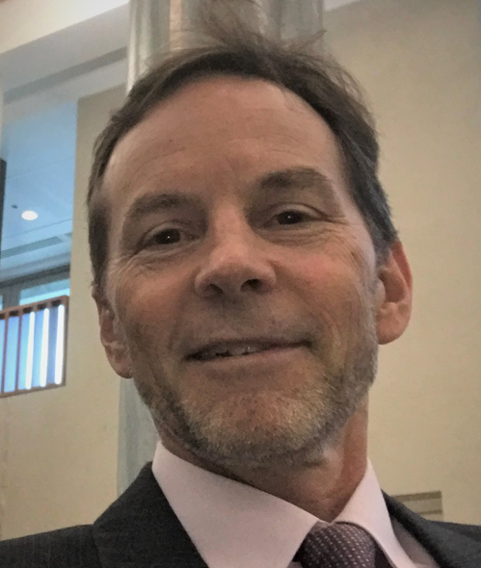
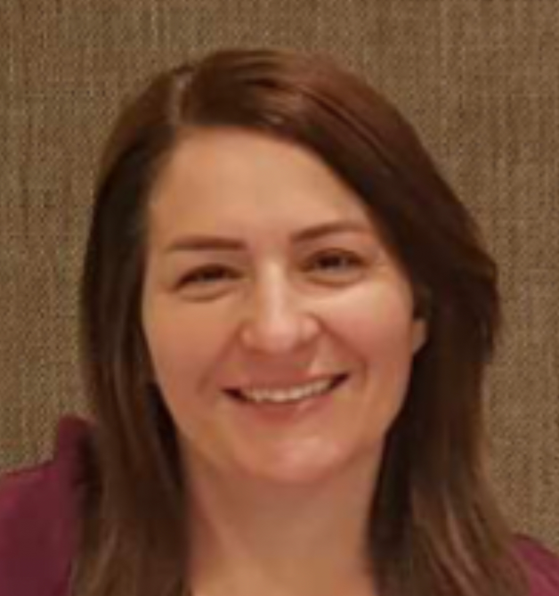
Panel member discussion
Dr Mitchell Smith, Director, NSW Refugee Health Service
Ms Sundus Yousif, SWSLHD Bi-Lingual Community Educator
Lisa Woodland, Director, South-Eastern Sydney Local Health District
Vesna Dragoje, Health Care Interpreter Service, Sydney Local Health District

Slide 16
CPHCE Awards 2022

Slide 17
Individual Partnership Award 2022
Dr Damian Conway, Population and Community Health Directorate

Slide 18
Organisational
Partnership Award 2022
Waterloo Human Services Collaborative Group

Slide 19
Primary Care Award 2022
Dr. Tim Shortus, Broadway General Practice

Slide 20
Consumer Award 2022
Dr. Anthony Brown, Health Consumers NSW

