Slide 1

The science and art of HIAs:
a case study from Green Square
Jane Lloyd, Director HERDU
Allison Heller, Manager Social Strategy, City of Sydney Council
CPHCE Annual Forum 16th August 2017

Slide 2
Acknowledgements
City of Sydney Council - Morris Bellamy, Lila Contziu, Dustin Moore, Yvette Andrews, Christine McBride, Kirsten Woodward
Sydney Local Health District – Elizabeth Harris, Gisselle Gallego, Jude Page, Pam Garrett, Lou-Anne Blunden, Lisa Parsci, Eleni Naude, George Johnson
Inner City Regional Social Development Council - Geoffrey Turnbull
Tenants' Union of NSW - Julie Foreman
UNSW CPHCE – Terry Findlay and Ben Harris-Roxas

Slide 3
Overview
What is the Green Square development?
What is the role of the City of Sydney in the development and what is the role of other government agencies?
Describe the governance and methods for the conducting the Green Square HIA
What are the likely health impacts of the development on child health?
How the HIA adds value to the City of Sydney’s roles and responsibilities and the development of Green Square

Slide 4
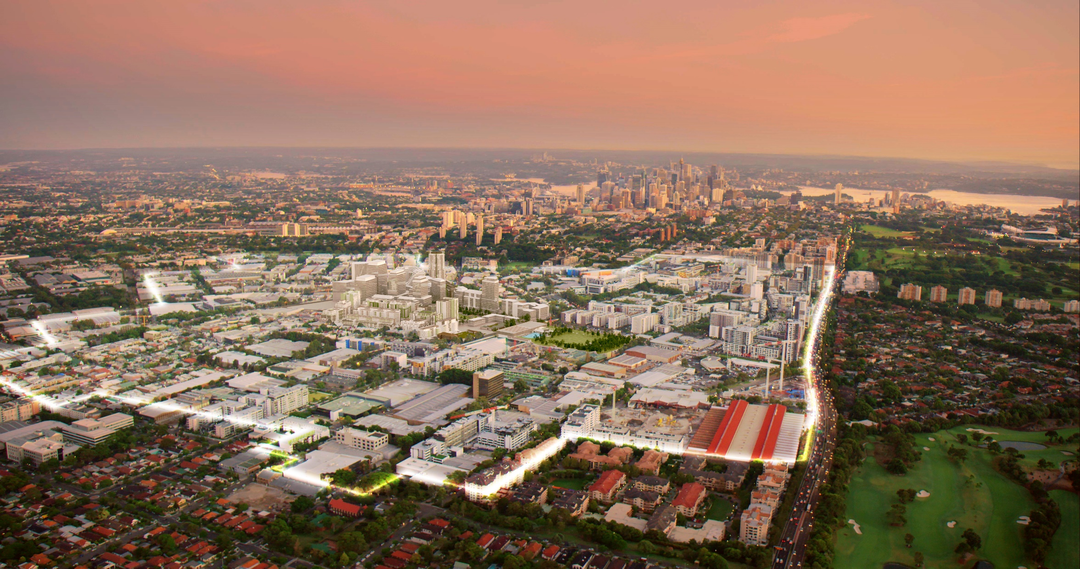
278 hectares located halfway between Sydney’s CBD and airport
$13 billion estimated total development value
61,000 residents
21,000 jobs
Green Square
Notes:
Green Square – a 278 hectare urban renewal project – located halfway between Sydney’s CBD and the airport.
With an estimated total development value of $13 billion – a new population of 61,000 residents and 21,000 jobs – Green Square is Australia's largest urban renewal project.
So what is disruptive about Green Square? Especially, from a Green Cities perspective?

Slide 5
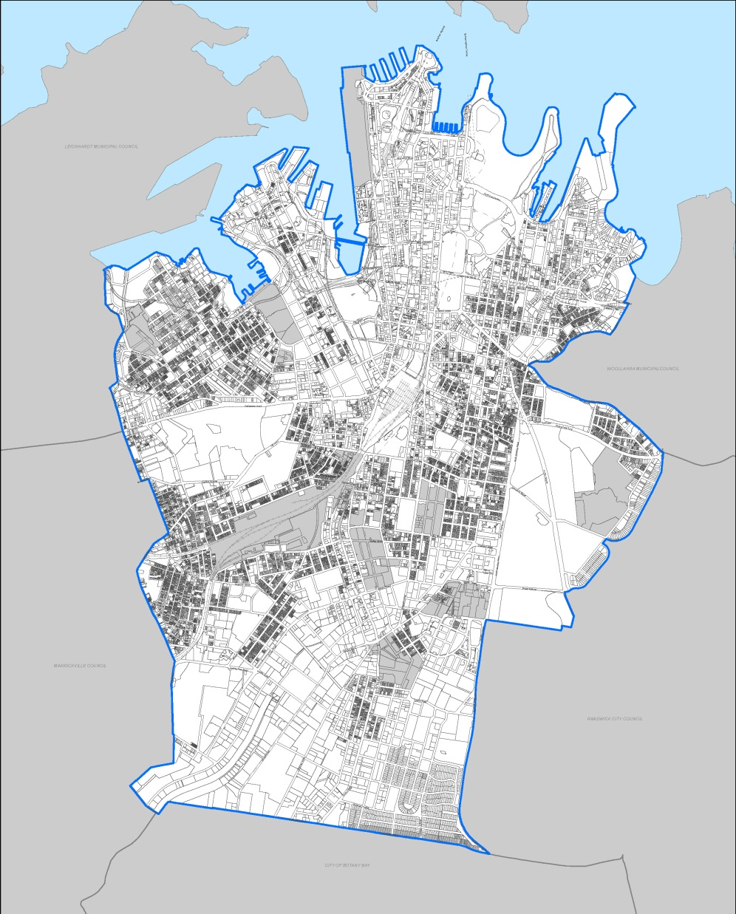
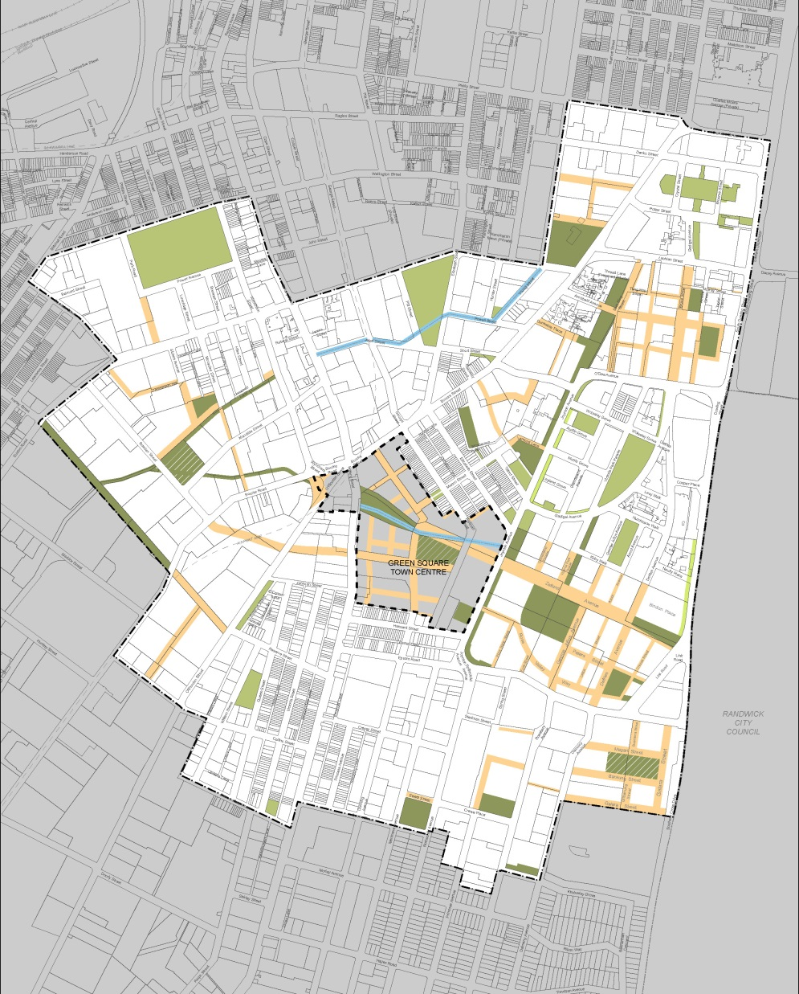
Australia’s largest urban renewal area
Barangaroo
BP
DH
CUB
C to E
Redfern
Waterloo
Green Square
Renewal Area
Notes:
The project is larger than all of the other State Significant sites in Sydney combined.
Public infrastructure covers 51.4 ha or about 18.5% of the land.
History of the project…:

Slide 6
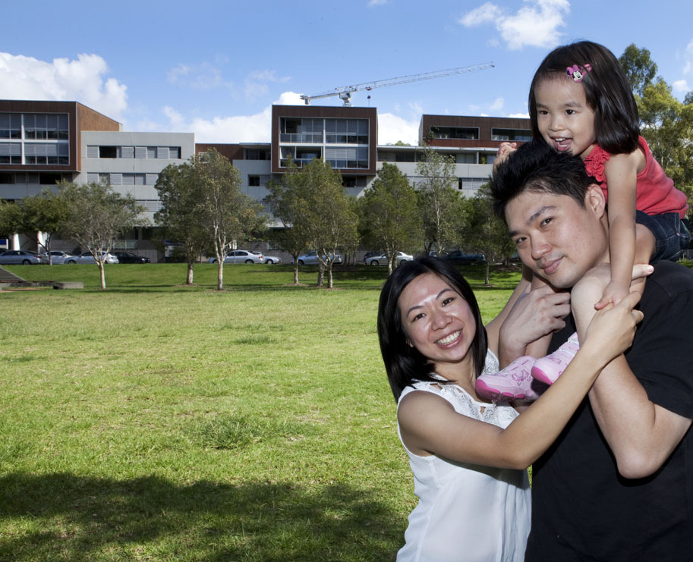
1999
3,000 residents
2030
61,000 residents
Notes:
So who is living here?
The total population in Green Square is expected that Green Square to grow to 61,000 people, when complete. Higher levels of urban density challenges the norm for living in Australian cities. And yet, the challenge for truly green cities is to deliver sustainable, quality living in tandem with higher density. Achieving this balance is at the heart of placemaking for Green Square.
Some value capture mechanisms, such as design excellence, have contributed to higher density The aim is to provide better built form outcomes via architectural competitions. However, core requirements, such as solar access for residents, must be maintained.
Is it disruptive, in the Australian context, to have population densities equivalent to international cities? Green Square is certainly pushing boundaries. Manhattan averages about 28,000 residents per square kilometre; while the average across all of greater metropolitan Sydney is just 372 people per square kilometre.
Sydney 2030 – the blueprint for the City of Sydney – indicates that higher density living can be the healthiest, the greenest, the most stimulating place for people – and with the smallest environmental footprint. It is already the case that three quarters of Sydney’s population live in apartments and other strata living.

Slide 7
1999
Living arrangements (household types)
 | Green Square | % local growth 2011-16 | City of Sydney
Couples with children | 13.8 | 42.7 | 10.3
Couples without children | 30.1 | 82.5 | 28.2
Sole parent + other family | 8.4 | 24.1 | 7.4
Group households | 17.4 | 106.7 | 14.2
Lone-person households | 30.3 | 36.3 | 39.9
All households | 100.0 | 53.8 | 100.0
2030
Notes:
Predominant household types 2011 Census are:
couples without children
single person households
Highest growth in household types 2011 to 2016:
Group households (107% growth) (typically student share households)
Couples without children (83% growth)
Couples with children (43% growth)

Slide 8
1999
Residents’ age profile (% age change)
 | Green Square | % local growth 2011-16 | City of Sydney
Median Age | 30 (32 in 2011) |  | 32 (32 in 2011)
0 - 4 | 4.5 | + 55.8 | + 15.0
5 -14 | 4.1 | + 15.7 | + 18.2
15 -19 | 5.9 | + 113.4 | + 44.2
20 - 24 | 14.6 | + 111.5 | + 35.2
25 - 34 | 33.1 | + 86.2 | + 24.5
35 - 44 | 14.4 | + 41.5 | + 15.5
45 - 54 | 18.7 | + 27.1 | + 15.8
55 - 64 | 6.6 | + 18.9 | + 14.4
65 - 74 | 4.8 | + 31.5 | + 34.2
75 + | 3.4 | + 17.5 | + 19.4
2030
Notes:
Youthful population
High proportion of young people (students)
High growth rate in young children and teenagers
This highlights the kinds of infrastructure required, including community, health and education facilities

Slide 9
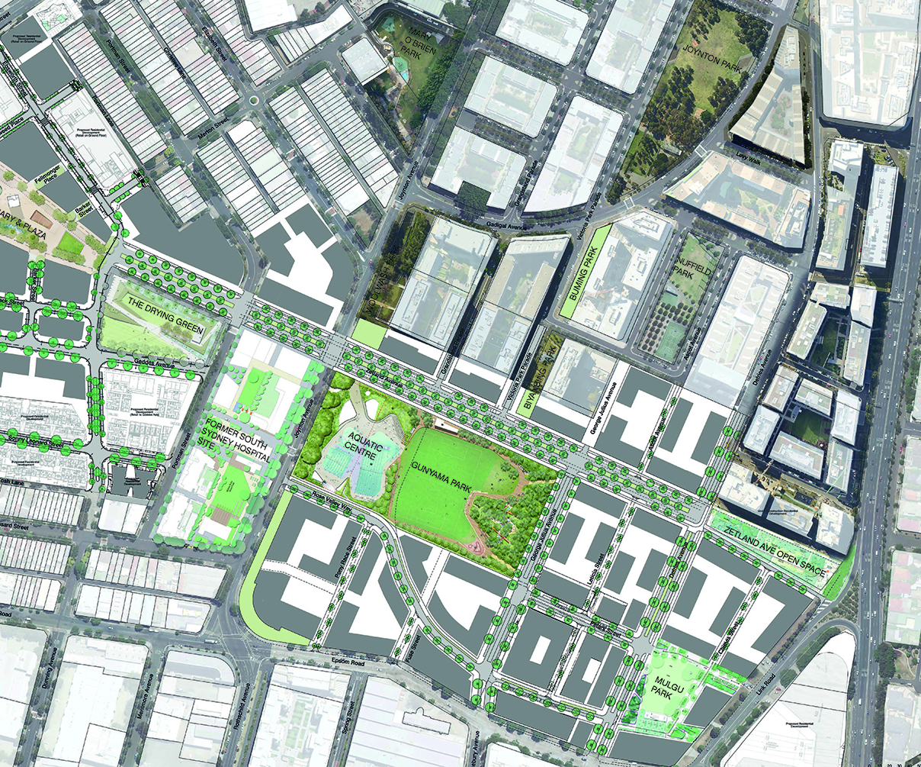
Master planning a new community
Notes:
So what is the City’s role?
This is an image showing the renewal area masterplan - the translation into reality of which is a key role for the city – including delivery much of the park and other infrastructure you see here.
The City’s role is the masterplanning, design and delivery of the precinct.
This includes delivery of key public infrastructure, which covers 51.4 ha or about 18.5% of the land.
Key infrastructure includes roads, trunk drainage and social infrastructure – parks and community facilities.
Additionally placemaking – the physical and social aspects of place creation - and the delivery of community development initiatives, and social and cultural programs and services, and economic development initiatives to support the new development.

Slide 10
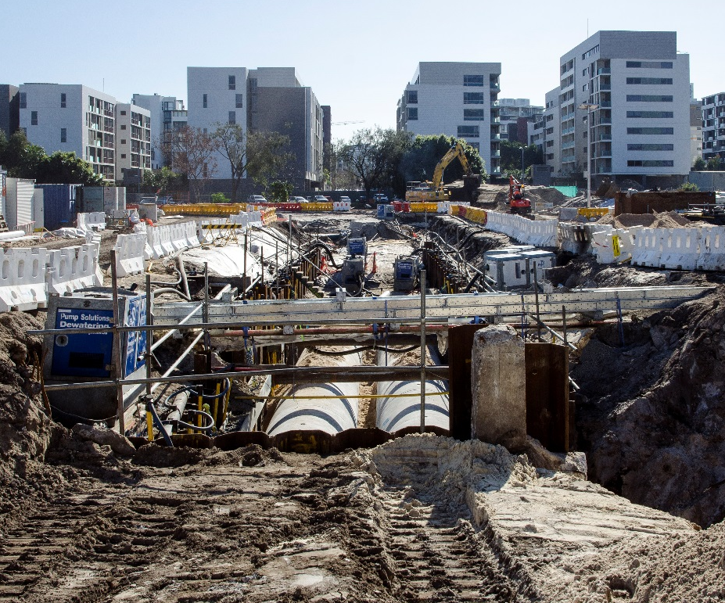
Urban transformation and major infrastructure delivery
Notes:
This shows the trunk drain that was essential to enable the entire development

Slide 11
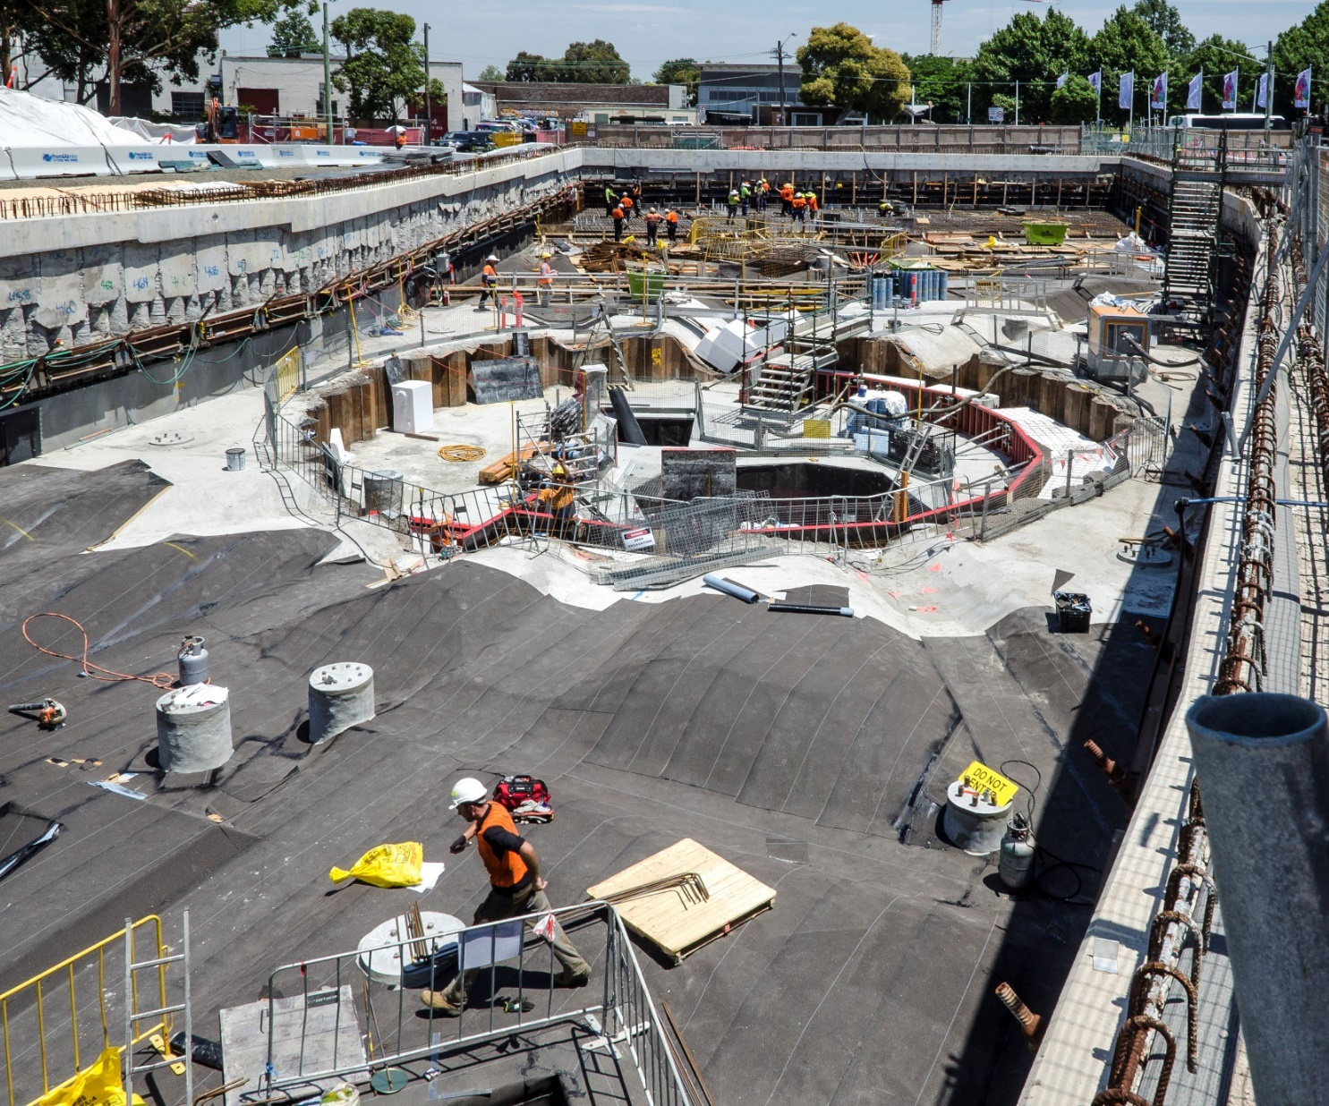
Delivery of major new developments
Notes:
This image shows the development of the new library…

Slide 12
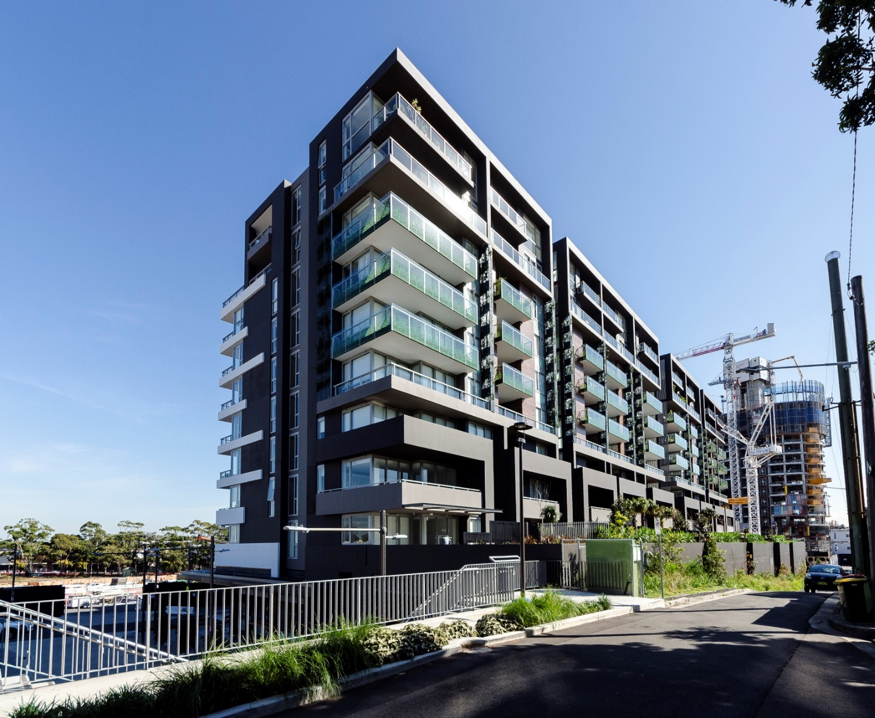
A high density urban village
Notes:
This requires consideration of living well at high density and how to support the quality of life and wellbeing of residents

Slide 13
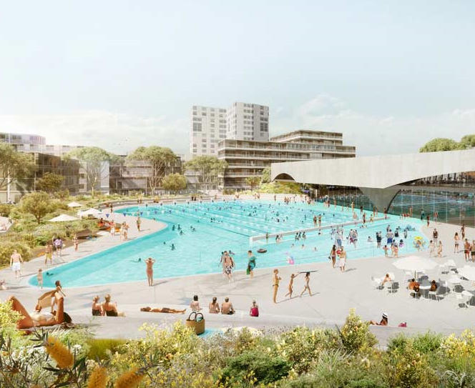
Social infrastructure to support quality of life and wellbeing: Gunyama Park Aquatic and Recreation Centre
Notes:
Social infrastructure to support wellbeing:
Health has been a key focus of the City’s investment in local social infrastructure to serve the community. This includes investment in a range of health and recreation facilities, including a new aquatic centre and hydrotherapy pool and indoor recreation centre.
These needs were determined at the early stages of the urban renewal process, through a social impact assessment and social infrastructure audit.
The City’s delivery strategy includes direct investment and delivery of local social infrastructure within our control, along with advocacy to state government agencies on higher order social infrastructure – including schools and health infrastructure, which is outside our control.

Slide 14
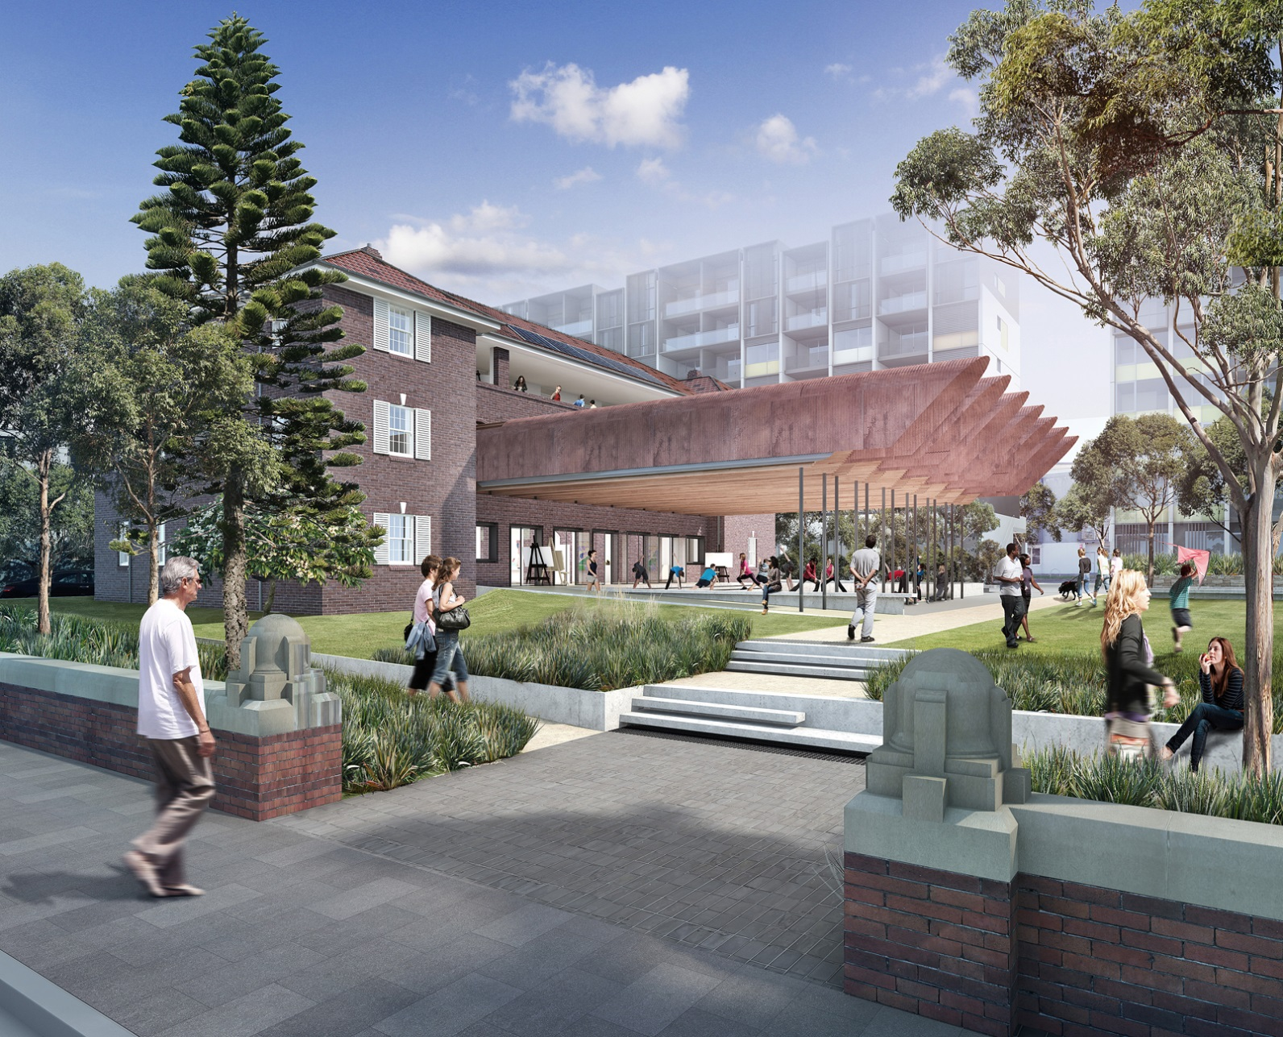
Former South Sydney Hospital: Community
and Cultural Infrastructure Precinct
Notes:
Infrastructure to support health and wellbeing, being delivered by the City, is diverse and wide ranging.
It includes facilities for cultural and creative expression:
The transformation of the former South Sydney Hospital site into community arts facilities, workshops, creative spaces and childcare – bringing these historic health facilities back into use for the contemporary era!
Creative Centre
74 place childcare centre
Community shed

Slide 15
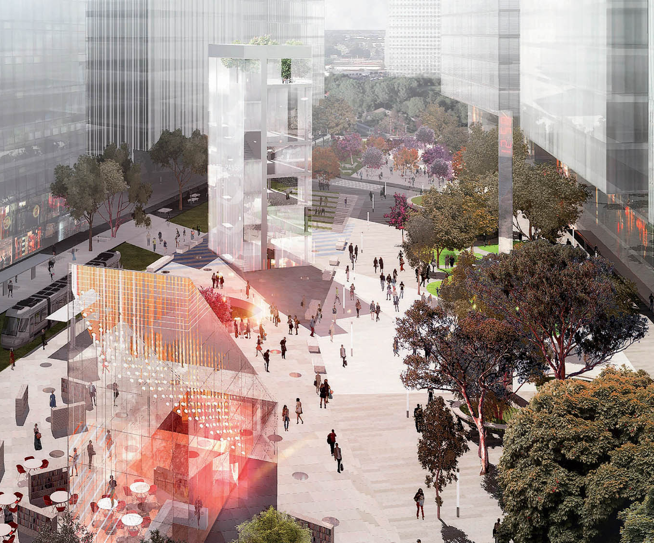
Library and plaza – lifelong learning focus
Notes:
Public works under construction include the Green Square Library and Plaza procured through an international competition.
Again, these facilities are being developed with a focus on delivering community wellbeing and lifelong learning. It will include gathering and tech-enabled recreation spaces and spaces for people to meet, mingle, gather or seek quiet respite from the busy urban environment.

Slide 16
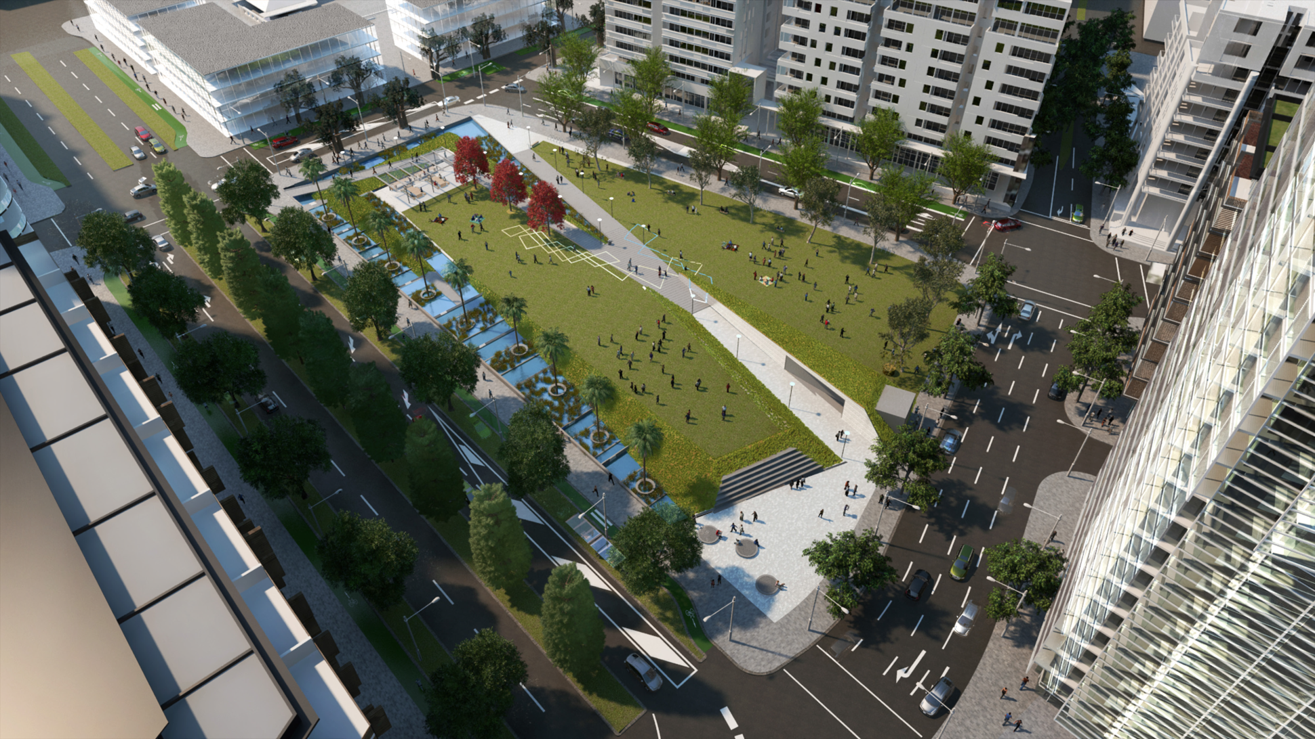
Drying Green Park – open space for wellbeing
public
facilities
new public
facilities
Notes:
The Drying Green, is Green Square’s urban park.
There has been a focus on open space delivery, with a number of new open spaces to be delivered throughout the renewal area – recognising the impact of open space on health and wellbeing.

Slide 17
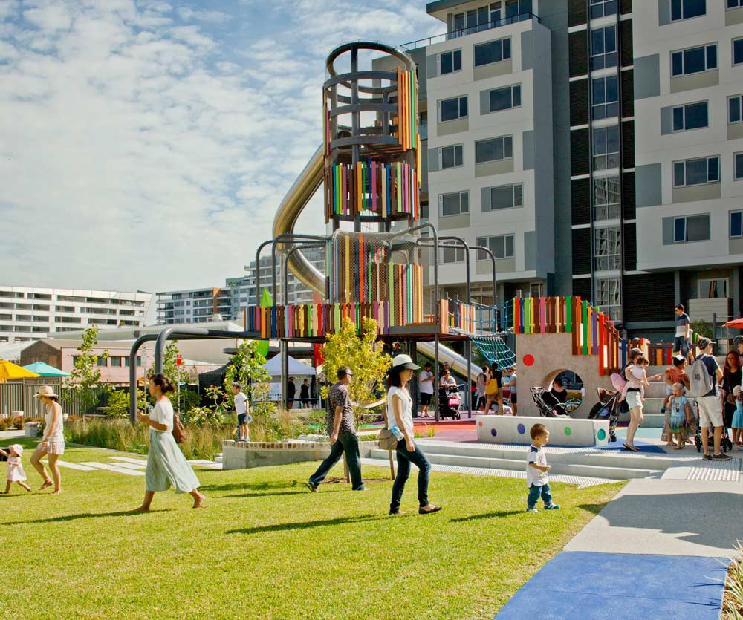
Drying Green park
Creating a child and family-friendly place; supporting quality of life and wellbeing
public
facilities
Notes:
The Drying Green, is Green Square’s urban park.
There has been a focus on open space delivery, with a number of new open spaces to be delivered throughout the renewal area – recognising the impact of open space on health and wellbeing.
Creating space for children and families is a key focus, and is an important part of the development given the numbers of children currently living there and forecast to live there in the future – many of whom will be living in high density housing – therefore requiring ample outdoor space for play.

Slide 18
Governance and aims for Green Square HIA
Green Square is a decision support HIA (as opposed to mandated, community-led)
It is coordinated by HERDU with input from SLHD (planning and integrated care), City of Sydney and CPHCE and community organisations.
The Green Square Steering Committee was established in August 2016 to oversee the HIA process and provide feedback on assessment findings, inform the development and implementation of the HIA recommendations.
The HIA aims to
    Identify the potential (direct and in-direct) health effects of the Green Square development as outlined in the Draft Infrastructure Strategy and Plan
    Recommend strategies and actions to be taken to provide better health outcomes for residents of Green Square
    Strengthen the ways in which the Green Square development can promote health and reduce health inequities.
Notes:
HIA is an structured solution-focused and action-oriented approach to maximising the positive and minimising the negative health impacts of new initiatives . It is both a technical exercise and a process

Slide 19
Method for Green Square HIA
  Pre-screening and scoping identified four dimensions of health impacts to consider including:
      child health and development
      transport
      community infrastructure and
      affordable housing.
  Assessment reports were based on a review of
      relevant policies
      the literature (black and grey)
      community forums and consultations and
      interviews with experts and key stakeholders.
  Draft final report due end of August
  Green Square Steering Committee convening in October 2017 to finalise and priorities recommendations and identify paths for implementation.

Slide 20
Why focus on child health and development?
• Children will be living in Green Square
False assumption that children don’t live in inner city high rise
Governments have historically underestimated the proportion of children living in new high rise developments in Sydney and consequently have not adequately planned for their needs. This practice has been called “Child Blind Planning”.
It is estimated that over 7,000 children aged 0-17 will reside in Green Square by 2030 (City of Sydney, 2015).
• The early years are an important time to address health inequities
Development in the early years, particularly the first three years, lays the foundations and sets the trajectory for children’s ongoing physical, social, emotional, and cognitive development.
• The built environment affects child health and development
        The design and implementation of healthy built environments in which young children can live, grow, and develop, has implications for health and well-being throughout the life course.

Slide 21
Built environment – vertical living and density
Bathroom’s big enough to fit a parent and child
Non carpeted entry area where parents can pull off wet jackets and muddy boots
No more than 12 units grouped together on the same hall or entry to foster a sense of community
A minimum of 130 square meters of outdoor play space somewhere in the complex – ideally where parents can see from the unit, with separate areas for preschools and older children
Landscaping with non-toxic plants that can withstand the rough and tumble of children's play
Soundproofing between units and sleeping areas that won’t be disturbed by proximity to living areas
In addition to clothes and linen closets, a minimum of 5.7cubic meters of bulk storage space within the unit or near the entry that can hold strollers, wheeled toys, suitcases and sports equipment
Lockable bicycle storage adjacent to a building entrance
Notes:
High density housing for families with children guidelines
Prepared by the City of Vancouver in 1992

Slide 22
Child health and development assessment report findings

Slide 23
Child health pathway
Direct Impacts
Intermediate Impacts
Potential Health Impacts
Bike and pedestrian infrastructure
Overweight and obesity
Physical activity
Access to parks and green space
Mental and physical health
Child health
Exposure to traffic
Perception of safety
Stigma and poor self esteem
Well being
Exposure to air pollution
Sleep disturbance
Quality of life
Traffic accidents
Child development
Overcrowding
Traffic injuries
Education outcomes
Access to schools/childcare
Parental stress
Social cohesion/networks
Poor quality housing
Child development
Living vertically
Family dysfunction
Behavioural problems

Slide 24
External environmental risks for Green Sq
Limited opportunities for physical activity and access to open and easily supervised space
Exposure to major arterial roads limiting walkability for primary aged children and exposing children to air pollution and injury via traffic accidents
No primary schools in the local area (within a 1km radius of the Green Square town centre), although five identified as needed in the Draft Infrastructure Strategy and Plan
Lag in developing infrastructure as population moves in: SLHD building new, innovative Health One as core health facility with pop up service in the interim.
Notes:
1. Limited opportunities for physical activity
Children living in neighbourhoods that lack safe active transport routes, local key destinations (including schools) and open spaces may limit opportunities for physical activity.
2. Exposure to traffic and air pollution
Living close to high traffic volumes and speed can expose children to air pollution and injury via traffic accidents. Those living close to major roads are at greatest risk.
3. Less access to local schools
Areas of high density commonly have fewer schools and of lesser quality than less dense neighbourhoods this is because regeneration commonly occurs in industrial areas where there was previously no need for nearby schools.
How the proximity of local schools impacts on health:
• Time spent with families
• Predictive of children’s level of physical activity (if within 1km of home more likely to walk)
4. Less access to local health care services, mothers and breastfeeding groups
A Green Square community consultation conducted in August 2016 revealed the following:
• The main health care services used by residents were GPs
• young parents travelled outside the area to access services prior to moving to Green Square
• There were community concerns about long wait times for GPs, and the lack of Chinese speaking health professionals.
• Residents had to travel long distances in heavy traffic to access care
• Lack of early childhood services (health checks), mothers groups and breast feeding groups, and allied health in particular speech and OT.
The health impacts of limited local health services on child health and development are that young families may delay seeking care, lost opportunities to build social connection and informal support network of families with young children, have to drive rather than walk or use active transport to access health care.

Slide 25
Internal environmental risks
High rise developments with insufficient space are not child friendly and can cause overcrowding, parental stress and limited development opportunities for children.
Children living in poorly designed and maintained housing are at increased risk of accidents (burns, falls) and weather extremes.
Heat and heat island effects can lead to heat exhaustion – where children and the elderly are most at risk.

Slide 26
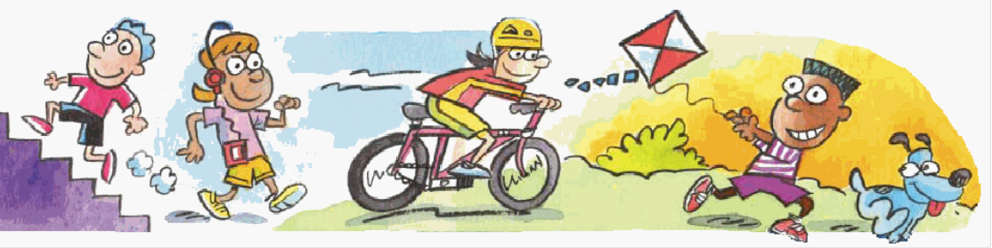
Differential impacts
Those most at risk of negative impacts include families
    under housing stress
    with young children
    who are renting
    with language barriers
    with children with a disability.

Slide 27
Draft recommendations – child health
• Advocate for a local school to be built within 1km of Green Square town centre
In line with Premier’s priority to reduce childhood obesity children should be encouraged and be able to walk to school or provide safe drop up and pick up areas for over 1,000 children.
• Examine the opportunities for local child care and preschools in Green Square that include multi lingual programs or speakers
• As well age-appropriate play grounds a number of Wild places should be provided where children can explore and build their own spaces in the natural environment
Health to consider how to deliver health services differently – how to provide home visits for new mother when it is difficult to park and access buildings
• Support high quality GPs with experience in child health to practice within Green Square and that cater to diverse language groups, especially Mandarin.

Slide 28
Science and art of an HIA
The focus of the HIA is not on the entire Green Square development it is on the Draft Infrastructure Strategy and Plan
HIAs are a step-wise process that enables us to integrate evidence to identify the likely health impacts of a plan in a timely way
However multiple government agencies have responsibility for implementing the recommendations such as placement of major arterial roads and the location of primary schools.
This is where the art of implementation, partnership and advocacy come into play.

Slide 29
How the HIA adds value to the City of Sydney’s roles and responsibilities and the development of Green Square

Slide 30
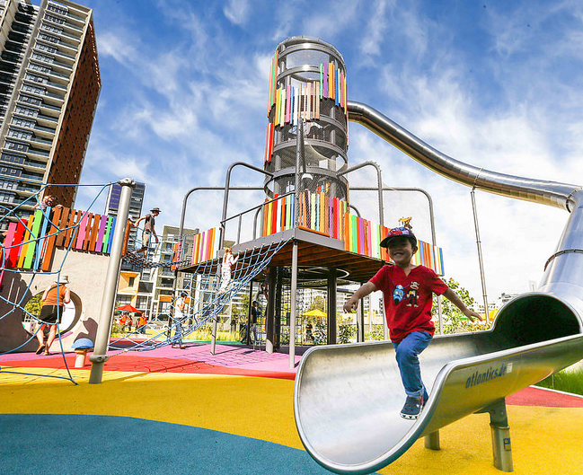
Better understanding communities’ needs to support health and wellbeing over time
Notes:
So we are really focusing on health and wellbeing:
Placemaking Strategy
Infrastructure Strategy and Plan
Community development and capacity building initiatives designed to connect incoming and surrounding communities
Engagement with other levels of government to seek to deliver a range of infrastructure to support quality of life and wellbeing
All of these areas of focus and delivery now are continuing and will be informed by this work across a range of areas:
Planning and program delivery in new facilities
Community development and capacity building
Ongoing advocacy and liaison with other levels of government to deliver infrastructure to support ongoing growth and development

