Slide 1
Evaluating Integrated Care
23 November 2017

Slide 2
Focus areas Chronic disease Multi-morbidity Integrated care Oral health Priority populations

Slide 3
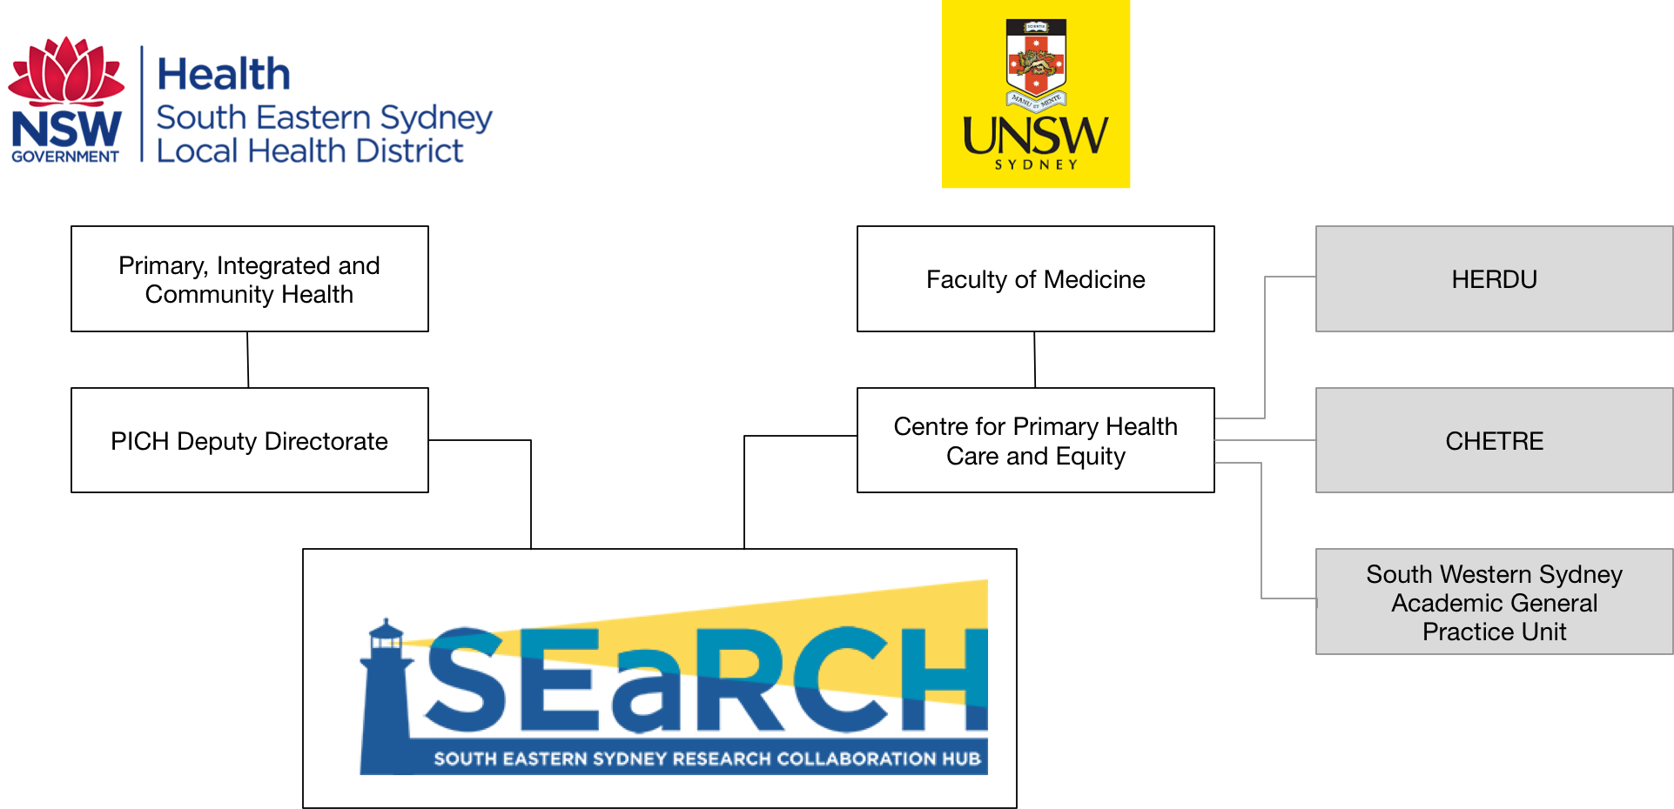

Slide 4
Examples of current SEaRCH projects
Evaluation of the SESLHD Integrated Care Strategy
Carers' information and technology needs
Evaluation of increasing access to and participation in cervical screening by Nepalese and Bangladeshi women in South Eastern Sydney project (2016-18)
Patient Activation Measure (PAM) Feasibility study on the use of PAM as a QI tool (Implementation Study)
Exploratory study on use of oral health data set to examine patterns of service utilisation
Building primary care capacity to increase screening participation within local communities: Bowel, breast and cervical cancer screening project
Extended family caregiving arrangements in families from Chinese backgrounds:Developing a culturally sensitive service response to enhance child development and wellbeing
Staying Well at Home Evaluation - Advice and support

Slide 5
Examples of other research we’re involved in
Advance Care Planning Translational Research Grant (Clinics) Project
SWSPHN After Hours Program Review and Model Development
National Evaluation of the Primary Health Networks Programme
45 & UP Primary and Community Health Cohort: A resource for local health planning in the Central and Eastern Sydney area
Community Diabetes Management Evidence Check Review
e-Shared Care Plan for Long-Term Cancer Care
Central and Eastern Sydney Bilingual Community Education Program
Review on the use of mHealth to promote healthy ageing

Slide 6
Governance and accountabilities SEaRCH Operational Group SESLHD Deputy Directorate CPHCE Steering Group

Slide 7
Next steps Strategic Framework (5 years) Location/cluster/network approaches - both PHC and priority populations Meeting the physical health needs of people with mental health conditions through PHC eHealth and informatics Meta-evaluation of integrated care initiatives

Slide 8
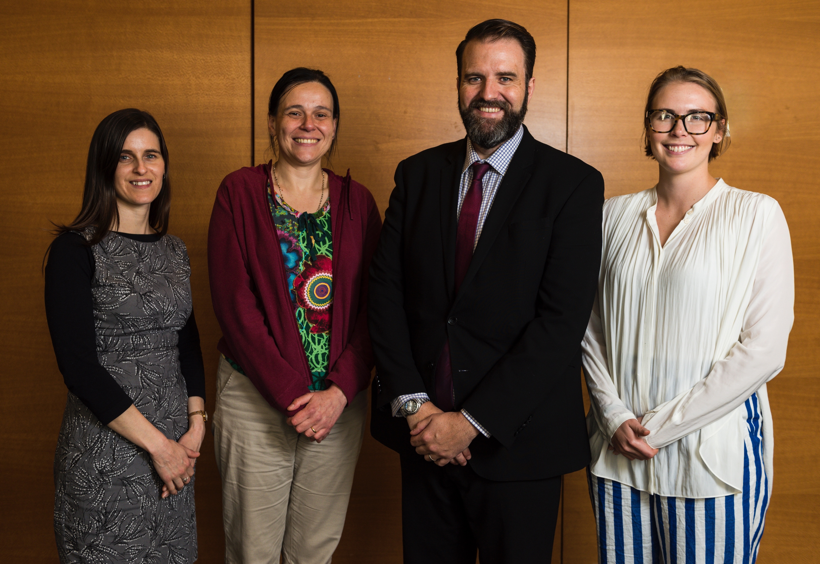
Contacts
Director
A/Prof Ben Harris-Roxas
b.harris-roxas@unsw.edu.au
Research Officer
Rachael Kearns
r.kearns@unsw.edu.au

