Slide 1





(Health) Equity Strategies & CPHCE
Evelyne de Leeuw
@evelynedeleeuw
@CHETRE_au
@UrbanHInc
@urban_healthy

Slide 2
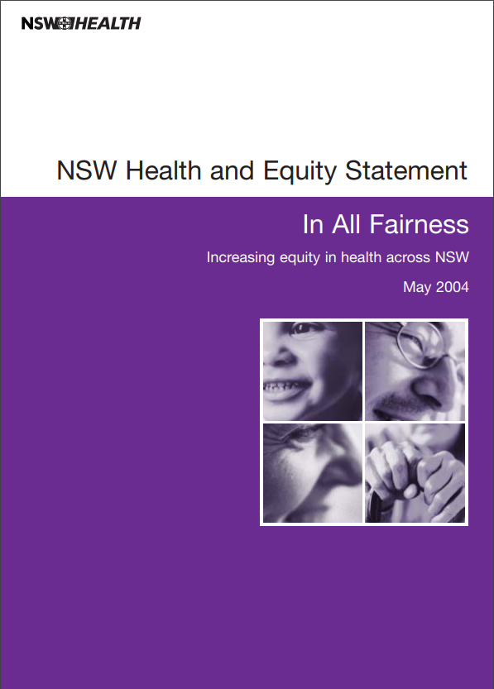
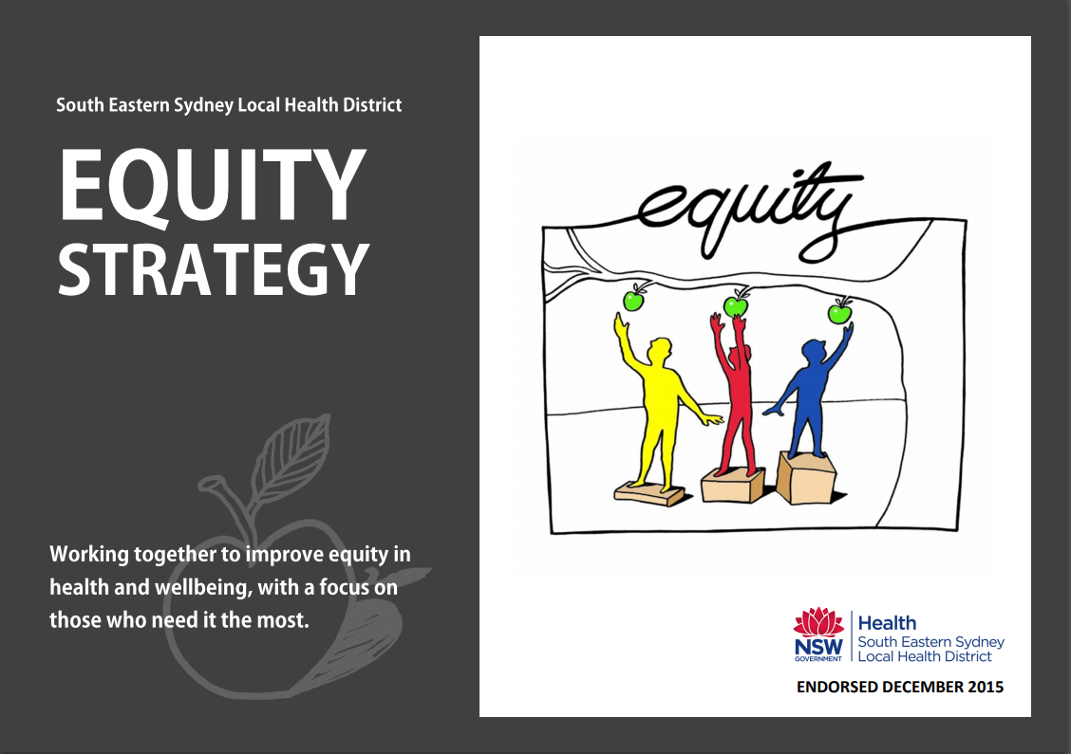
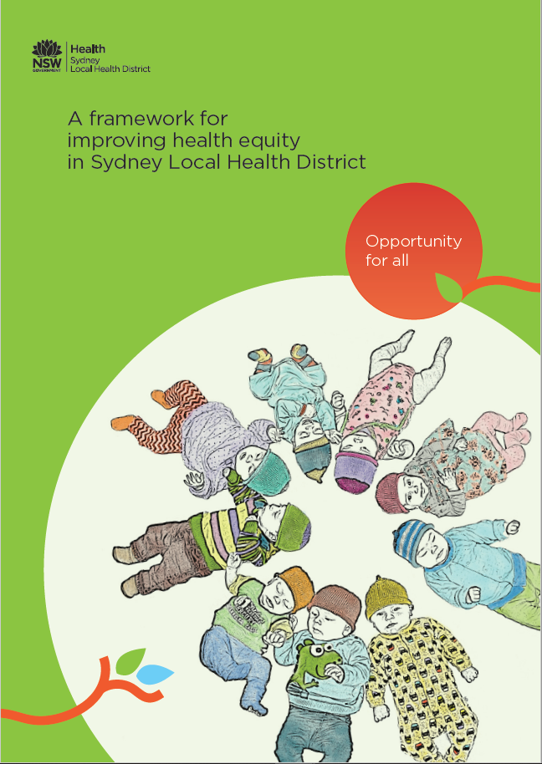
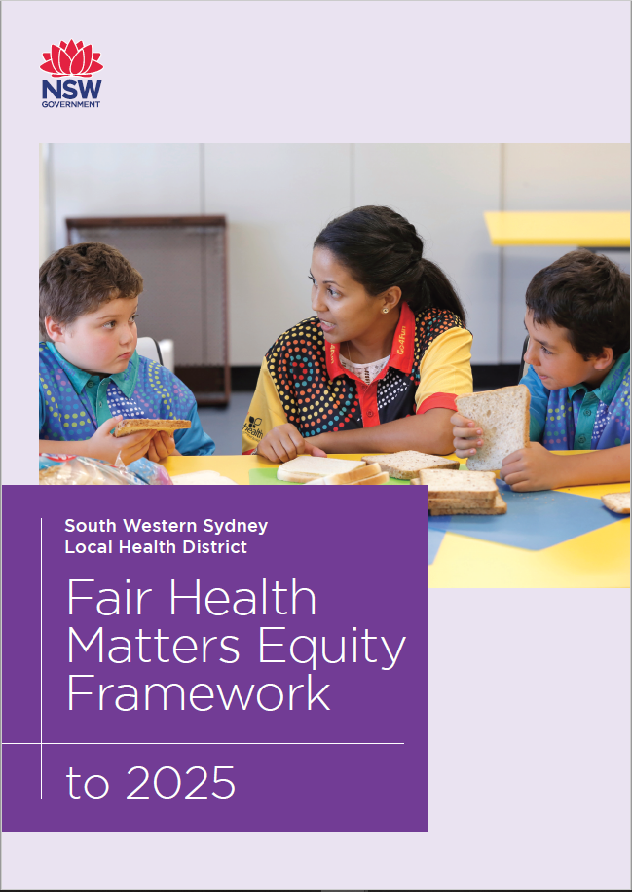
2004
2015
2017
2020

Slide 3
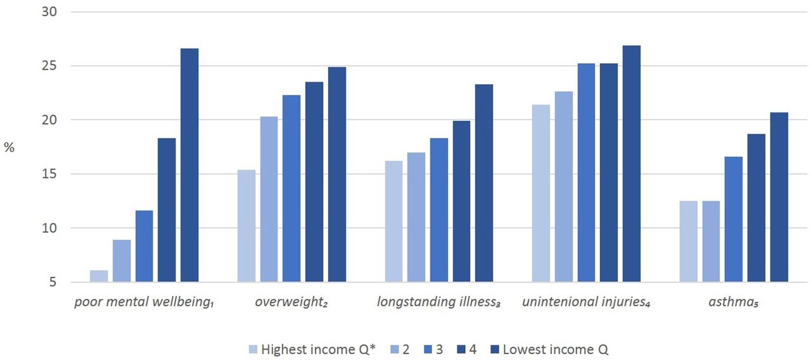
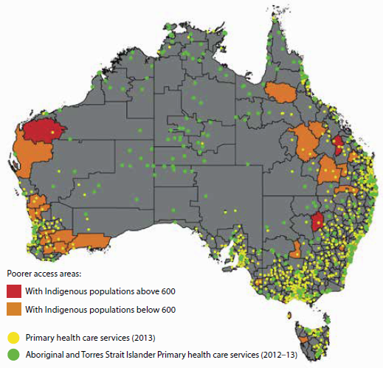
A quick reminder: what is (in)equity ?
Systemic, unfair and avoidable differences in health
Mostly expressed by social gradient or in maps
Figure 6.6.1: Areas where Indigenous Australians have poor access to primary health care services, by SA2, and location of services, 2012–13 and 2013
AIHW, 2015
Child health inequalities, UK Millennium Cohort Study (http://doi.org/10.5255/UKDA-SN-6411-7) (age 7 years, 2008). 1Borderline—abnormal total difficulties score, using the parent-reported Strengths and Difficulties Questionnaire. 2Including obese, applying International Obesity Task Force cut-offs to measured body mass index. 3Parent report of conditions that have troubled or are likely to trouble the child for a period of time. 4Medical opinion sought for one or more unintentional injuries occuring since the last survey (∼5 years). 5Parent report of the child having ever had asthma. *Quintiles, based on OECD equivalised household income.
Anna Pearce et al. Arch Dis Child 2019;104:998-1003

Slide 4
CPHCE is the pre-eminent health equity advocate
Action for Equity
Health System Integration and Primary Health Care Development
Health Environment
Informatics and eHealth
Prevention and Management of Long Term Conditions

Slide 5
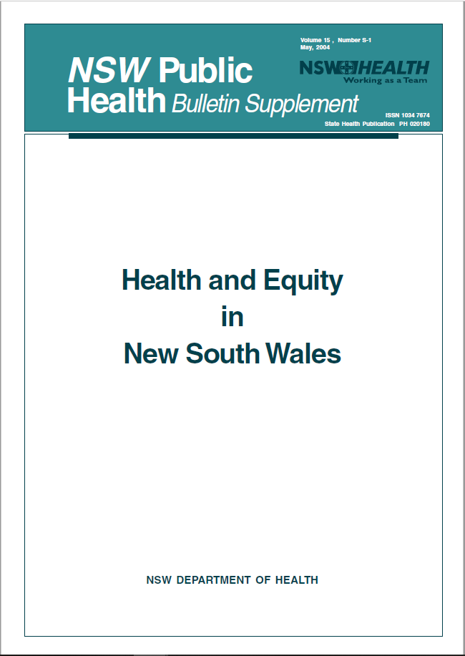
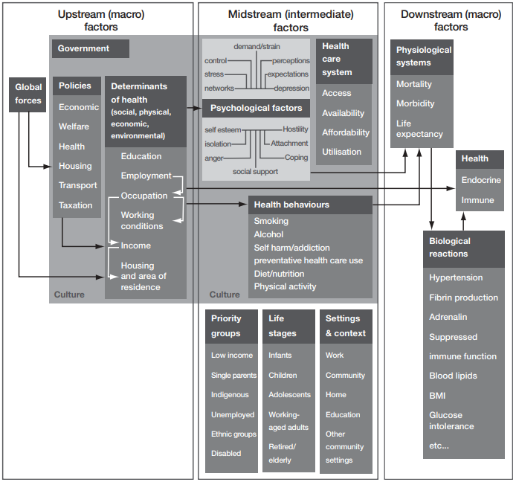
2004 – In All Fairness
Why?
Logic?
Equity has been a guiding principle for NSW Health for a number of years. Many initiatives including Strengthening Health Care in the Community, Families First, and Young People’s Health: Our Future, have been developed and implemented to reduce health inequities across a range of health issues and specific population groups. These initiatives have in general been successful in directing attention and resources to the health needs of particular groups. Nevertheless, at a health system level, it is evident the general improvements in population health and life expectancy achieved over time have not been equally shared across the population.
In All Fairness is a point of reference for the NSW health system to gauge current strategic directions, policies and programs in terms of reducing health inequities. It provides a framework for NSW Health to build on the good work that it is already being done, by acting as a platform for future planning and decision-making within the NSW health system to reduce the ‘gap’ in health outcomes. It also provides a foundation for integrating equity into the core business of NSW Health so that it becomes second nature in practice, in a similar manner to quality and safety.
1. Strong beginnings: investing in the early years of life
2. Increased participation: engaging communities for better health outcomes
3. Developing a strong primary health care system
4. Regional planning and inter-sectoral action
5. Organisational development: building our capacity to act
6. Resources for long-term reduction in health inequities
How?

Slide 6
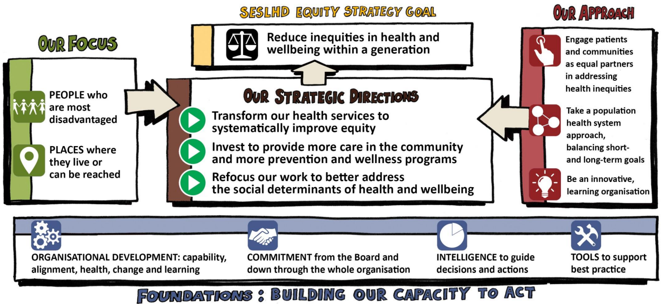
2015 – Equity Strategy
Why?
Logic?
We know that there are inequities in our world, our country and our District, and that these differences have direct and tangible consequences for the health and wellbeing of individuals and communities. There are differences in our socioeconomic positions, and the social and physical environments in which we live. There are differences in the vulnerabilities of individuals and groups, in their health beliefs, their risks and their health and wellbeing outcomes.
And we know that these differences are unfair.
We will directly challenge this. We will be bold in our ambitions for the communities we serve. We will engage with our communities. We will take a positive, long-term approach, seeing our service users, families, carers and communities not as consumers but as assets and partners in developing resilient, healthy communities. It is a task that is not to be underestimated, and will require a long-term and systematic commitment working with our partners, but it is one that we must and will achieve. Everyone has a role to play in transforming our health system into one that routinely and directly acts to recognise, understand and address inequities.
As a whole District, we aim to develop a culture in which our workforce is inspired and empowered to test new approaches to close the gaps in avoidable deaths and avoidable hospitalisation rates between our most disadvantaged people and places, as compared to the rest of the South Eastern Sydney population. We will address what matters the most, for those who need it the most, to improve their health and wellbeing.
Our Focus:
People who are most disadvantaged
Places where they live or can be reached
Our Strategic Directions:
Transform our health services to systematically improve equity
Invest to provide more care in the community and more prevention and wellness programs
Refocus our work to better address the social determinants of health and wellbeing
How?
Our Approach:
  We will engage people and communities as equal partners in addressing inequities
  We will take a population health system approach, balancing short- and long-term goals
  We will be an innovative, learning organisation
Our Foundations:
  Organisational development
  Commitment
  Intelligence to guide decisions and actions
  Tools to support best practice

Slide 7
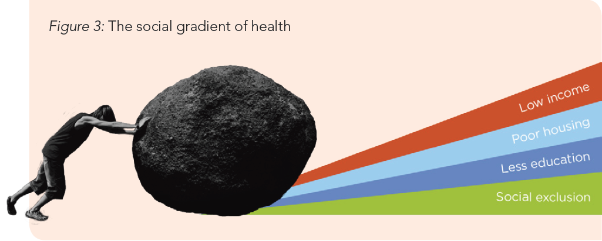
2017 – Opportunity for all – equity framework
Why?
Logic?
Health inequities are not the responsibility of health services alone, but they can be addressed in two aspects; looking in to the health care services provided and the way the organisation operates, and looking out to address the social determinants of health in the community and to work towards a fairer, more inclusive system.
Looking in:
• providing high quality individual health care for all that respects the diversity of the population, addresses the needs of the most disadvantaged, is accessible to all and used by those who need it most
• operating as an organisation in a way that promotes equity for staff and local communities.
Looking out, in partnership with the community and other organisations:
• prevention and health promotion that addresses the problems that are most important to disadvantaged individuals and communities
• supporting action on social determinants of poor health in the community, for example, social isolation or poor housing.
• working towards a fairer and more inclusive system, especially in health and social care.
Leadership and commitment: Making equity a priority for the District, and making it a part of reporting systems and quality improvement activities.
Engagement and partnerships: Involving disadvantaged and marginalised communities in decisions about their health and health care; and committing to long term partnerships with communities and other organisations to address problems in health equity and the social determinants of health.
Organisational and workforce development: Providing more training, better information and other forms of support to help clinicians, services, planners and managers identify and address inequities.
Resource allocation: Allocating and targeting resources to provide access to health care to all groups in the population, in proportion to need, and address the causes of unequal health.
Research and evaluation
How?

Slide 8
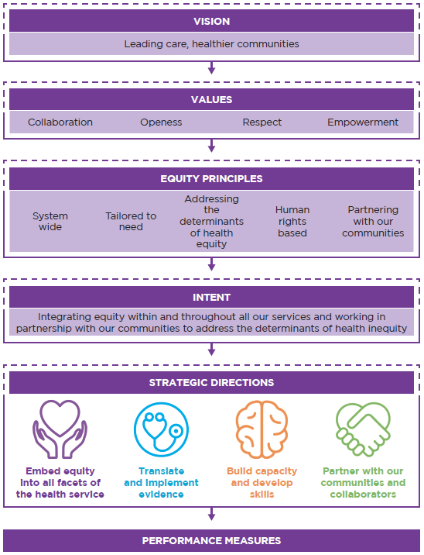
2020 – Fair Health Matters - Equity Framework
Why?
Logic?
Equity is a priority for South Western Sydney Local Health District
(SWSLHD). Our district is characterised by high levels of cultural diversity, a growing population, areas of low income, social housing areas with concentrated disadvantage, and significant numbers of newly arrived refugees and asylum seekers. SWSLHD has a history of leadership in tackling health inequities, and the Equity Framework to 2025 will further strengthen and prioritise this work. The Framework will ensure that our services effectively meet the needs of our communities through four strategic directions:
embedding equity into all facets of the health service;
using evidence and equity data to translate into practical implementation;
building capacity and developing skills; and
partnering with our communities and collaborators.
(…)
The district is highly diverse with a high proportion of the population born overseas, Aboriginal and Torres Strait Islander peoples and newly arrived refugees. It also has areas of socioeconomic disadvantage and high unemployment.
How?

Slide 9
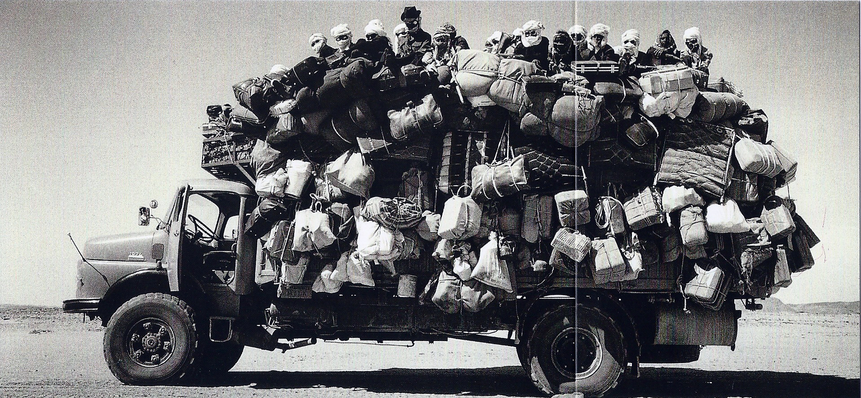
How does CPHCE progress this important work?

