Slide 1
Training of a Lay Navigator to Increase Equitable Access to Resources in the Community ARC
March 26th, 2018
Sydney, Australia

Slide 3
Investigators
Simone Dahrouge, PhD
Dept. of Family Medicine, University of Ottawa
François Chiocchio, PhD, PMP, CHRL
Telfer School of Management, University of Ottawa
Denis Prud’homme, MD, MSc
Institut de recherche de l’Hôpital Montfort /
Justin Presseau, PhD
Methodologist, Ottawa Methods Centre,
Monica Taljaard, PhD
Statistician, Ottawa Methods Centre,
Alain Gauthier, PhD
Centre for Rural and Northern Health Research
Manon Lemonde PhD (RN)
Nursing, Faculty of Health Sciences
Darene Toal-Sullivan, PhD, OT. Reg (Ont.)
Research Associate, Educator
Andrea Perna, PhD, MSc
ARC study Coordinator, Research Associate
Tanya Karyakina, Hon. BSc
ARC Research Assistant
Amélie Cardinal, Hon. BSc
Patient Navigator
Patrick Timony, PhD, MA
Sudbury ARC Study Coordinator
(Ottawa Methods Centre)
Notes:
Each site undertook a common process to address the gap identified in their region.
In Ottawa, Ontario, in the country’s capital, the gap identified was inadequate access to health enabling resources, and the main component of the intervention we implemented to address that is providing the support of a navigator.
This is the project I’ll be talking about

Slide 4
Local Innovative Partnership
Health Planners
Jacques Lemelin | Primary Care Network Lead
Karen Patzer | Senior Integration Specialist
Renee Lebovitz | Integration Specialist
Service Providers – Community Health Centres
Laura Muldoon | General Practitioner
Jennifer Simpson | Health Planner
Ana Mercedes-Guerra | Social Worker
Service Providers – Community Organizations
Michel Fournier | 211 services - Data Manager
Jeanne Bonnell | Home Care - Care Coordinator
Anne Desjardin | Home Care - Care Coordinator
Nada Hamade | Home Care – PC Integration
Patient Partners - Community Members
Guillaume Mulimbwa | Newcomers
Karen James | Mental Health and Addictions
Dee Campbell | Caregiver
Marie-France Proulx | Francophones
Ginette Carrière | Francophones
Knowledge Users – University of Ottawa
Shelby Allison | Medical Student
Erin Klar | Medical Student
Mike Hirsh | General Practitioner & Director, Social Accountability

Slide 5
Today’s Objectives
Presentation
Describe the ARC curricular design process
Share lessons learned
Group exercise
Example of developing competencies
Example of a role playing for motivational interviewing
Notes:
Describe the ARC team’s rigorous approach to the curricular design process
Discuss ARC Patient Navigator roles, competencies and training program
Share lessons learned and curriculum revisions for improvement
Apply the navigator competency in motivational interviewing (MI)

Slide 6
Current Knowledge in Navigator Training

Slide 7
Scoping review
No established standard or certification for navigator training
On-the-job training
5 to > 6 months period
dependent upon navigator role, clinical responsibilities, educational responsibilities
Background
Notes:
Length of training varies widely from 5 hours to 6 months” (O’Brien et al., 2009, p. S265); varied 12 hours to > 12 months (Ustjanauskas et al., 2015). Majority of studies used a combination of training concentrated in time and training distributed over time e.g weekly, monthly (Ustjanauskas et al., 2015); duration ranged from 6 hours to 3 months; some include an evaluation at completion of training (Goris, 2013)
-length of training depends upon complexity of patients receiving navigation and navigator role e.g. navigators that provide services to patients with diabetes receive more comprehensive and structured training, than for patients with hypertension (OBrien et al., 2009). Jolly et al. (2015) training for chronic kidney disease patient navigator: Freeman Institute, online course 36 hours over a 30 day period.

Slide 8
Format options
Set up
In-person courses – most common internally or conferences outside of the organization.
Web-based - less common
In the field - Shadowing
Background
Notes:
A survey of 226 community health workers and 44 employers in the United States was conducted to identify elements of scope of practice and training. Findings revealed that employers used “a patchwork of training strategies: 60% provided on-the-job training, 68% offered courses internally or made use of those offered outside the organization, and 56% offered short courses. Only 32% indicated that they provided a comprehensive skills-based course… the majority (93%) believed that a standardized training program would improve the effectiveness of CHWs at their organization (Findley et al., 2012, p. 1984-1985).

Slide 9
Format options
Ongoing
Oversight/debrief
Continuing education and skill development
Community of practice
Background
Notes:
A survey of 226 community health workers and 44 employers in the United States was conducted to identify elements of scope of practice and training. Findings revealed that employers used “a patchwork of training strategies: 60% provided on-the-job training, 68% offered courses internally or made use of those offered outside the organization, and 56% offered short courses. Only 32% indicated that they provided a comprehensive skills-based course… the majority (93%) believed that a standardized training program would improve the effectiveness of CHWs at their organization (Findley et al., 2012, p. 1984-1985).

Slide 10
The Curriculum Design Process

Slide 11
Curriculum Mapping
Needs Assessment
Stakeholder Consultation
Patients, PC providers, community members, Health TAPESTRY, Multicultural Health Navigators
Literature Review
Patient navigation training programs, scope of practice, different populations, various settings
Analysis of Context
Province of Ontario, Champlain Health Region
Navigation Roles/Activities
Competencies
Curriculum Design: General
Learning Objectives
Assessment of Learning
Program Topics
Learning Resources
Delivery Format
F2F, Online
Teaching Strategies
Notes:
Curriculum mapping activity was undertaken in which navigator roles in primary care were determined and aligned with key competencies. The applied skills and knowledge related to each competency were then identified with corresponding learning objectives, training content and assessment strategies.
Navigator curriculum conceived as an iterative process to ensure constructive alignment. See slide # 34

Slide 12
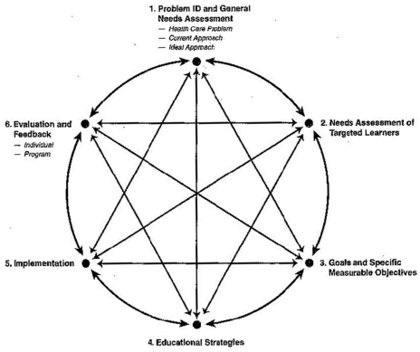
Curriculum Development Model
◆

❖
Curriculum Design: General

⬥
Adapted Kern et al. (2009)

Notes:
Curriculum planning
-Planning by intentions, principles to guide teaching
“Recognizes that teaching and learning are not causally related” (Fish & Coles, 2005, p. 71). Knowledge resides in both teacher and learner.
While there may be shared goals, learners will also develop own goals of learning.
Kern et al. state that this is a loop system; meaning evaluation and feedback results (step 6) drive to improve curriculum, learning of participants, and gain support, resources for curriculum.
Circle depicts that curriculum development never ends; it evolves based on feedback, larger social political and cultural influences; changing learners. They also advise that we often work on more than one step at a time; progress on one step influences others; this is illustrated by the two-way arrows in the diagram. For example limited resources (step 5) may limit the scope of your objectives (Step 3)

Slide 13
◆ ARC - Problem & Needs
Primary Care Providers:
Primary Care Patients:
.
Limited AWARENESS of resources
Limited TIME
to share information
Limited AWARENESS of resources
.
Limited knowledge to NAVIGATE a complex system
Lack of SUPPORT to overcome barriers
Curriculum : Needs Assessment

Slide 14
◆ ARC - Problem & Needs
Priority Access Gap and Need for Navigation
Curriculum : Needs Assessment
Barriers to access
community resources
Underutilized health
and social services
Increased unmet health needs and inequities

Slide 15
❖ ARC - Learner needs (Role)
Most common needs areas:
Care coordination
Overcoming barriers to care (e.g. financial, transportation)
Psychosocial needs
Navigator skills (communication, cultural competency, developing trust relationships)
Health education
Curriculum : Needs Assessment

Slide 16
❖ ARC - Learner needs (Role)
Research evidence
LIP core team
Focus groups, interviews, stakeholder consultation
Consultation with other Canadian programs
Multicultural health navigators,
McMaster University Health TAPESTRY navigation program
Curriculum : Learner’s Needs
Notes:
based on Kern et al. (2009)
2. Could be surveys or interviews
Research Evidence
Critically studied the primary care practice setting to understand the complexity of patient care and to prepare learners for navigation in this context.
LIP Core Team
Our LIP was our “Curriculum Committee” which provided expertise in knowing the primary care context (Primary Investigator and members of research team, policy and decisi on-makers), practice (primary care providers), knowledge of the learners (MHNs), lived experience of patients and families (patient partners), and knowledge of education (research associate). Provided feedback on navigator roles, competencies, learning objectives and educational content. Training program graduates:

Slide 17
⬥ Program Goals: Approach
Theoretical foundation
Learning objectives
Identification of competencies
Curriculum : Program Goals
Notes:
based on Kern et al. (2009)
2. Could be surveys or interviews

Slide 18
⬥ a) ARC - Theoretical Foundation
Founded in humanistic and sociocultural theories of learning
Main tenets :
Authentic problem-centred practice
Agency of the learner and self-directedness
Experiential, participatory and collaborative learning
Critical thinking
Peer mentorship
Curriculum : Program Goals
Notes:
The learner-centred curriculum is founded in humanistic and sociocultural theories of learning with main tenets as: authentic problem-centred practice, agency of the learner and self-directedness, experiential, participatory and collaborative learning, critical thinking, peer mentorship.
Based on the above identified goal and the required competencies for each navigator role, a theoretical foundation was chosen for the training program which was consistent with the patient-centredness and the social interaction, problem-oriented approach to helping others which is essential to patient navigation.
Social constructivism (Braungart & Braungart, 2007) acknowledges that factors such as culture, social support, previous experiences, and the person’s life situation influences their knowledge, emotions and how they respond to a situation (e.g health problem).

Slide 19
⬥ b) Learning Objectives
Participants will develop the knowledge, skills and abilities to work with primary care practices to support individuals experiencing social barriers reach community health and social resources.
Curriculum : Program Goals

Slide 20
⬥ b) ARC - Learning Objectives
Identified the foundational knowledge and skills for patient navigation through review of evidence and other Navigation Programs
e.g.
Colorado Patient Navigator Training Collaborative http://patientnavigatortraining.org/
McMaster University Health TAPESTRY http://healthtapestry.ca/
IMPaCT: Penn Center for Community Health Workers http://chw.upenn.edu/
Curriculum : Educational Strategies
Notes:
The Online training is the foundation for the subsequent sessions and is therefore completed first, followed by the F2F sessions. Community mentorship is provided by experienced Multicultural Health Navigators at Somerset West Community Health Centre (SWCHC) for the duration of the time the ARC Patient Navigator is working in the primary care practice.
12 Online modules=expected time for completion: 12 hours
F2F=13 hours

Slide 21
⬥ b) ARC - Learning Objectives
Describe the ARC project and the scope of the Patient Navigator role.
Apply basic knowledge and skills in cultural humility and health literacy to navigation.
Demonstrate effective communication skills with the primary care team and patients, and sensitivity in working with underserved populations.
Know how to help patients identify goals and priorities related to their health and develop an action plan to reach this goal.
Know how to problem-solve barriers to patients’ self-care and support their self-management
Identify social barriers to access community health and social resources and ways to assist patients to reach these resources.
Identify and appraise available community resources and programs to ensure that they are appropriate and relevant for patients’ needs and goals.
Demonstrate the ability to document navigation activities and gather data for the ARC project as required.
Curriculum : Program Goals

Slide 22
⬥ c) Competencies
“What a person should be able to do upon completion of the training”
Competencies define the applied abilities including skills and knowledge that are required by people to successfully perform a particular role.
Curriculum : Program Goals
Notes:
Competence-based Approaches
Health professionals required to be competent in many different domains of practice
Ability to apply scientific knowledge to practice, communicate effectively, present in a professional manner and work collaboratively with colleagues. (Kuper & D’Eon, 2011; Malone & Supri, 2010; Royal College of Physicians and Surgeons of Canada, 2015).
Competencies are defined first. A curriculum is then developed based on what is needed for learners to acquire these competencies.
Competence-based education has been instituted in Canada, US, and the UK as a means to address changes in practice, so that students are required to demonstrate not only the ability to apply scientific knowledge to practice, (rather than memorize facts), but also the scholarly and social competencies needed for practice (Malone & Supri, 2010; Royal College of Physicians and Surgeons of Canada, 2015).
Process of competency-based education:
List competencies
Devise training programs to fit these
Use appropriate assessment methods
Determine pass levels

Slide 23
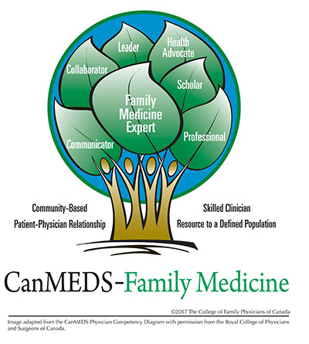
⬥ c) Example: Competencies
Curriculum : Program Goals
Adapted from CanMeds, CFPC
Notes:
CANMED IS A COMPETENCY FRAMEWORK.
ARC Patient Navigator competencies informed by CanMEDs, other health professional competency frameworks, and non-clinical navigation competencies.
George Washington University Cancer Institute, 2014; Lorhan et al., 2014; Royal College of Physicians and Surgeons of Canada, 2015

Slide 24
⬥ c) ARC - Competencies
Navigator (integrating role)
Communicator
Collaborator
Advocate
Educator
Professional
Educator
Navigation
Curriculum : Program Goals
Notes:
CANMED IS A COMPETENCY FRAMEWORK.
ARC Patient Navigator competencies informed by CanMEDs, other health professional competency frameworks, and non-clinical navigation competencies.
George Washington University Cancer Institute, 2014; Lorhan et al., 2014; Royal College of Physicians and Surgeons of Canada, 2015

Slide 25
⬥ c) Competencies
Activity
Competencies
Curriculum : Program Goals
Notes:
based on Kern et al. (2009)
2. Could be surveys or interviews

Slide 26
⬥ c) ARC - Example Communicator
Competency:
Communicator
Activities
Activities | Key Competencies
Interacts with PC, patients and community resources | Demonstrates effective interpersonal and communication skills
 | Demonstrates knowledge of health literacy and cultural humility
Encourages patients to engage in self care | Applies appropriate communication skills to motivate
Curriculum : Program Goals
Notes:
based on Kern et al. (2009)
2. Could be surveys or interviews

Slide 27
⬥ Exercise (10 minutes)
Identify three key activities
Map each to a competency
For each identify key/Enabling competencies
“What a person should be able to do upon
completion of the training”
Curriculum : Program Goals
Activities
Competency
Key/Enabling
Competencies

Slide 28
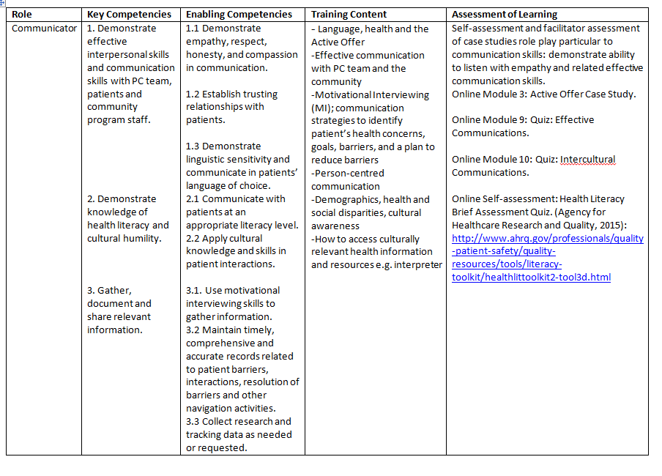
Communication
Curriculum : Program Goals
Notes:
The curriculum was then developed based on what was needed for learners to acquire these competencies. (See column on training content)

Slide 29
 Training Content
Activities
Competency
Key/Enabling
Competencies
Training content
Curriculum : Educational Strategies
Notes:
based on Kern et al. (2009)
2. Could be surveys or interviews

Slide 30
Training Content
Curriculum : Educational Strategies
Notes:
The curriculum was then developed based on what was needed for learners to acquire these competencies. (See column on training content)

Slide 31
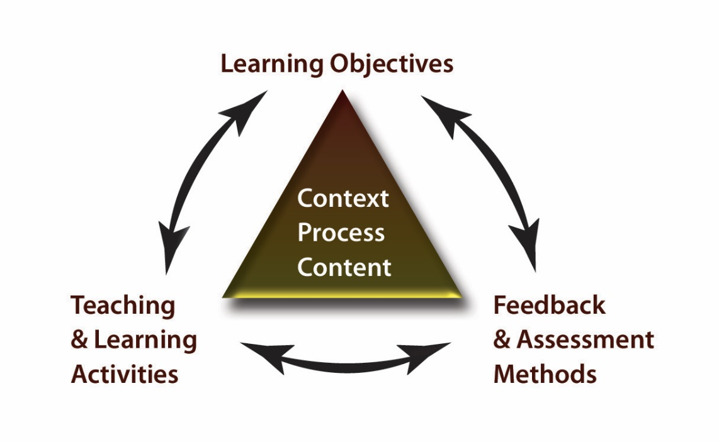
 Constructive Alignment
We ensured that the learning objectives, teaching strategies, learning resources and assessment align, with the intended navigator role and competencies.
Curriculum : Educational Strategies
Biggs (2003).
Notes:
The 'constructive' aspect refers to the idea that students construct meaning
through relevant learning activities. That is, meaning is not something imparted or transmitted from teacher to learner. We accomplished this through our active learning e.g. group discussion, role play, case studies.
Alignment: The teaching methods used and the assessment tasks, are aligned with the intended learning objectives.

Slide 32
 ARC - Training Format
1. Begin Training
2. Online Modules
4. Role playing
3. Face to Face
5. Oversight & Community support
Navigator Toolbox
Info Sheets
Learning Resources
Logs
Discussion Board
Complete for Modules:
2, 3, 4, 8, 9, 10
Navigator workbook
Complete for Modules:
1, 2, 3, 6-12
Community Resources
2a.
2b.
Curriculum : Educational Strategies
6. Assessment: Formative, summative, in the field (self-assessment)

Slide 33
 ARC - Eg of on Line Training
For the role of Communicator and related Competencies:
Describe a patient for whom Motivational Interviewing would be beneficial.
Describe the stages of Behavioural Change and the use of RIC scales (Readiness, Importance and Confidence)
Name and explain the guiding PRINCIPLES of MI
Name the anchoring communication SKILLS of MI
Curriculum : Evaluation
Notes:
The Online training is the foundation for the subsequent sessions and is therefore completed first, followed by the F2F sessions. Community mentorship is provided by experienced Multicultural Health Navigators at Somerset West Community Health Centre (SWCHC) for the duration of the time the ARC Patient Navigator is working in the primary care practice.
12 Online modules=expected time for completion: 12 hours
F2F=13 hours

Slide 34
 ARC - Face to Face Content
Patient Navigation in Primary Care and the ARC Study
Culture, A Social Determinant of Health
Language, Health and Active Offer
Motivational Interviewing
Advocacy and Empowerment
Learning from the field: Multicultural Health Navigators’ Experience
* All F2F session audio-recordings and content now posted online
Curriculum : Educational Strategies
Notes:
F2F training involved a team-based approach to training, involving navigators, educators with different professional backgrounds, and research team members.

Slide 35
 ARC - Oversight and mentorship
Bi-weekly meetings with experienced multicultural health navigators (MHNs)
Weekly meetings with ARC Research Coordinator for supervision, problem-solving and sharing of knowledge
e.g.
How to determine patient’s readiness to engage in a community resource and how to facilitate motivation
Complexity of patient needs and appropriateness for navigation
Curriculum : Educational Strategies
Notes:
The ARC Patient Navigator meets with the Multicultural Health Navigators (MHNs) at SWCHC for learning, guidance and support. These meetings provide an opportunity for navigators to debrief about patients, share resources, and participate in ongoing education activities.
Community mentorship is provided for the duration of the time the Navigator is working in the primary care practice.

Slide 36
 ARC - Implementation
Piloted in May-June 2017, with new navigators participating in the program since this date.
Participants include patient navigators, research team members, and medical students working with vulnerable populations.
Participants complete online learning prior to F2F sessions.
Curriculum : Implementation
Notes:
Training program was piloted in May-June 2017, with new navigators participating in the program since this date.
Participants include patient navigators, research team members, and medical students working with vulnerable populations.
Participants complete online learning prior to F2F sessions.

Slide 37
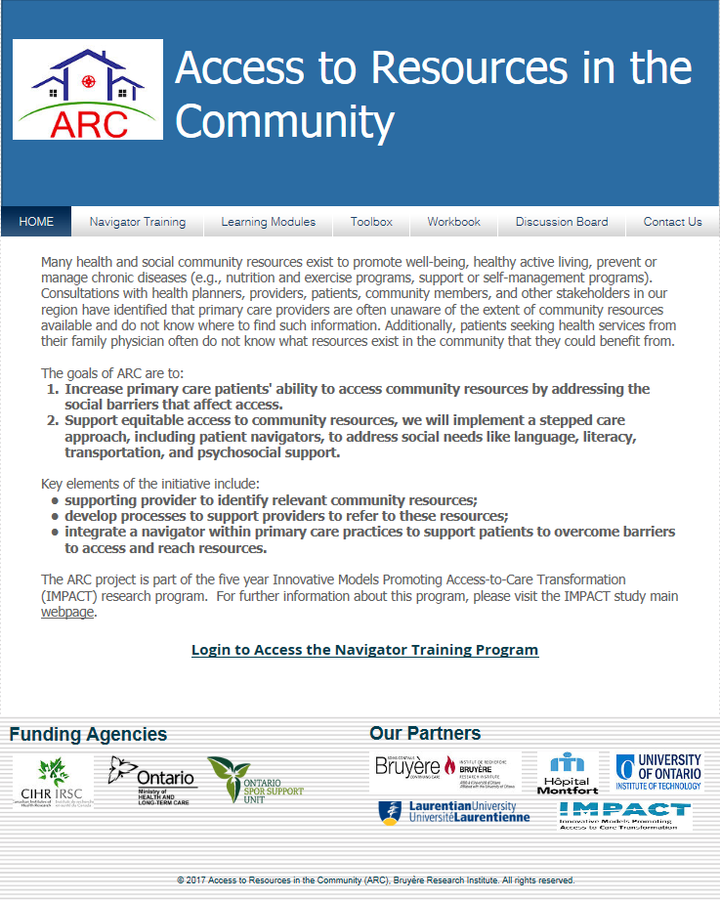
Curriculum : Implementation
https://researchprogram.wixsite.com/arcproject
Notes:
https://researchprogram.wixsite.com/arcproject
Login
Email: DToalSullivan@bruyere.org
Password: ARC2017

Slide 38
Curriculum : Implementation
Notes:
https://researchprogram.wixsite.com/arcproject
Login
Email: DToalSullivan@bruyere.org
Password: ARC2017

Slide 39
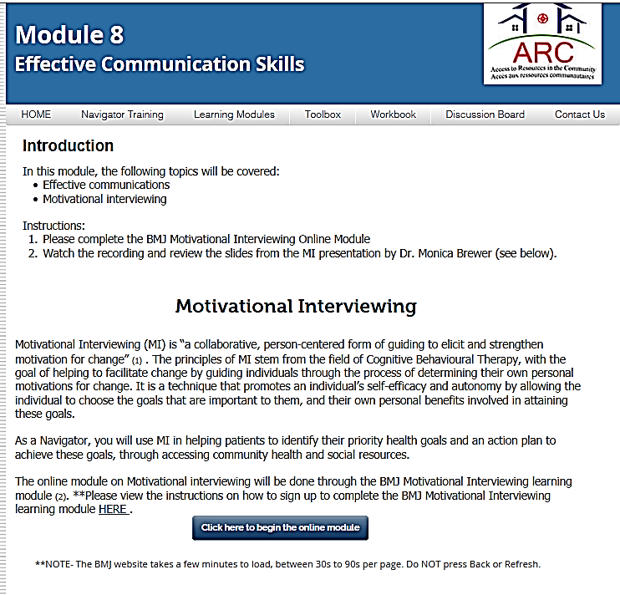
Curriculum : Implementation
Notes:
https://researchprogram.wixsite.com/arcproject
Login
Email: DToalSullivan@bruyere.org
Password: ARC2017

Slide 40
 ARC - Implementation
Motivational Interview Slides
Motivational Interview Audio
Participants include patient navigators, research team members, and medical students working with vulnerable populations.
Participants complete online learning prior to F2F sessions.
Curriculum : Implementation
Notes:
Training program was piloted in May-June 2017, with new navigators participating in the program since this date.
Participants include patient navigators, research team members, and medical students working with vulnerable populations.
Participants complete online learning prior to F2F sessions.

Slide 41
 Training Evaluation
Activities
Competency
Key/Enabling
Competencies
Training content
Training Evaluation
Curriculum : Educational Strategies
Notes:
based on Kern et al. (2009)
2. Could be surveys or interviews

Slide 42
Curriculum : Evaluation
Notes:
The curriculum was then developed based on what was needed for learners to acquire these competencies. (See column on training content)

Slide 43
 ARC – Evaluation & Feedback
During and post-training:
F2F role play and case studies
Survey post each F2F session
Online Case Studies, Quizzes, Discussion Workbook Questions
In the field:
Periodic assessment: Navigator Log
Ongoing: Navigator Reflection Guide
Curriculum : Evaluation
Notes:
IN THE FIELD
Periodic assessment is required after 5, 10, 20, 25, 30, 35, 40 patients. The navigator enters their response to the following questions in the Navigator Log.
Think about specific clients and encounters with them. What were you thinking, feeling, during that visit:
Describe your interaction with the client. Did anything specific stand out?
What did you feel prepared for?
What did you not feel prepared for?
What would you do differently?
What is an important learning that you will take forward with other clients?
Write any questions or concerns that you have to discuss with other navigators or the local project coordinator at the next community mentorship meeting. This meeting is an important form of professional development and an opportunity for you to share your concerns, receive support and guidance.
Ongoing: Reflection Guide (Navigator completes weekly entries in journal guided by questions to prompt reflection on day-to-day practice)

Slide 44
Lessons Learned

Slide 45
ARC – Lessons Learned
More time required for practical learning activities: case studies, communication skills
Provide tools for self-assessment: e.g. cultural competency
Discuss compassion fatigue and self-care for navigators
More information on patient empowerment
Consider potential for mentorship within the practice
Curriculum : Lessons
Notes:
Mentorship within the practice: With the navigator situated within the practice, the navigator and PCP there is an opportunity for shared learning: e.g. navigator informs PCP about community resources; PCP guides navigator about patient need for support

Slide 46
ARC – Conclusions
Curriculum mapping enabled the development of a comprehensive program, consistent with CBE
Development of content for unique navigation role in primary care
Collaboration with McMaster University Health TAPESTRY was integral to development of content and learning resources
Curriculum : Lessons

Slide 47
ARC – Conclusions
Mentorship is essential to ongoing professional development and learning in the field
Training program is an iterative process; further development and plans for scalability are currently underway.
Curriculum : Lessons

Slide 48
References
Biggs, J. B. (2003). Teaching for quality learning at university (2nd ed.). Buckingham: Open University Press/Society for Research into Higher Education.
Colorado Patient Navigator Training Collaborative. http://patientnavigatortraining.org/
Colorado Patient Navigator Training Collaborative. http://patientnavigatortraining.org/
DeGroff, A., Coa, K. Morrissey, K. G. et al. (2014). Key considerations in designing a patient navigation program for colorectal screening. Health Promotion Practice, 15(4), 483-495.
Grant, J. (2002). Learning needs assessment: Assessing the need. BMJ, 324, 156–159. http://www.bmj.com/content/324/7330/156
Kern, D. E., Thomas, P. A., & Hughes, M. T. (Eds). (2009). Curriculum development for medical education. A six-step approach (2nd ed.). Baltimore, MD: The Johns Hopkins University Press.

Slide 49
References
Kangovi, S. K., Clayton, K., Chanton, C., McCollum, S., White, M., Carter, T., Grande, D., Long, J. A. (2014). IMPaCT (Individualized Management for Patient-Centered Targets) Director Manual. http://chw.upenn.edu
Lorhan, S., Wright, M., Hodgson, S., & van der Westhuizen, M. (2014). The development and implementation of a volunteer lay navigation competency framework at an outpatient cancer center. Supportive Care in Cancer, 22(9), 2571-2580.
McKenney K.M. Martinez, N.G., Yee L.M. (2018) Patient navigation across the spectrum of women’s health care in the United States. American Journal of Obstetrics & Gynecology, 280(March), 280-286
McMaster University Department of Family Medicine Health TAPESTRY
The George Washington University Cancer Institute (GWUCI). (2014). Core Competencies for Non-Clinically Licensed Patient Navigators.
The College of Family Physicians of Canada. (2017). CanMEDS Framework. http://www.cfpc.ca/canmedsfm/
Ustjanauskas, A., Bredice, M., Nuhaily, S., et al.( 2016). Training in patient navigation: A review of the research literature. Health Promotion Practice, 17(3), 378-381.

Slide 50
Some of our Participants in ARC Patient Navigator Training

Slide 51
Questions?

