Slide 1
Social Isolation and Loneliness amongst people aged over 45 years in Central and Eastern Sydney: CES-P&CH analysis
Margo Barr
Centre for Primary Health Care and Equity

Slide 2
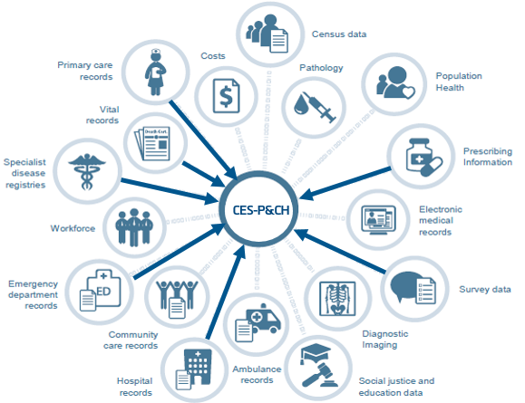
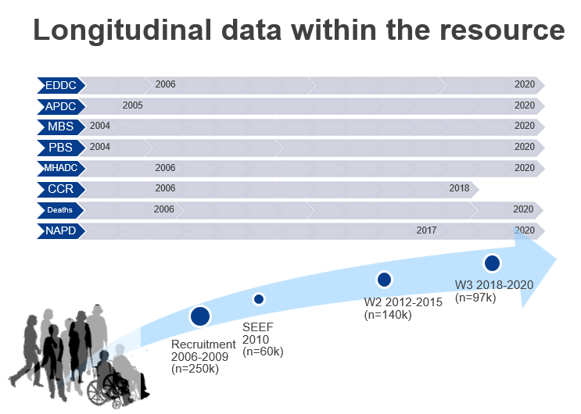
Linkage Resource
Cohort: over 250k NSW residents (45 and Up Study); 30,645 in CES (20,337 in SES and 10,308 in Sydney)
Resource: 10 datasets; over 172.7 mil records in NSW and 20.7 mil recodes for CES; 2006 onwards.
Modified from figure in Bureau of Health Information. Data Matters – Linking data to unlock information. The use of linked data in healthcare performance assessment. Sydney (NSW). 2015; BHI
Link to CES-P&CH web page:
https://cphce.unsw.edu.au/research/health-system-integration-and-primary-health-care-development/central-and-eastern-sydney

Slide 3
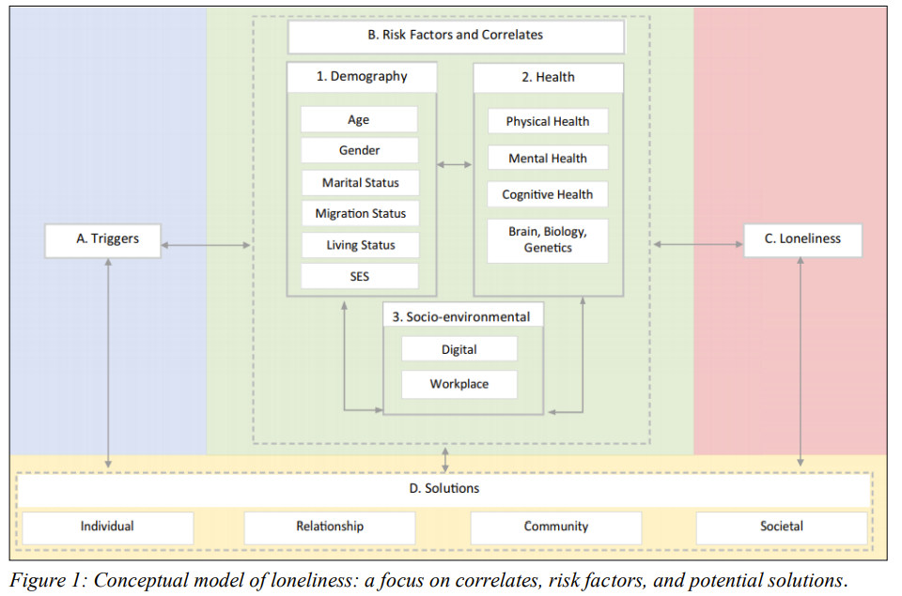
Rational/Gaps identified as a potential risk factors for poor health outcomes and inappropriate or inadequate service use understanding relationships between social isolation and loneliness
Lim, MH, Eres R, Vasan S (2020) Understanding loneliness in the twenty-first century: an update on correlates, risk factors, and potential solutions. Social Psychiatry and Psychiatric Epidemiology. Vol. 55, no. 7, pp. 793-810.

Slide 4
Methods
Identified people in CES (6,176 in 2010, and 4,833 in 2020)
Used the social interaction subscale of the Duke Social Support Index
Used the De Jong Loneliness Scale (added to the 2020 questionnaire)
PR and 95% CI calculated using generalised linear model with Poisson family and log link function
PRs were adjusted for the potential confounders which were found to be associated with social isolation or loneliness at p<0.20

Slide 5
Tools
Social isolation
Measured using the Duke Social Support Index - Social Interaction subscale (George et al., 1989)
4 questions about family connections, social contacts and interactions and attendance at groups
All questions need to be answered. Responses summarised to a score of 4-12 with ≤8 being classified as socially isolated
Loneliness
Measured using the De Jong Loneliness Scale (de Jong Gierveld and van Tilburg 2006)
6 questions: 3 about emotional loneliness (emptiness, miss having people around, feel rejected) and 3 about social loneliness (not having people to rely on, people to trust, people feel close to)
All questions need to be answered. Responses summarised to a score of 0-6 with 4 plus being classified as lonely

Slide 6
Factors associated with living alone and social isolation in CES (2010)
Characteristic |  | Social Isolation | Loneliness
Demographic | More likely
 | Less likely | Aged between 60 and 84 years Being female Having school certificate or higher (compared to no schooling) Having private health insurance
Social and medical factors | More likely | Full-time worker Current smoker Self-reporting poor quality of life Self-reporting heart disease Self-reporting anxiety
 | Less likely | Living alone Being a parent Undertaking adequate physical activity Eating adequate fruit and vegetable Consuming alcohol Needing help for their daily activities

Slide 7
Factors associated with living alone, social isolation and loneliness 2020
Characteristic |  | Social Isolation | Loneliness
Demographic | More likely
 | Less likely | Aged 60 plus Being female Having school certificate or higher (compared to no schooling) Having private health insurance | Aged 85 plus Being female Having private health insurance
Social and medical factors | More likely | Full-time worker Current smoker Self-reporting poor quality of life Self-reporting anxiety | Living alone High psychological distress Self-reporting poor quality of life Self reported anxiety
 | Less likely | Living alone Being a parent Undertaking adequate physical activity Eating adequate fruit and vegetable Consuming alcohol Needing help for their daily activities | Self-reported cancer Being a parent Currently married Self reported diabetes

Slide 8
Service use and mortality SEEF (2010)
Service use/Mortality | Not socially isolated N=4963 | Socially isolated N=1213 | Crude PR (95% CI) | Adj. PR (95% CI)
 | n (%) | n (%)
High GP use (>13 visits/ year) | 761 (15.3) | 201 (16.6) | 1.08 (0.92, 1.26) | 0.92 (0.76, 1.10)
High Hospital use (1+ ED visits/ year) | 341 (6.9) | 88 (7.3) | 1.06 (0.83, 1.33) | 0.86 (0.64, 1.12)
High ED use (1+stays/year) | 311 (6.3) | 100 (8.2) | 1.32 (1.05, 1.64) | 0.99 (0.75, 1.30)
Died within 5 years of enrolment | 323 (6.5) | 111 (9.2) | 1.41 (1.13, 1.74) | 0.94 (0.72, 1.22)

Slide 9
Summary
2010
Overall, 19.6% of the cohort were classified as socially isolated.
Living alone was sig less likely to be associated with social isolation.
No difference in high service use or mortality for those socially isolated.
2020
Overall, 41% of the cohort were classified as socially isolated and 43% were classified as lonely.
25% of the cohort were both socially isolated and lonely.
Increased rates because of more negative answers to questions in loneliness scale and in social isolation scale.
Yet to examine association between loneliness and service use or mortality.

Slide 10
Acknowledgments
The Central and Eastern Sydney Primary and Community Health Cohort/Resource (CES-P&CH) is funded by a consortium of South Eastern Sydney Local Health District, Sydney Local Health District, and the Central and Eastern Sydney Primary Health Network.
This research was completed using data collected through the 45 and Up Study (www.saxinstitute.org.au). The 45 and Up Study is managed by the Sax Institute in collaboration with major partner Cancer Council NSW, and partners the National Heart Foundation of Australia (NSW Division), NSW Ministry of Health, NSW Government Family & Community Services—Ageing, Carers, and the Disability Council NSW, and the Australian Red Cross Blood Service. We thank the many thousands of people participating in the 45 and Up Study

Slide 11
Thank you

