Slide 1
City Futures Research Centre
Ian Webster “Health for All” Oration
16 August 2017
Prof Bill Randolph
Inequality, Wellbeing and the City

Slide 2
Public health and epidemiology and urban planning and public housing were joined at birth….
…as well as urban social geography and urban analytics

Slide 3
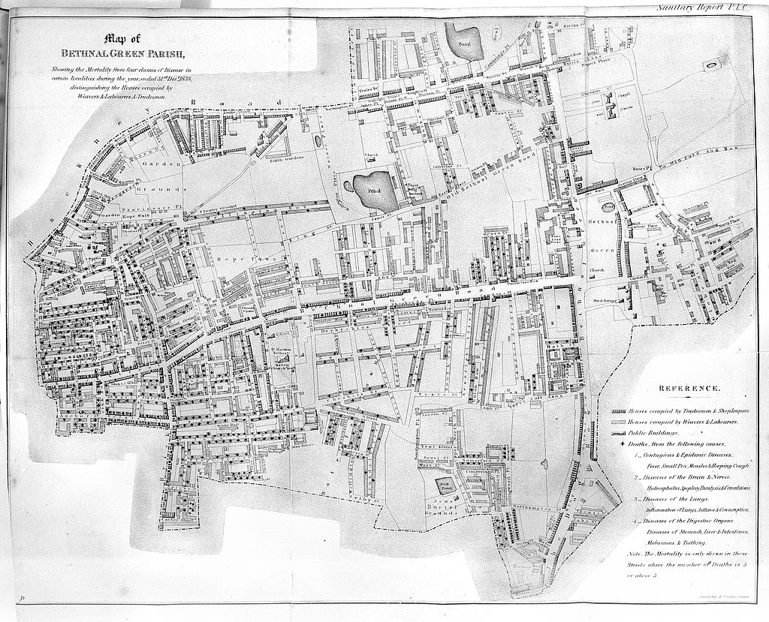
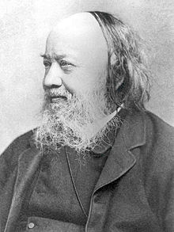
Sir Edwin Chadwick (1800 – 1890): Sanitation and sewers
Report on the Sanitary Condition of the Labouring Populations of Great Britain (1842)
Notes:
Chadwick established a link between sanitary conditions and high mortality rates showing that the misery of the poor lay within the government control, not in some intrinsic deficiency in the class. In other wrds, public policy would have a real bearing on public health. Led to the 1848 Public Health Ac.t
Chadwick was appointed a commissioner of the Metropolitan Commission of Sewers in London from 1848 to 1849 as and became the first president of the Association of Public Sanitary Inspectors, now the Chartered Institute of Environmental Health.

Slide 4
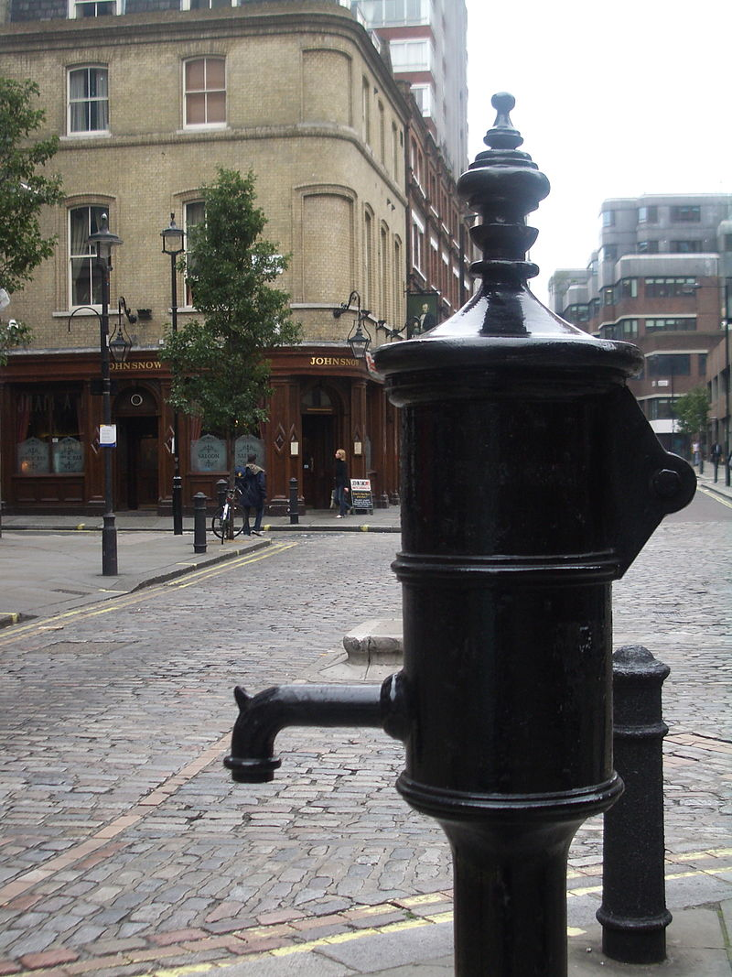
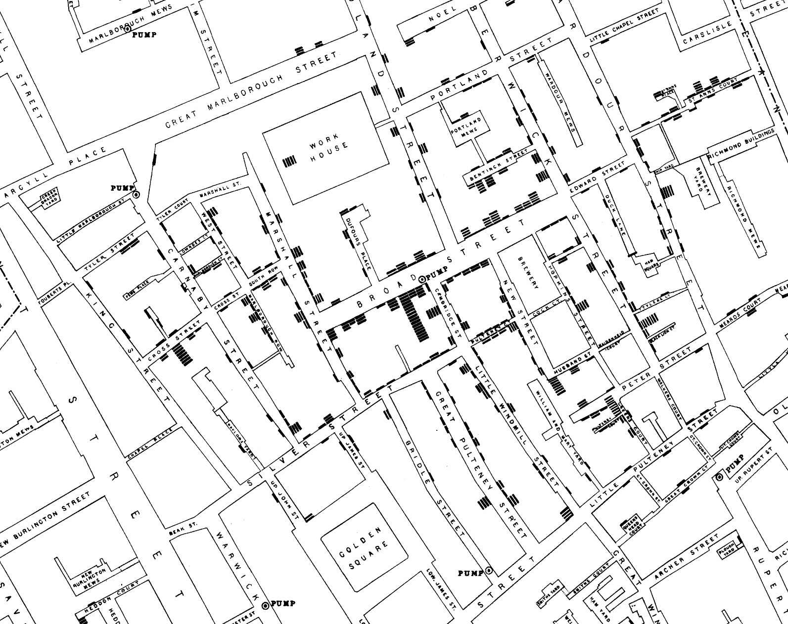
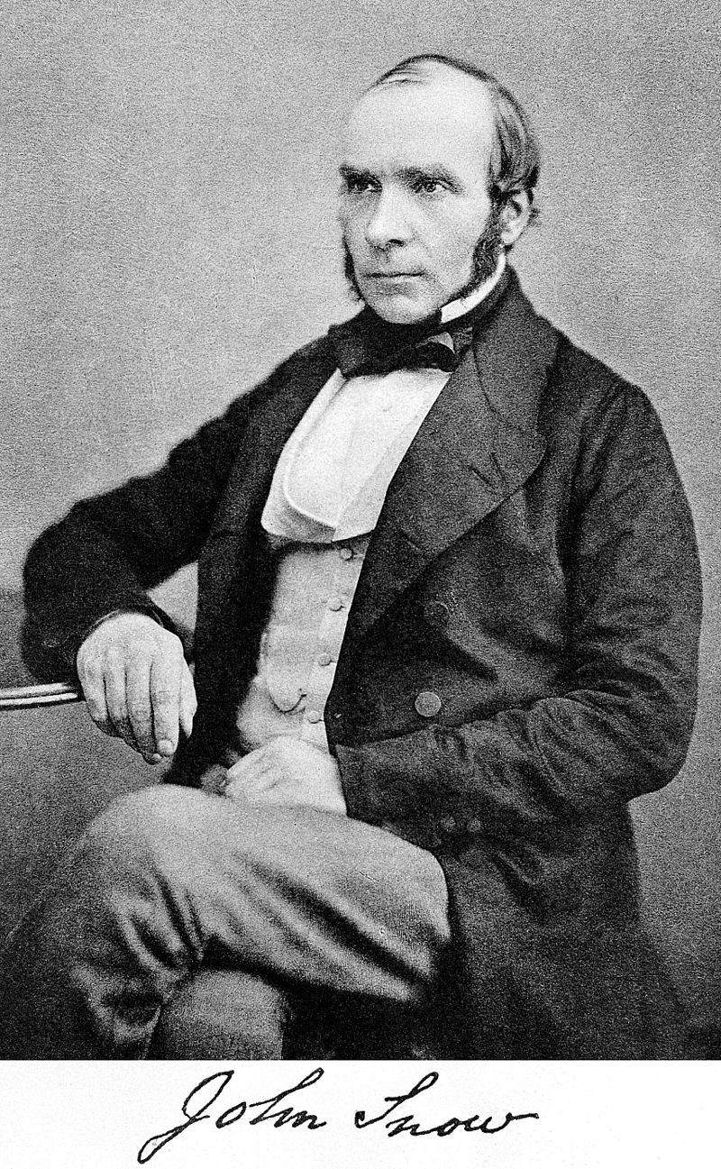
Dr John Snow (1800 – 1890)
The birth of public health
The Broad Street Cholera outbreak (1854) - Germ Theory beats Miasma
Notes:
Chadwick established a link between sanitary conditions and high mortality rates showing that the misery of the poor lay within the government control, not in some intrinsic deficiency in the class. In other wrds, public policy would have a real bearing on public health. Led to the 1848 Public Health Ac.t
Chadwick was appointed a commissioner of the Metropolitan Commission of Sewers in London from 1848 to 1849 as and became the first president of the Association of Public Sanitary Inspectors, now the Chartered Institute of Environmental Health.

Slide 5
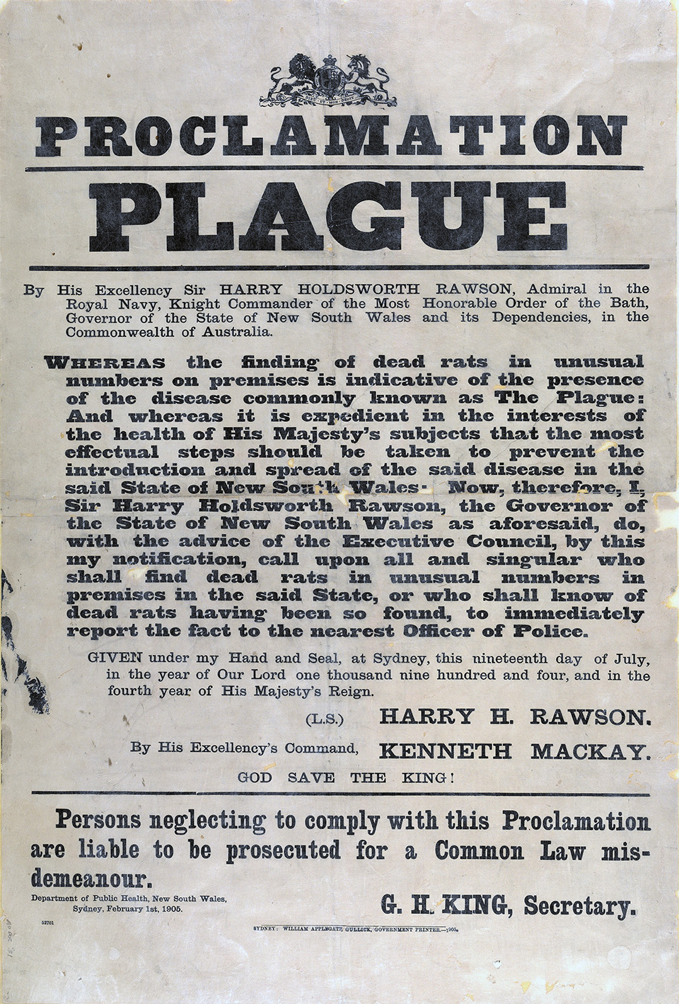
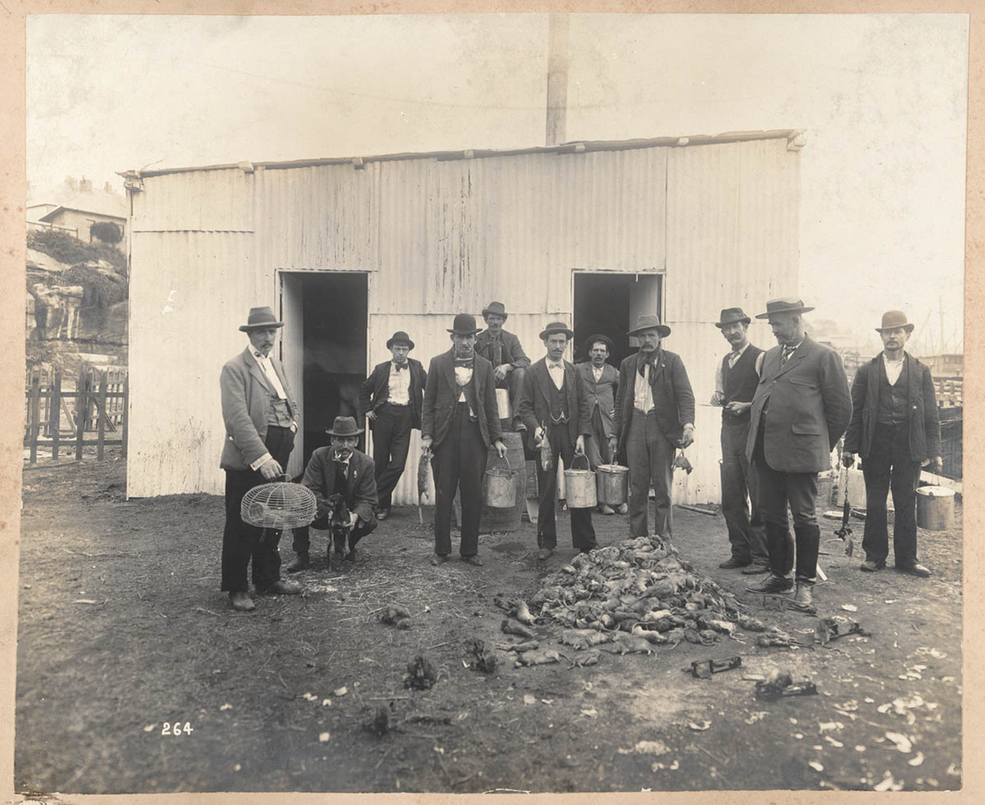
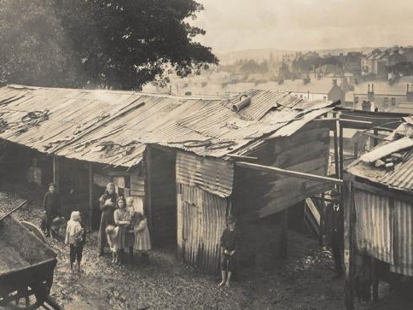
Rats, The Rocks and Redfern:
The Bubonic Plague, 1900
Notes:
Chadwick established a link between sanitary conditions and high mortality rates showing that the misery of the poor lay within the government control, not in some intrinsic deficiency in the class. In other wrds, public policy would have a real bearing on public health. Led to the 1848 Public Health Ac.t
Chadwick was appointed a commissioner of the Metropolitan Commission of Sewers in London from 1848 to 1849 as and became the first president of the Association of Public Sanitary Inspectors, now the Chartered Institute of Environmental Health.

Slide 6
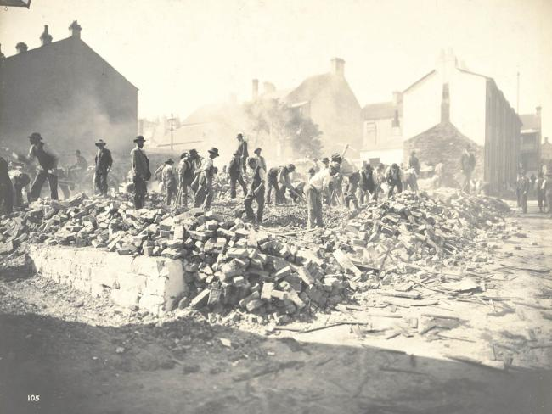
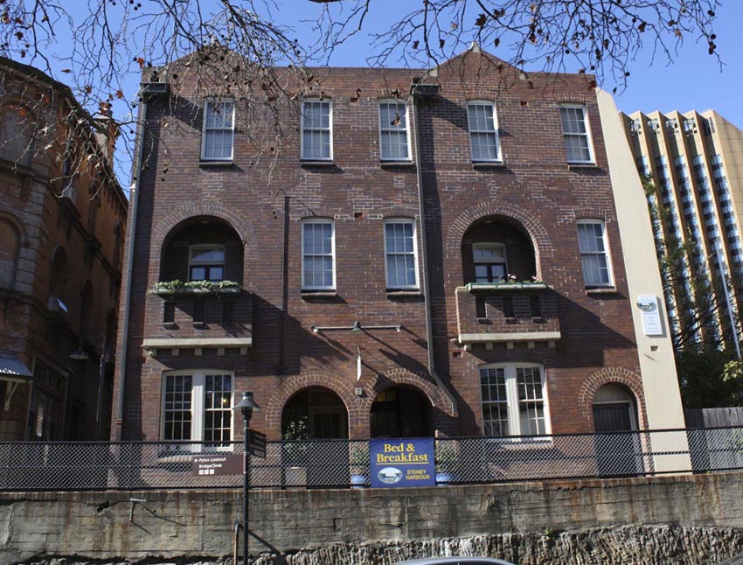
Slum clearance, 1900
The response….
Cumberland Street, The Rocks, 1914

Slide 7
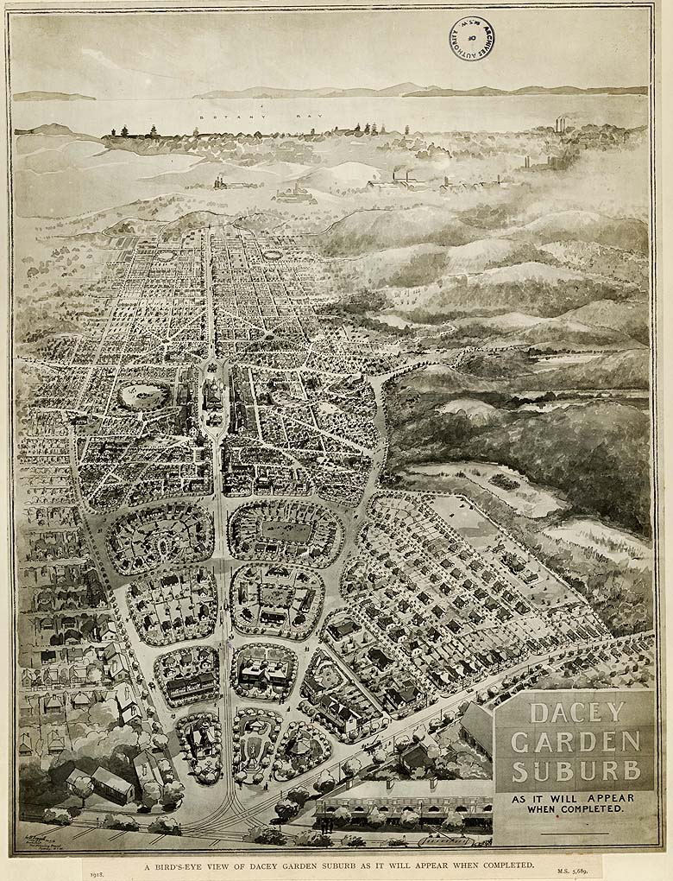
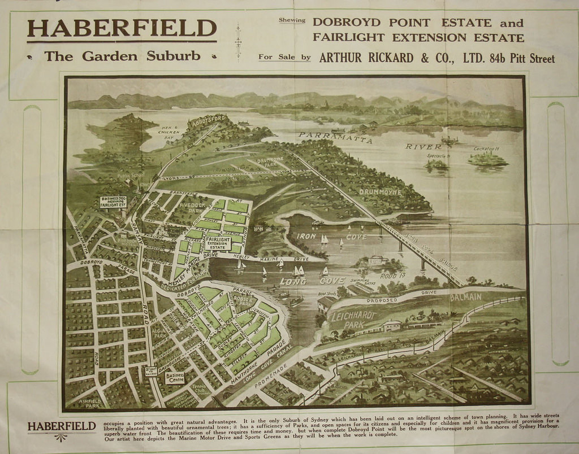
Daceyville – Australia’s first public housing estate built to relieve the insanitary slums of old Sydney
Haberfield – built to house the
aspiring Sydney middle classes:
“slumless, laneless and publess”

Slide 8
Back to the Future:
The re-emergence of inequality

Slide 9




The re-emergence of inequality ……

Slide 10
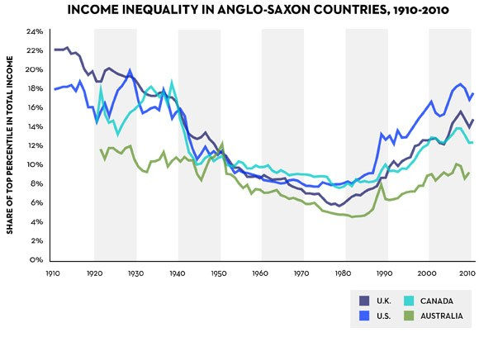
Thomas Picketty: proving the re-emergence of inequality
http://www.newyorker.com/news/john-cassidy/pikettys-inequality-story-in-six-charts

Slide 11
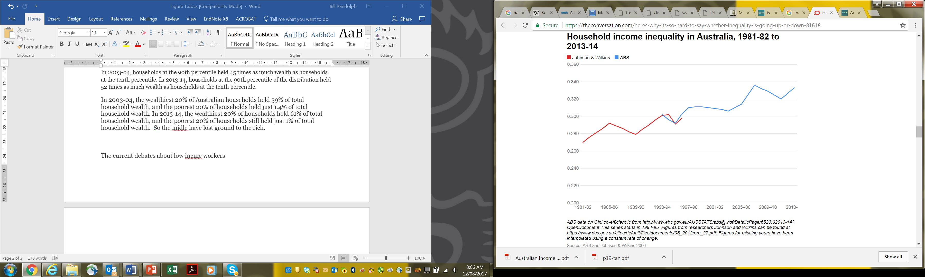
The steady march of inequality - even in egalitarian Australia
Whiteford P. (2017) https://theconversation.com/heres-why-its-so-hard-to-say-whether-inequality-is-going-up-or-down-81618

Slide 12
But income is one thing – wealth is another….
“For whosoever hath, to him shall be given, and he shall have more abundance: but whosoever hath not, from him shall be taken away even that he hath.”
Matthew 13:12

Slide 13
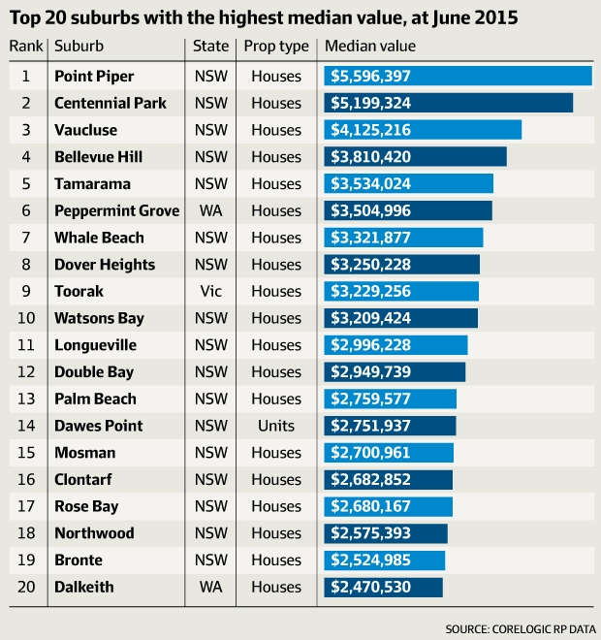
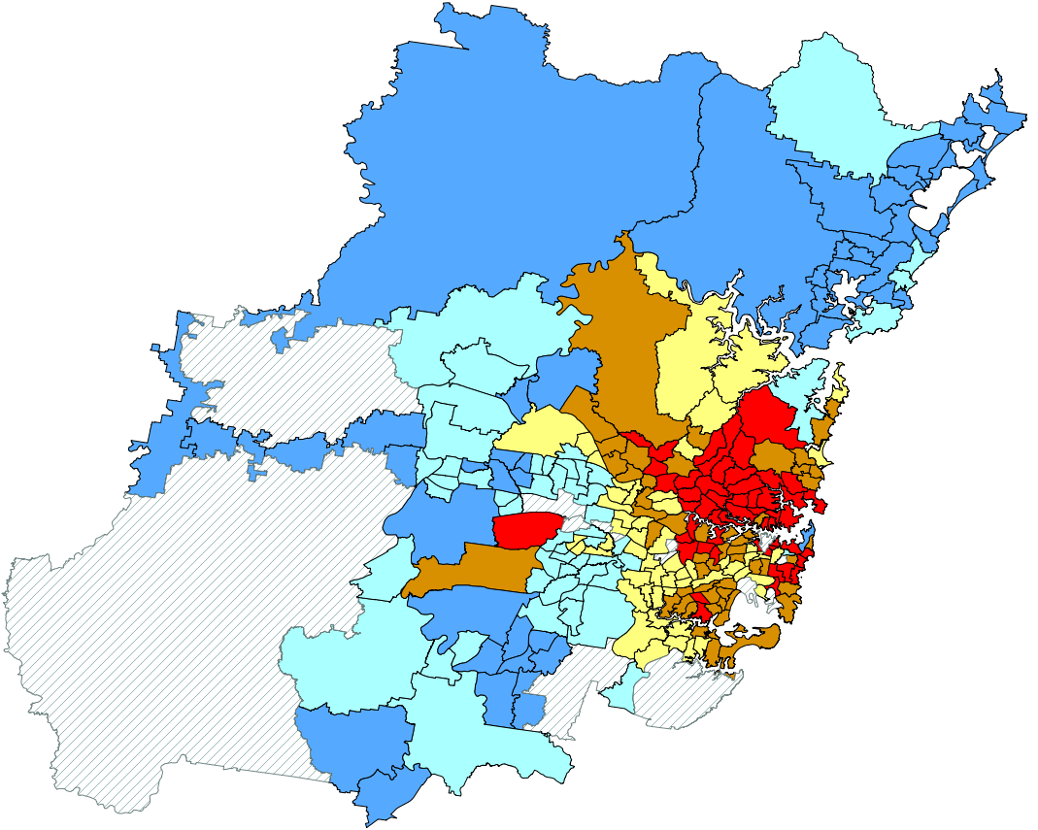
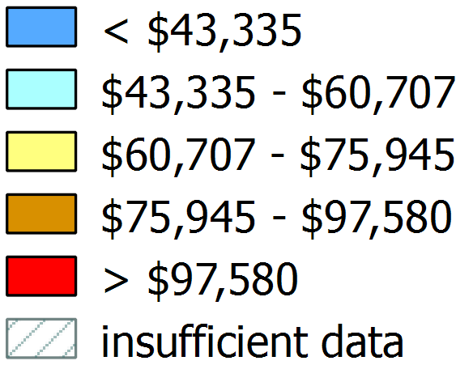
Property wealth as a key driver of wealth – for some: Differential spatial impacts of property value increase
Annualised average value increase for houses, Sydney 2011
www.afr.com/real-estate/point-piper-in-sydney-retains-crown-of-australias-most-expensive-suburb-20150813-giy4bl

Slide 14
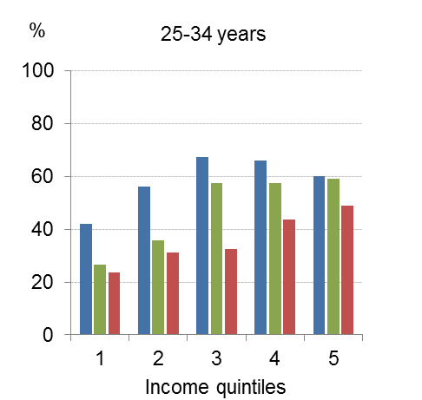
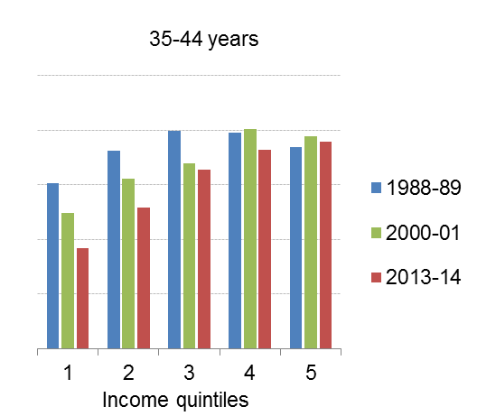
Property wealth is leaving younger lower incomes behind Home ownership rates have declined greatest for lower income younger households – the rise of “Generation Rent”
Source: ABS Surveys of Income and Housing, analysed for (lapsed) 2015 Parliamentary Inquiry into Home Ownership . See Yates, Submission no. 3 <http://www.aph.gov.au/HomeOwnership>
13

Slide 15
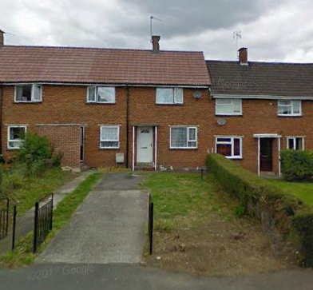
Why I’m here……
17 Severn Road, Woodfields, Dursley Gloucestershire
UK
1953-62
Notes:
Most of us wonder why we’ve been put this earth. What’s the point of our existence? What’s the meaning of our life – why were we here?
Many of us spend years trying to an find answer to that question. It’s the issue that has challenged religions throughout the ages. Most of us probably never find an answer.
Well, I’m lucky because I know exactly why I’m here. I was born with a pre-determined mission in life. I was born to live in this house.

Slide 16
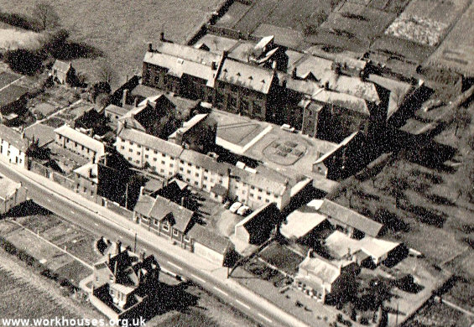
15
Victorian social values at their peak
Penalising the poor
for being poor
Westbury-on-Severn Workhouse
Goucestershire
Notes:
But I also have another affiliation to the issue of inequality and even poverty. Together with my patents and sibings I may be one of the few people alive today who has spent time in the workhouse.

Slide 17
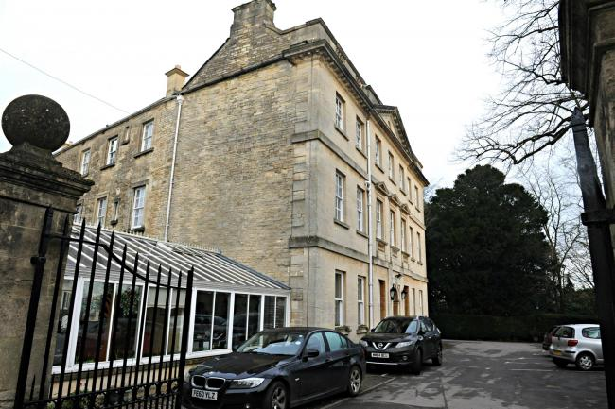
The Priory
Tetbury
Gloucestershire
UK
Post-war social values at their peak
Redistribution of wealth - from the taxed-out rich to the welfare state
Notes:
It wansn’t all bad news. This is the first old peoples home I lived in – a fine Cotswold town house commandeered in the 2nd world war and then bequeathed to the state in leu of death duties. Yes, inequality really did take a hit in the post-wat period! We had a croquet lawn and fantastic cellars – and the green hoses were steam heated to tropic temperatures.

Slide 18
Inequality, spatial equity and the Great Urban Inversion
…or how the ‘Triumph of the City’ replaced the ‘Triumph of Suburbia’

Slide 19
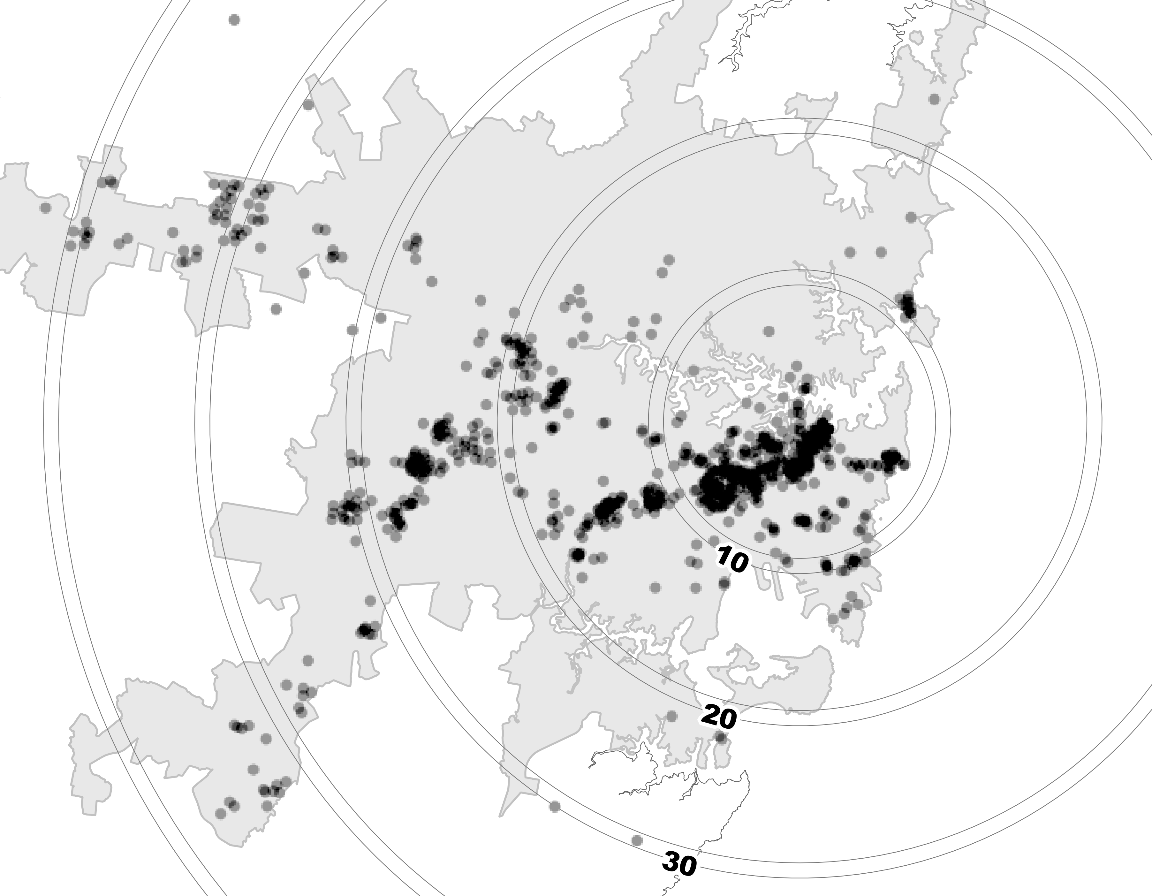
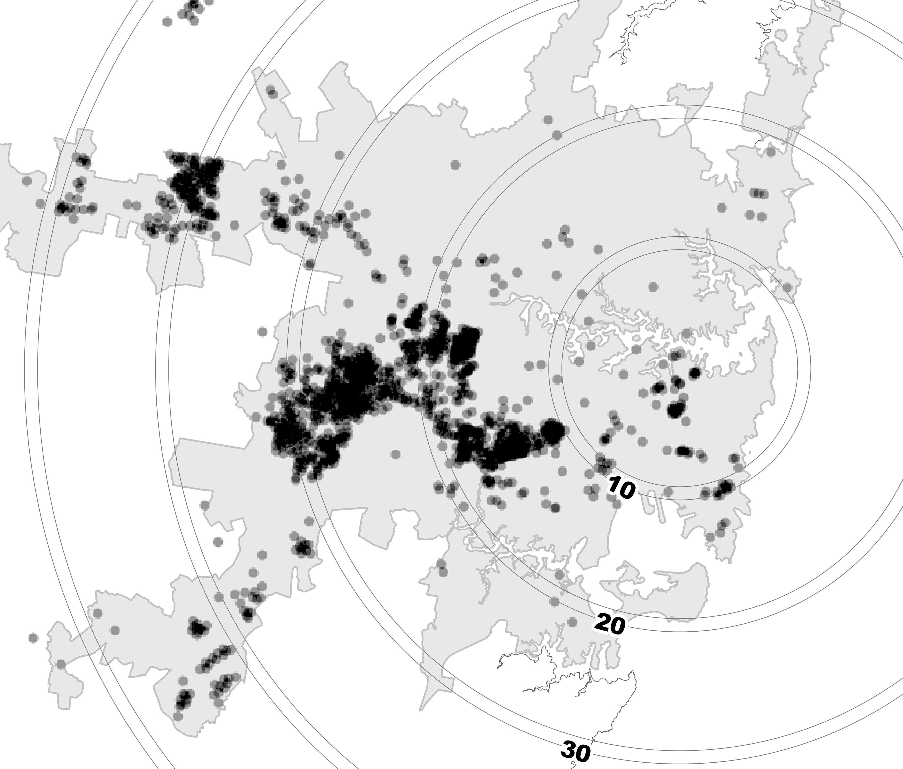
The Suburbanisation of Disadvantage in Sydney
1986
2011
Highly disadvantaged Census tracts

Slide 20
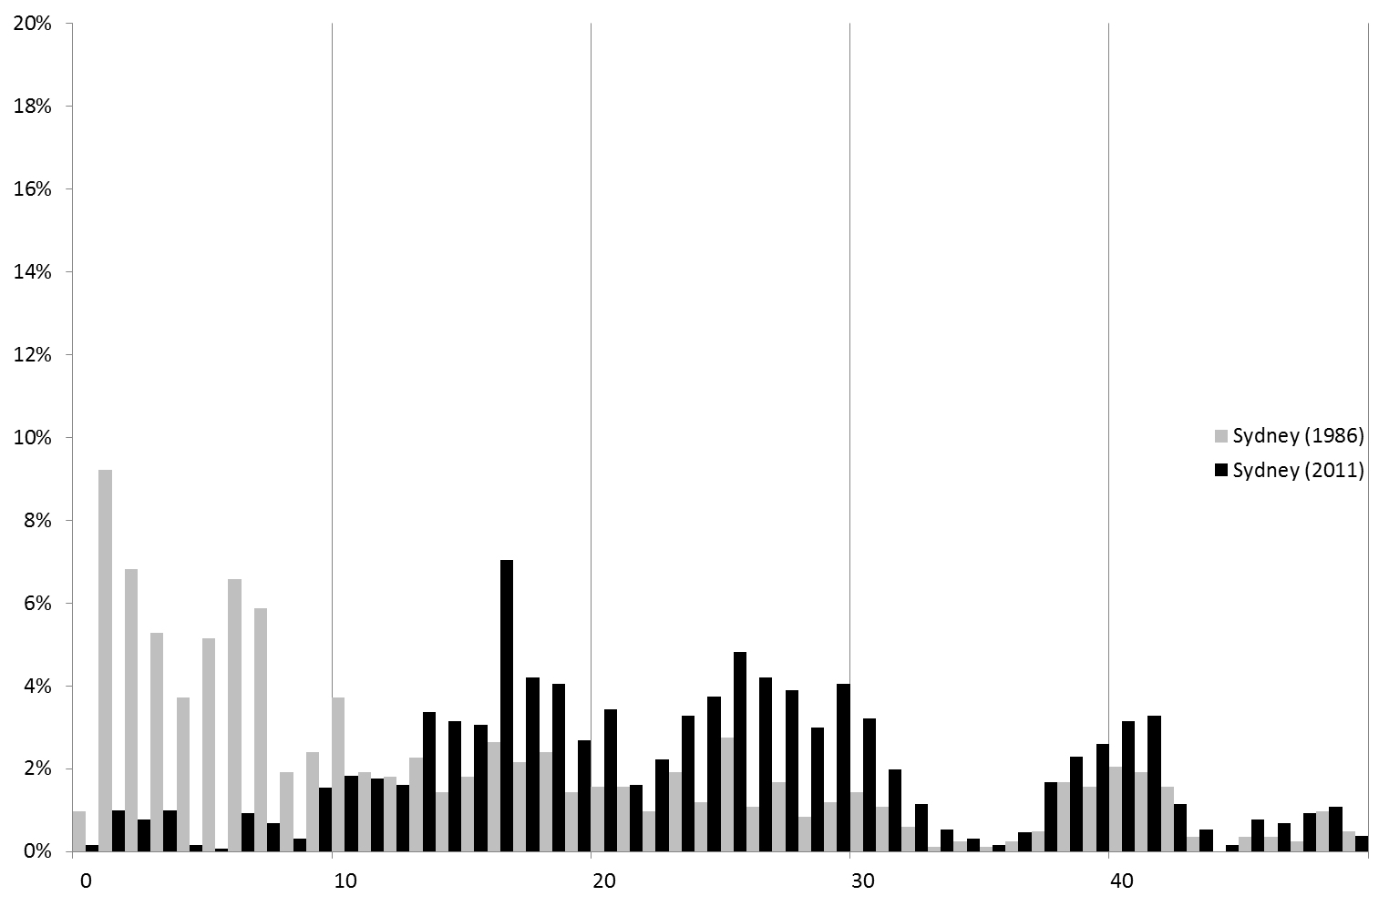
Sydney’s suburbanisation of disadvantage
By the 1980s some outer west concentrations of disadvantage – reflecting siting of large PH estates in 1960s/70s
Long-established inner city poverty focus strongly visible
But by 2011, a dramatic shift towards the west and southwest
Gentrification has cleared the poor from the inner city
Similar ‘suburbanisation of disadvantage’ seen in Melbourne and other major cities
Also reflected in many (but not all) large North American and European cities – ‘The Urban Inversion’
Distribution of disadvantaged CCDs by half-Km bands 1986 and 2011– Sydney
The poor have been squeezed out

Slide 21
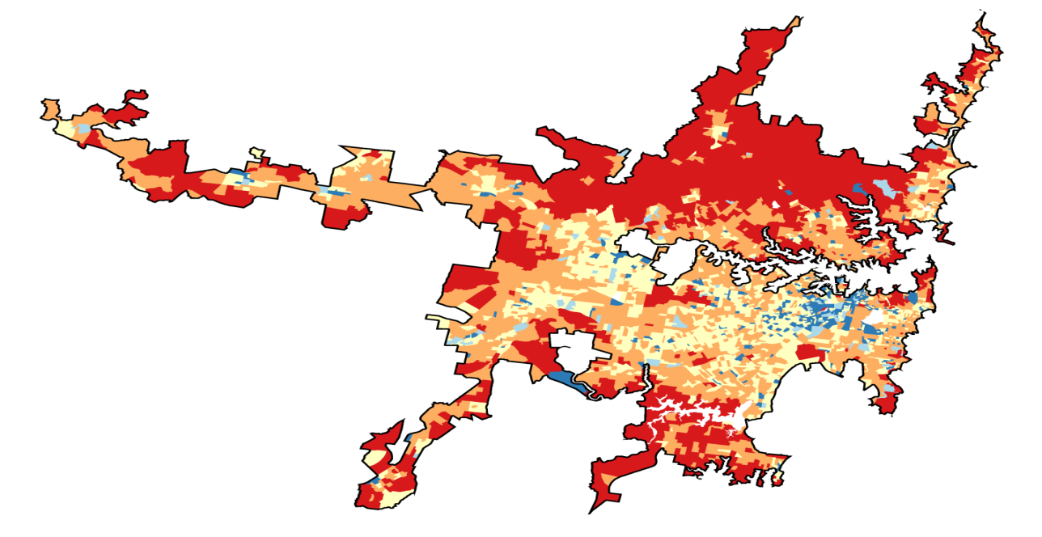
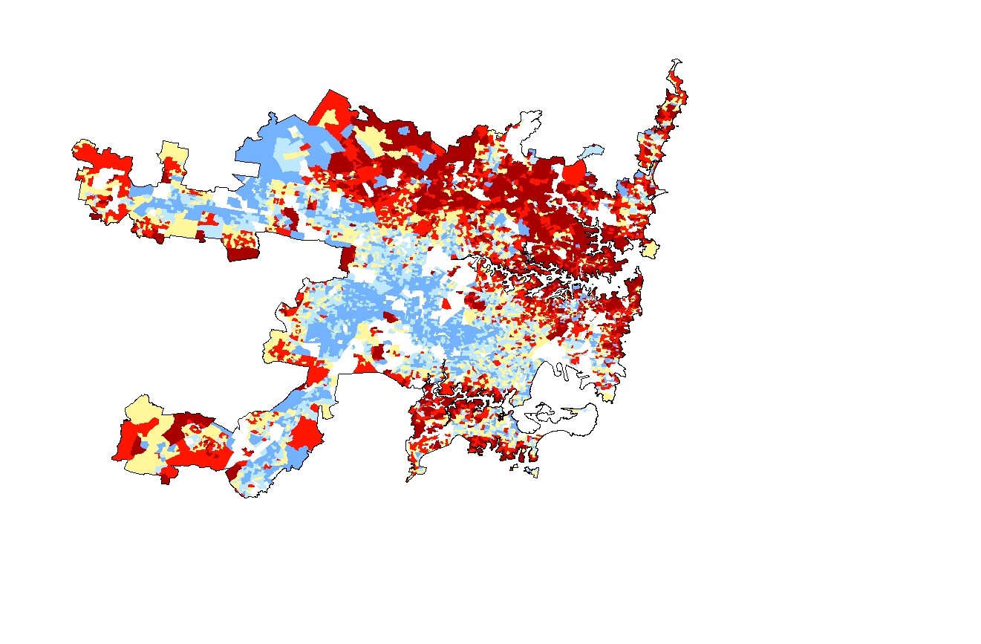
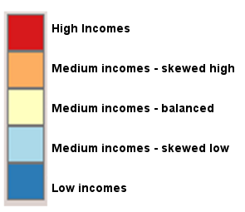
‘The Urban Inversion’: The rise of suburban disadvantage and income polarisation
N.B. Loss of the ‘middle’ income areas and an enlargement of the higher and lower income areas
1986
2011
More of us and more of them – but fewer in the middle

Slide 22
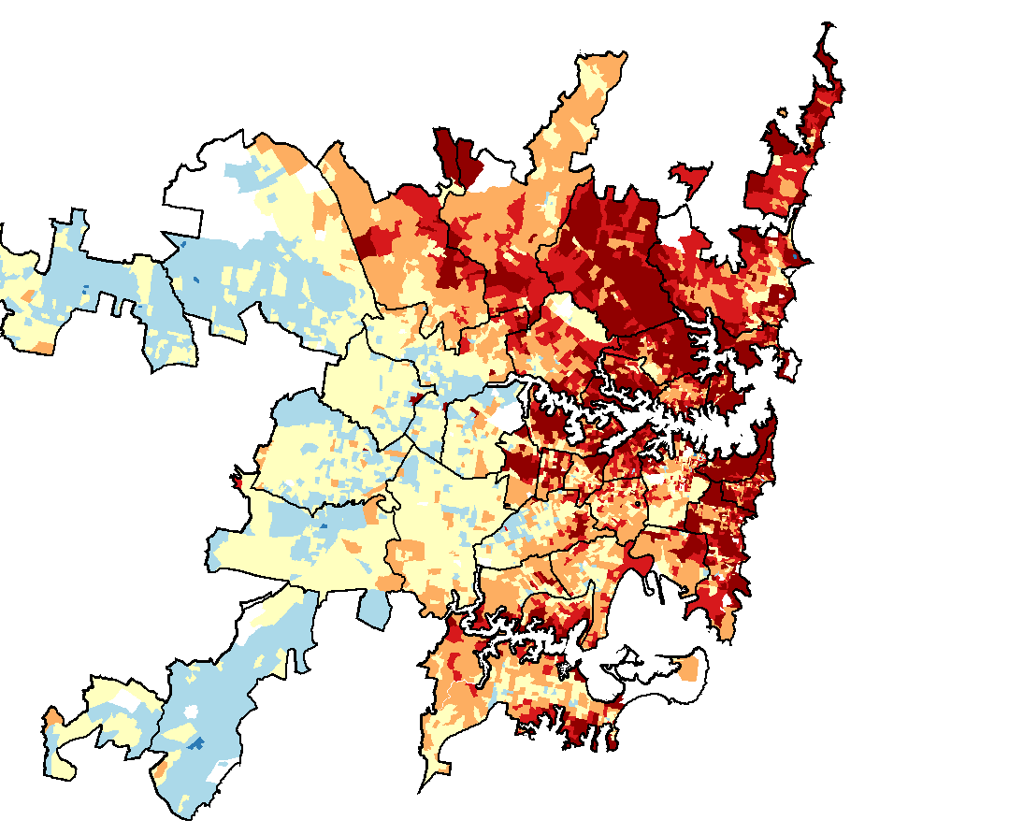
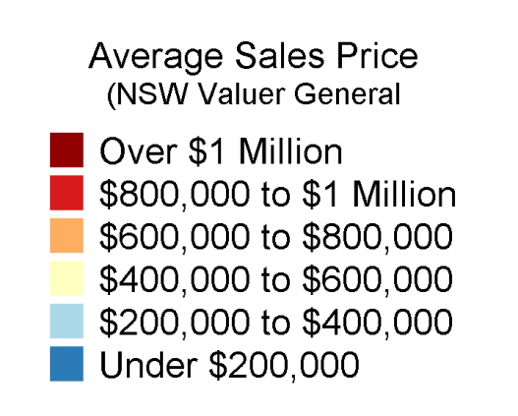
Income differentials translate into housing wealth differentials
Average sales prices 2011 Sydney

Slide 23
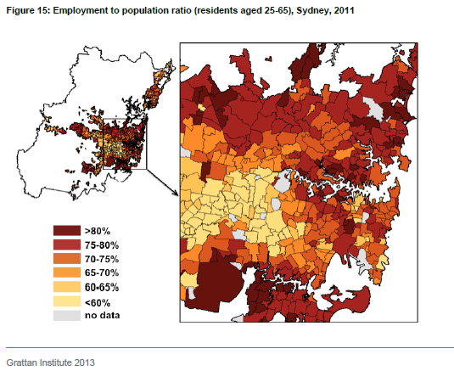
The drivers of suburban disadvantage in Sydney: Low economic activity

Slide 24
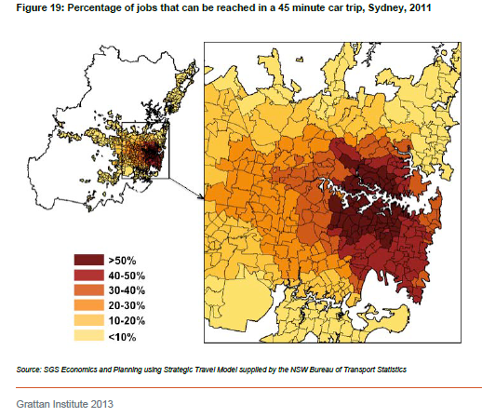
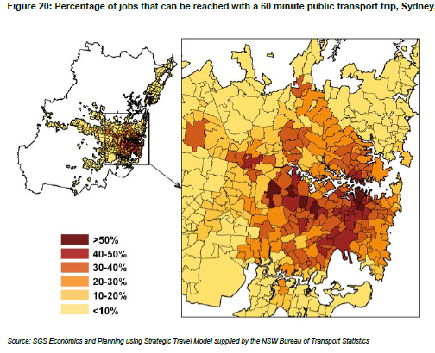
Suburban ‘transport poverty’….
…. Makes getting to the good jobs – or anything – difficult

Slide 25
Concentrations of disadvantage: do they matter?
Policy consensus that spatial concentration of disadvantage is problematic – policy makers argue that “social mix” can solve the problem – see box on the right
Rests on the ‘neighbourhood effects’ thesis that:
  ‘…deprived people who live in deprived areas may have their life chances reduced compared to their counterparts in more socially mixed neighbourhoods ... living in a neighbourhood which is predominantly poor is itself a source of disadvantage’ . (Atkinson & Kintrea 2001).
This supposedly comes about due to:
  ‘…negative peer/role modelling, weak social norms/control, limited resource-networks, and stigmatisation mechanisms’ (Galster 2009)
But essentially unproven – and controversial – in Australia:
  ‘…the ‘problems’ of poor households living in public housing have been reconstructed as problems of place …to support a policy intervention [redevelopment] …closely linked with dominant neo-liberal ideology …’ (Darcy 2010)
2009 National Affordable Housing Agreement
‘Agreed policy actions’ included aspiration for state/territory action in:
‘…creating mixed communities that promote social and economic opportunities by reducing concentrations of disadvantage that exist in some social housing estates’

Slide 26
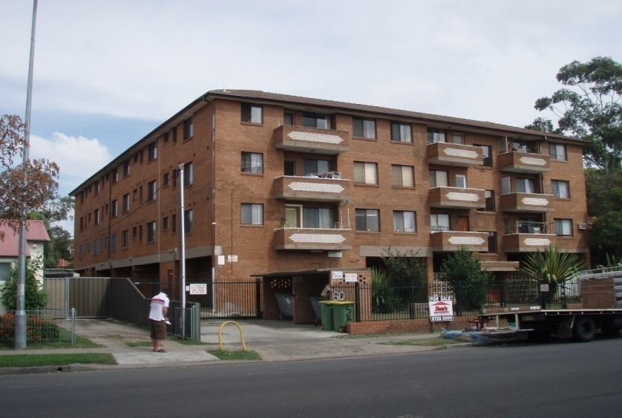
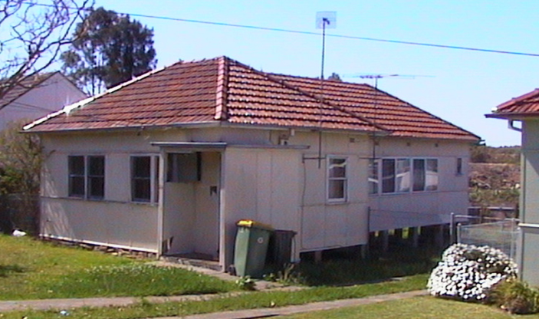
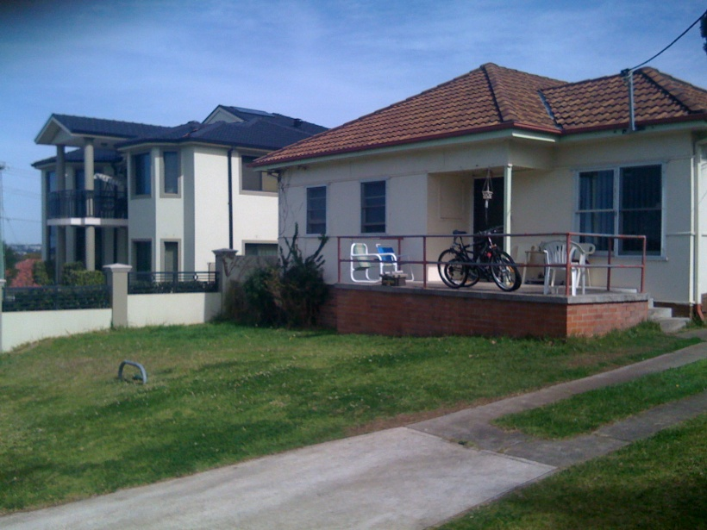
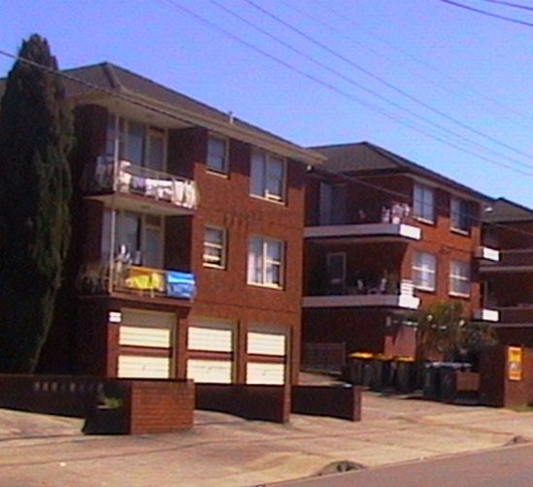
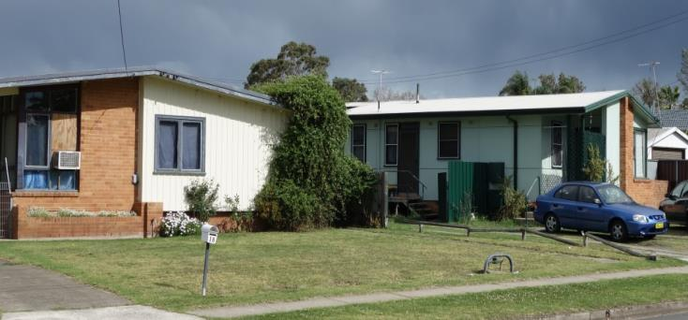
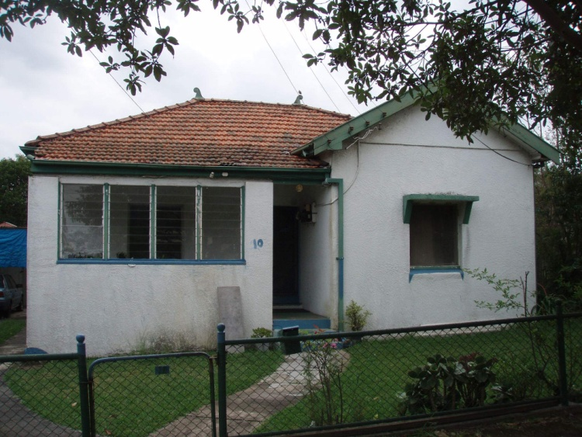
Typical ‘disadvantaged area’ housing in Sydney….
….but only one of these is public housing.

Slide 27
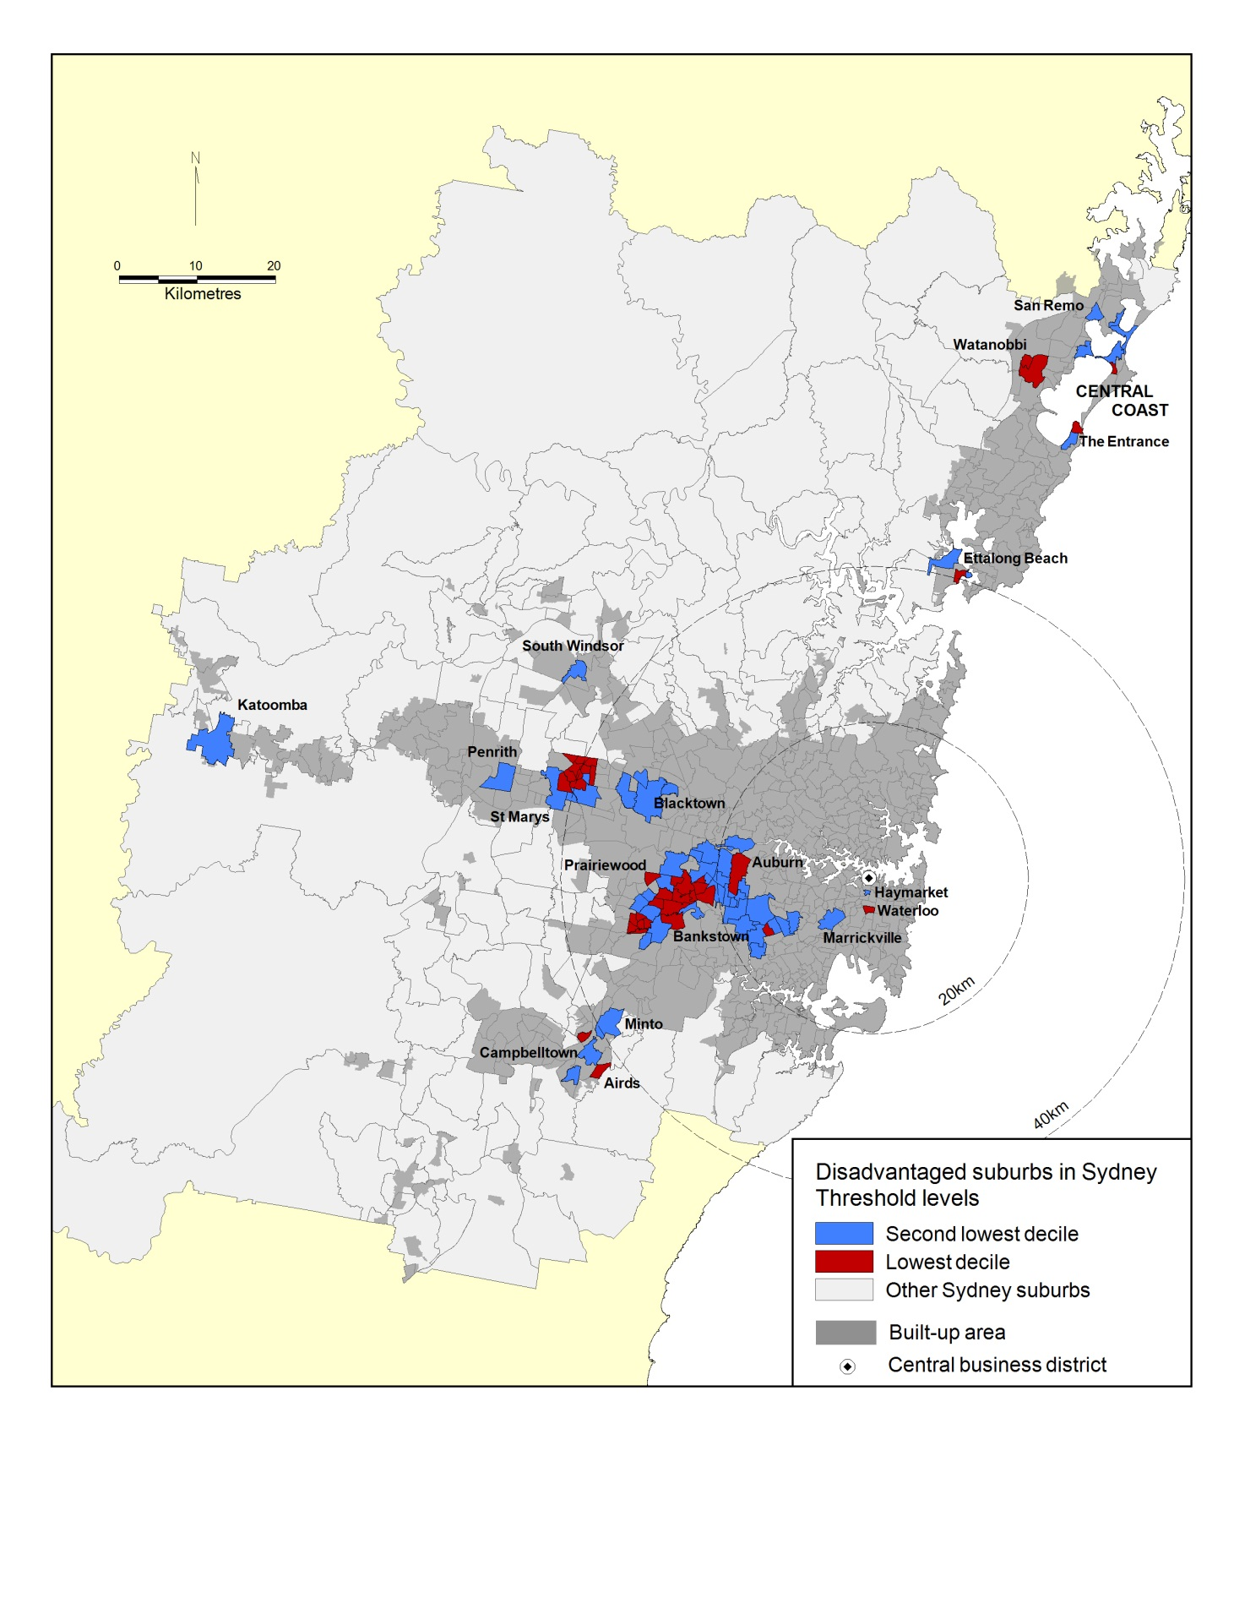
Unpacking ‘disadvantaged’ places
Three ear study of most disadvantaged neighbourhoods in Sydney and Melbourne
Red and blue areas show lowest SEIFA decile suburbs
Private housing dominates – older owners and low income renters
Public housing only 13% of households in these areas
Census-based by multi-factor analysis to better understand characteristics and drivers

Slide 28
Unpacking ‘disadvantaged’ places
Socio-Economic Typology |  | Suburb | Designation
1 | High on young people and single parent households; public housing | Emerton | ‘Isolate suburbs’
2 | High on overseas movers, high on two parent families, low rent | Auburn | ‘Lower price suburbs’
3 | High on residential mobility (domestic movers), high on older people & lone person households | The Entrance | ‘Marginal suburbs’
4 | High on overseas movers, on reduced unemployment and reduced incidence of persons in low status jobs | Warwick Farm | ‘Dynamic improver suburbs’
Area characteristics analysed by multi-factor analysis
Disadvantaged places are not all the same!

Slide 29
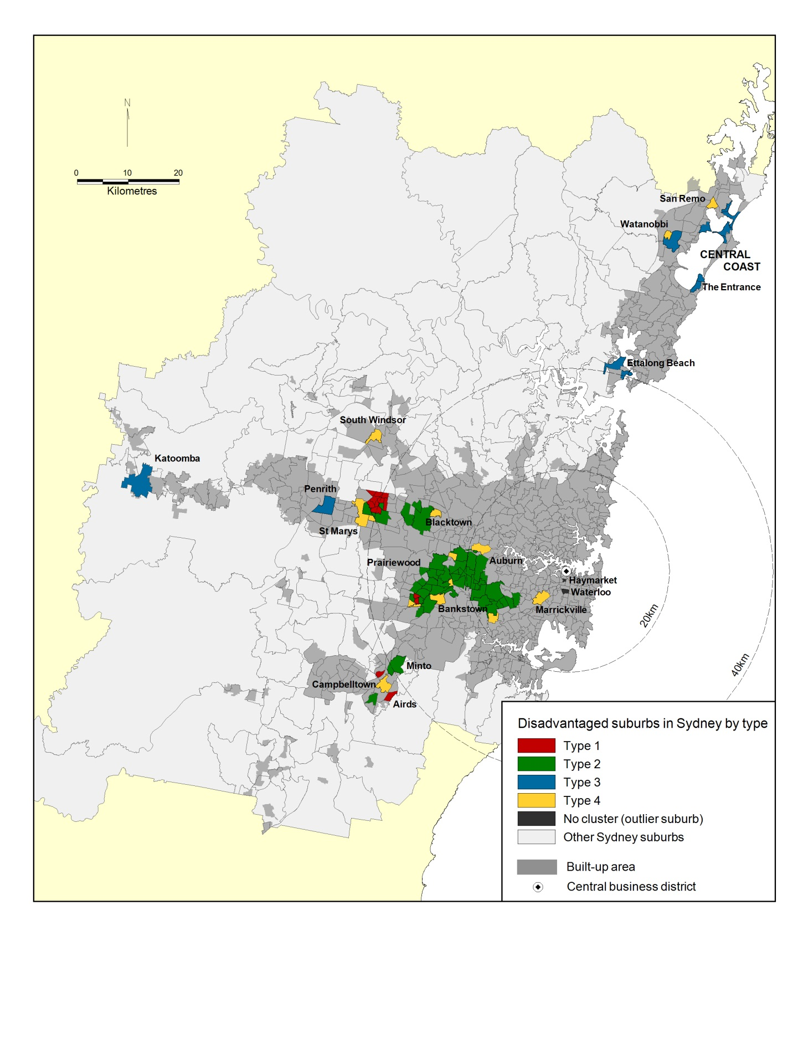
Socio-economic typology
Unpacking ‘disadvantaged’ places
Disadvantaged area types highly spatially grouped and/or spatially distinctive
Type 1 area distribution influenced by public housing geography
Type 3 areas very peripheral
Types 2 and 4 distinguished by greater accessibility (e.g. town centres)

Slide 30
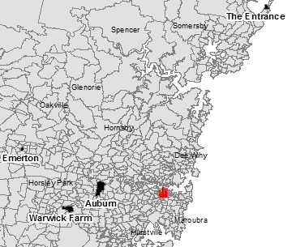
Survey fieldwork locations
Unpacking ‘disadvantaged’ places
Face-to-face survey of 800 households in 2014 in four sub-areas identified from a cluster analysis of the most disadvantaged CCDs
To investigate the nature and extent of poverty and exclusion and the functioning of local housing markets

Slide 31
Findings: Income poverty and economic exclusion measures
‘Deep poverty’
75% incomes <$5K per month; <20% struggling day-day; <5% in ‘deep poverty’
Source: City Futures Survey 2014

Slide 32
Income poverty and economic exclusion measures by tenure
Source: City Futures Survey 2014

Slide 33
Households in ‘deep poverty’ – it’s the private rental sector
Among ‘deep poverty’ cohort private renters greatly outnumber public renters because:
  Incidence of ‘deep poverty’ in private renting not much less than for public housing
  But the number of private renters in disadvantaged suburbs is much greater
Home owner
9%
Public renter
20%
Private renter 71%
Source: City Futures Survey 2014

Slide 34
Suburbanisation of disadvantage: a summary
Suburbanisation of disadvantage clearly in evidence across Sydney between 1986 and 2011.
Concentrations of disadvantaged are increasing in size and deepening in the older middle and outer suburbs
The private housing market is the principle spatial driver behind these trends
The analysis has pointed to low income outright ownership, related to aging in place, and the suburbanisation of the low income private rental market as key features of disadvantaged populations
Strongly associated with income polarisation and the spatial mismatch in economic growth
May prove more difficult to target social interventions than with public housing.

Slide 35
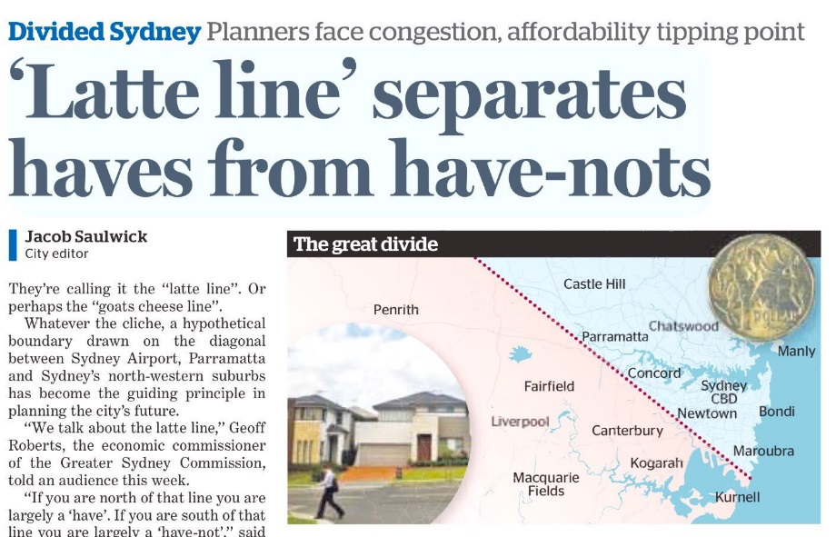
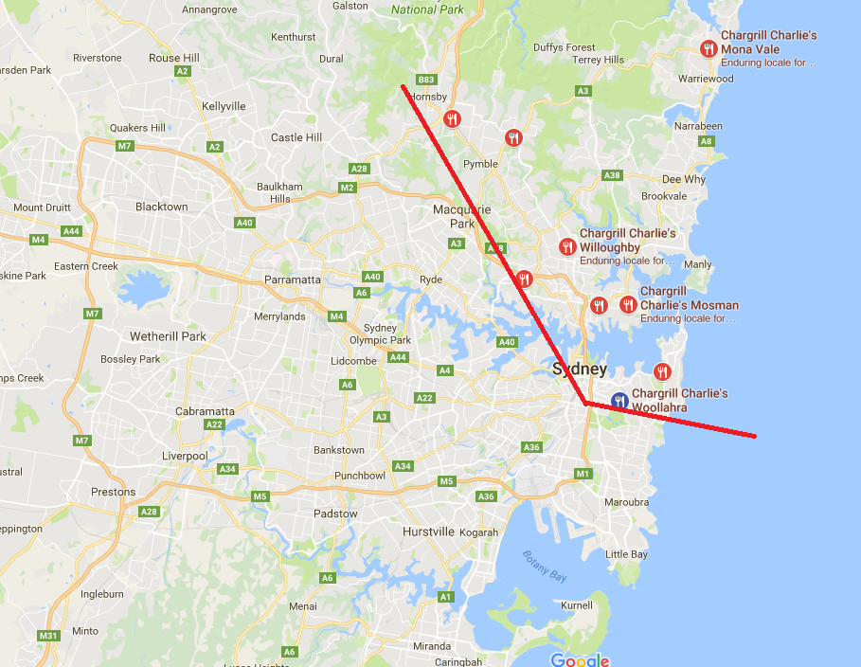


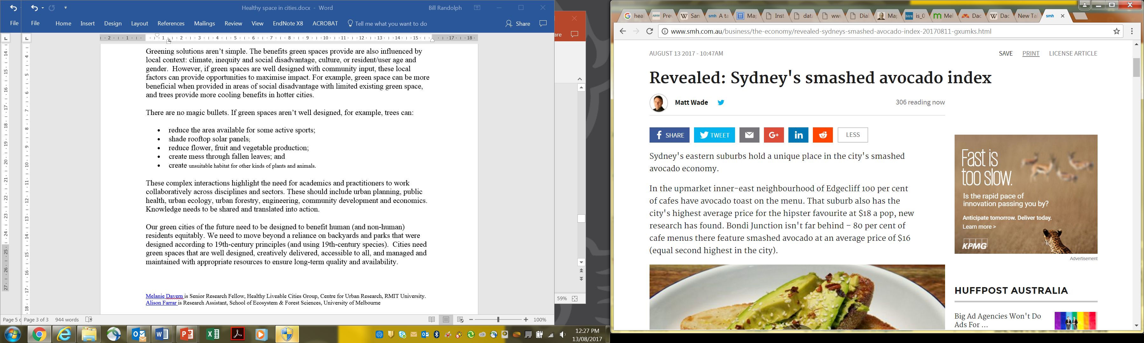
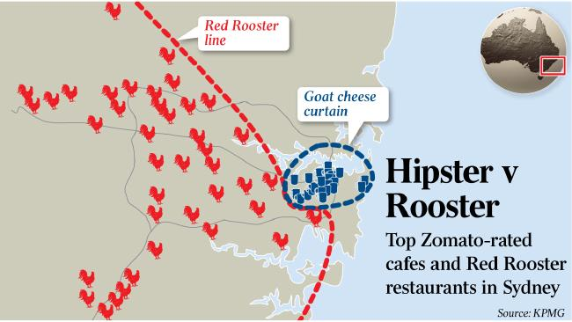
Current Features
Wealth, health and life-style: The “us and them” of Sydney

Slide 36
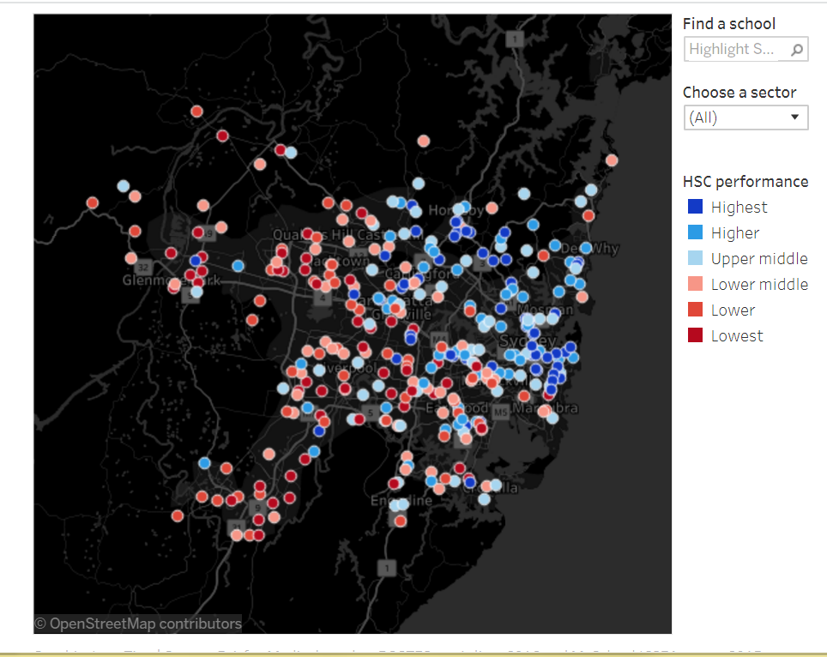
Sydney’s social divide: its not just a marketing device
The Great School Divide
Schools ranked by their share of exam results that scored 90 or above in the HSC.
Inga Ting, Eryk Bagshaw, Sydney Morning Herald, Dec 23 2016 ‘HSC results 2016: Sydney divided by education 'latte line'

Slide 37
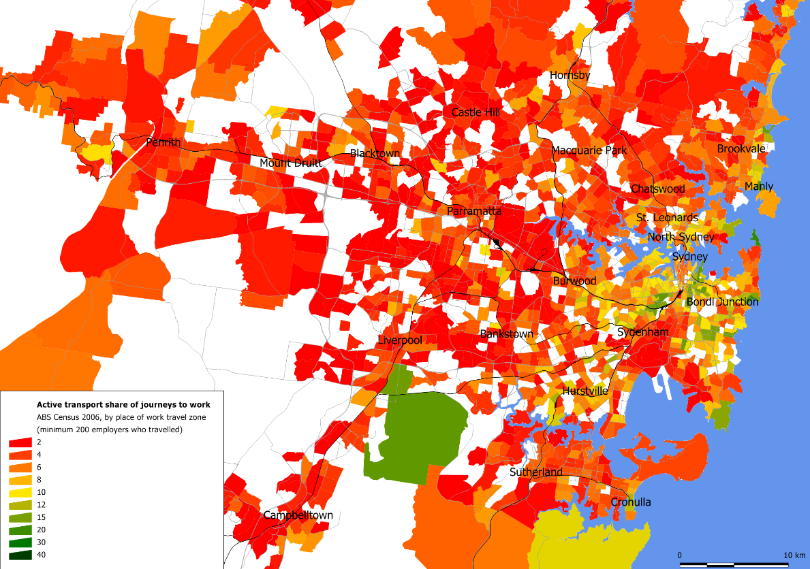
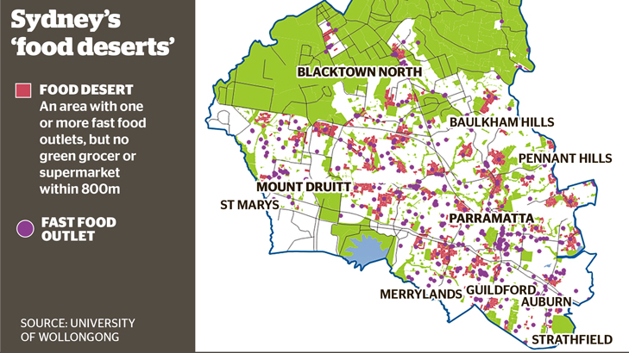
The physical and social structure of the city impacts on a wide range of urban well-being: e.g. Active transport and access to healthy food

Slide 38
Self-assessed health vrs Private health insurance r² = -0.94 i.e. almost perfectly negatively correlated
Inequality and wellbeing – a serious spatial story
  Fair or poor
  self-assessed health
  Rates of private health insurance hospital cover
Social Health Atlas of Australia (2017) Public Health Information Development Unit

Slide 39
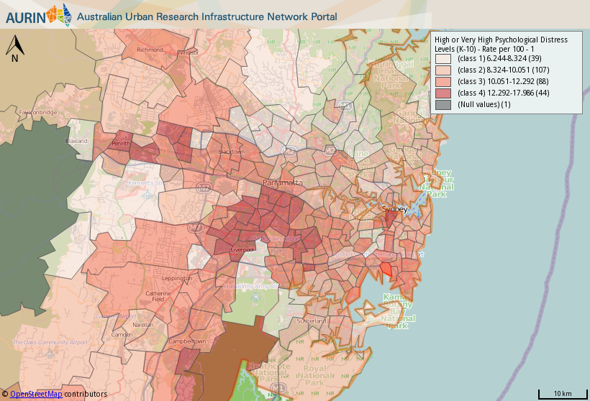
Spatial inequality and wellbeing – Psychological Distress

Slide 40

Spatial inequality and wellbeing – Obesity

Slide 41

Spatial inequality and wellbeing – Alcohol consumption

Slide 42

The next health threat: Thermal comfort
Dealing with climate change – plant more trees!

Slide 43
Suburbanisation of disadvantage: does it matter?
Disadvantaged populations in less accessible places— remote from jobs and services
Mixed private housing makes it hard to target place-based approaches.
Especially problematic for women because of ‘the spatial leash’
Long term underinvestment in social infrastructure – and its more dispersed.
Many disadvantaged households are doubly disadvantage through reliance on private transport – or hamstrung by lack of it.
Increasingly, suburban disadvantage has become a health issue and concentrations of poor health in the suburbs are key issues for public health policy intervention
The danger is that the older, poorer suburbs will be left behind as a policy focus – urban renewal and high density in higher value locations are driving spatial planning.

Slide 44


Blacktown: Low density to high density disadvantage?

Slide 45
City Futures Research Centre
Ian Webster “Health for All” Oration
16 August 2017
Prof Bill Randolph
Thank you

