Slide 1

Navigating the Healthcare Neighbourhood
https://www.aci.nsw.gov.au/nhn

Slide 2



How we define the ‘Patient Centred Medical Home’ model
The PCMH model refers to the use of a primary care medical practice as the “hub” for a person’s care. As an arrangement of the health system the Patient Centred Medical Home model can be thought of in two integrated parts; the Patient Centred Medical Home and the Healthcare Neighbourhood (the rest of the health system) in which it operates.

Slide 3
Navigating the Healthcare Neighbourhood Website
Patients, general practice and the wider health system working together.
provide implementation advice
link to evidence
keep people updated
provide a base for a community of interest
host resources
educate

Slide 4
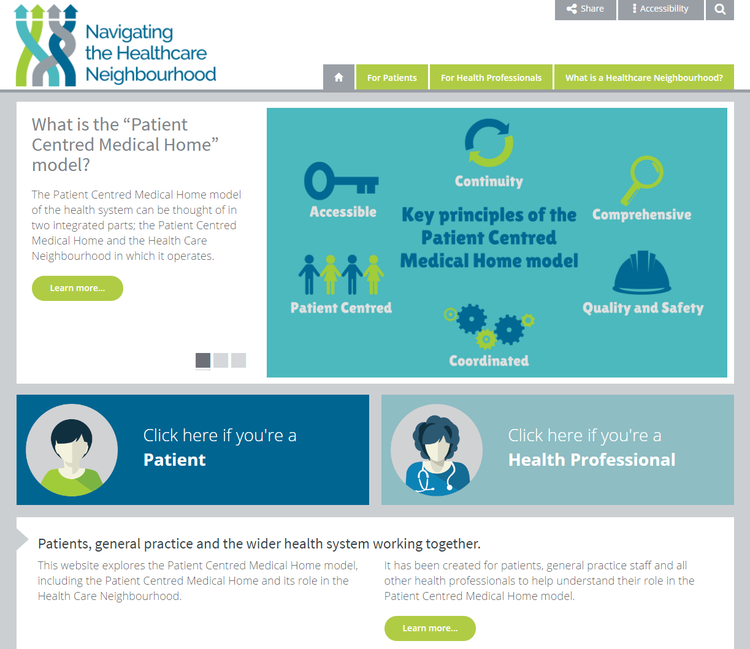
Home Page
https://www.aci.health.nsw.gov.au/nhn
Username: nhn_preview
Password:
aci?nhn11

Slide 5
Animation

Slide 6

Opportunities for development
Community of Interest – available early next year
More case studies/links/documents/articles
Additional content as requested
Contact: Rhiannon Beck
Rhiannon.beck@health.nsw.gov.au
(02) 9464 4681

Slide 7

Acknowledgements
The PCMH Website Team:
Cynthia Stanton/Abby Edwards – Sydney North PHN
Dr Dan Ewald /Safa Rahbar – North Coast PHN
Gayle Mortimer/Paul Taqueban – Northern Sydney LHD
Summa Stephens – Murrumbidgee LHD
Denise Whitehead – Practice Manager
Rachel Norman – Practice Manager
Mary Potter – Consumer
Erin Lilley/Haley Flanagan – NSW Ministry of Health
ACI staff (Joanna Goodenough, Jenni Johnson, Regina Osten, Val Middleton, Mel Tinsley, Dr Paresh Dawda)
Additional contributors;
Catriona Wilson – Northern NSW LHD
Dr Kean-Seng Lim and the staff at Mount Druitt Medical Centre
Nathan Jones – SES LHD
Fred Mark and Barry Bromley - patients
WentWest PHN
North Coast PHN
Dr Tony Lembke
Centre for Primary Health Care and Equity

